Slide 1
Capacity Development Program for Investment Promotion Agencies of the LDCs
Susanna Wolf
Senior Programme Officer

Slide 2
Background
IPoA: increased focus on investment promotion
AAAA and SDGs: investment promotion regimes for LDCs
MTR of IPoA: encourage LDCs to strengthen investment climate and to establish and maintain national investment promotion facilities and encourage development partners to support

Slide 3
Foreign Direct Investment – LDCs
FDI flows to LDCs declined: After a high of $44 billion in 2015, FDI inflows to the LDCs contracted by 13 per cent to $38 billion in 2016
Six developing economies feature among the top 10 countries investing in LDCs. China remained the largest home economy investing in LDCs
FDI is still concentrated in extractive industries: Higher manufacturing and infrastructure FDI in selected LDCs – Ethiopia, Bangladesh and Cambodia – was not enough to offset lower foreign investment in leading commodity rich LDCs and Asian LDCs

Slide 5
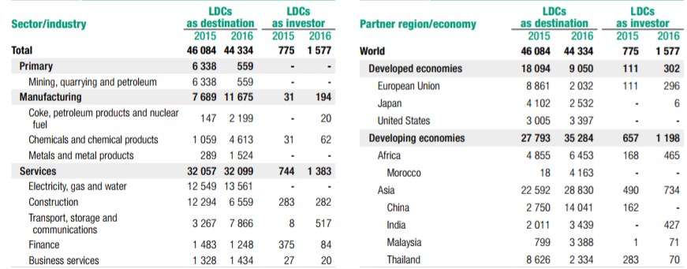
Announced greenfield FDI Project by industry/region (2015-2016) - mill US

Slide 6
Mixed prospects for FDI in LDCs
Although the sectoral distribution of announced greenfield FDI projects in LDCs underscores the potential for more investment in the manufacturing and services sectors, investments related to oil and gas will continue to drive overall FDI flows into LDCs for the foreseeable future (UNCTAD WIR 2016)
Risk perceptions of potential investors are still high
South-South FDI can play a major role in diversification
→ Need to attract “quality” investment that fosters inclusive employment, skills, technology transfer and increased backward and forward linkages

Slide 7
Challenges for attracting FDI
Limited effectiveness of Investment Promotion Agencies (IPAs) in many of the LDCs
IPAs in LDCs at different levels of maturity
Information failures (lack of capacity, accurate and timely information lead to high risk assessments)
LDC entrepreneurs have capacity and information limitations when seeking investment and technology partners

Slide 8
Strategic Approaches of IPAs
Adopt a spatial approach to investment promotion - providing information about specific regions, industrial corridors etc.
Providing relevant, accurate and timely information to potential investors (including SMEs)
More elaborate investment promotion programs to increase benefits of FDI
IPAs to become focal points for broader regulatory reforms and investment facilitation activities
IPA aftercare services – forge long term strategic partnerships with investors

Slide 9
Objectives of capacity development programme
Strengthen strategic orientation of IPAs
Strengthen collaboration across IPAs from LDCs and development partners
Improve business climate and investment conditions to attract “quality” FDI and enhance sustainable development of LDCs

Slide 10
Thank you

