Slide 1
Distributed Design, an emergent approach
Design Advanced Center, Santiago, Chile
Andrés Briceño Gutiérrez,
andres@fablabsantiago.org

Slide 2
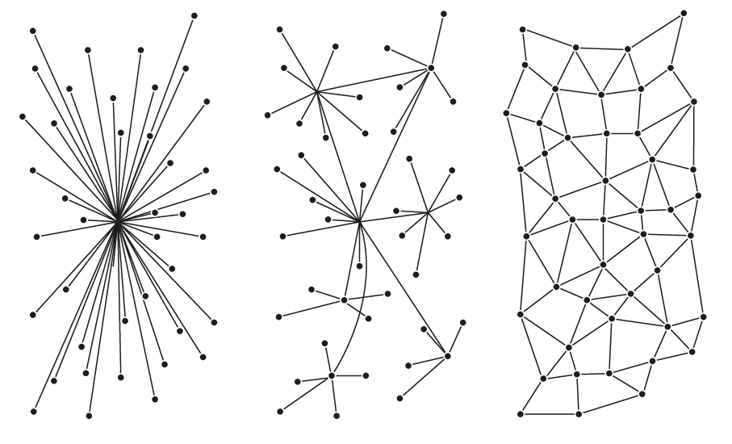
1_An ORIENTED SYSTEMIC DESIGN APPROACH.
2_DISPERSION OF OWNERSHIP SENSE
3_POTENTIAL PROSUMERS ACTIVE CO-CREATION PROCESS
DISTRIBUTED SCENARIO
AUTONOMY
DISTRIBUTED DESIGN APPROACH
6 principles
4_EMERGENT PRESENCE OF PREFIX SELF-AUTO (SELF-ORGANISATION, SELF-GOVERNMENT, ETC).
5_INFORMATION VALUATION (FLUID) INSTEAD OF MATTER VALUATION (SOLID) ONLY.
6_CRITICAL APPROACH OF THE ANTHROPOCENE SCENARIO.
WHAT WE THINK?

Slide 3
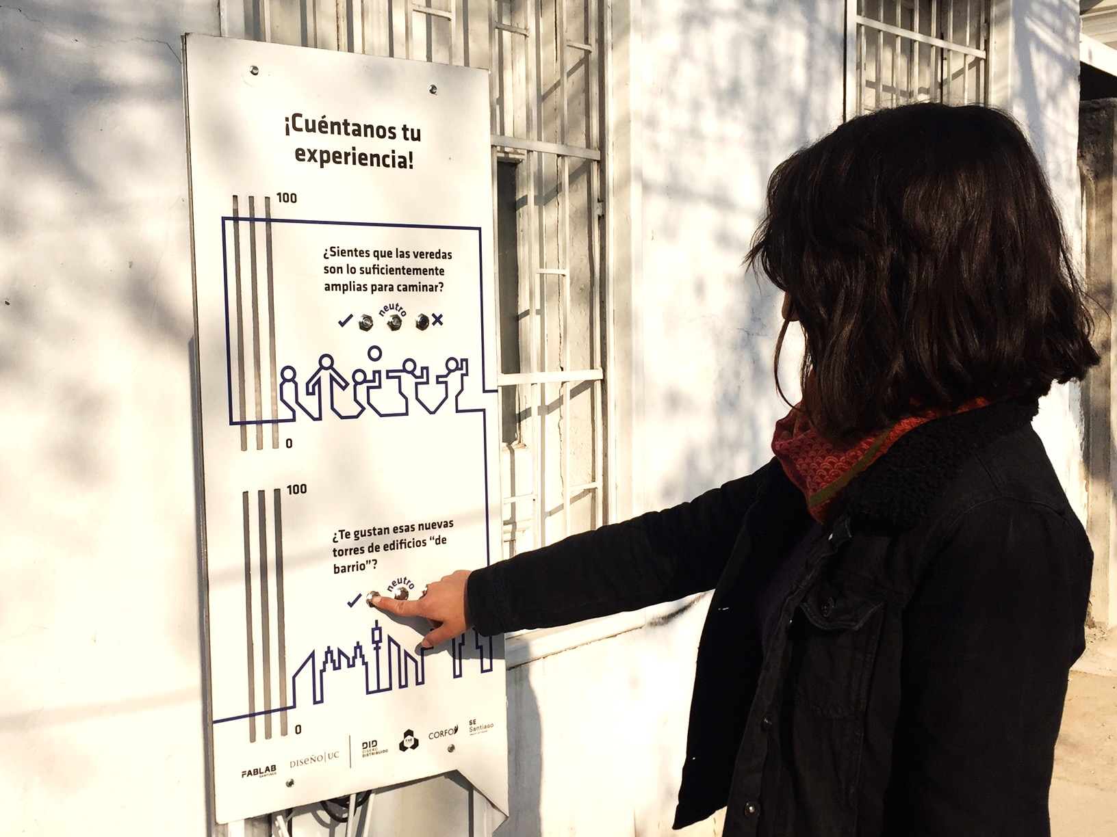
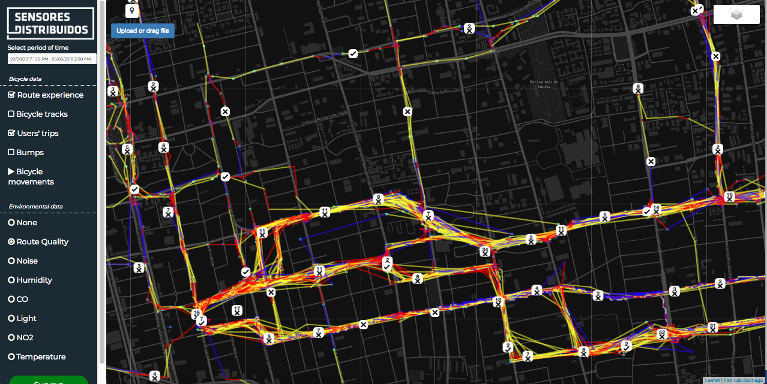
DID Citizens Urban Involvement / Mobile & Stacionary Devices / smartcitizen.cl
A platform that generate the chance to créate a crowd-sensing process, collecting data from the environment and people.
The main goal of this platform is to give tools for public policies, and a deeple understanding of urban phenomena.
WHAT WE DO?

Slide 4
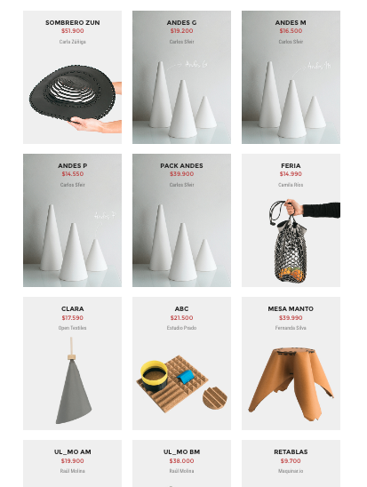
Is an emergent design platform & e-commerce, that gather local designers to create products using digital fabrication techniques.
WHAT WE DO?

Slide 5
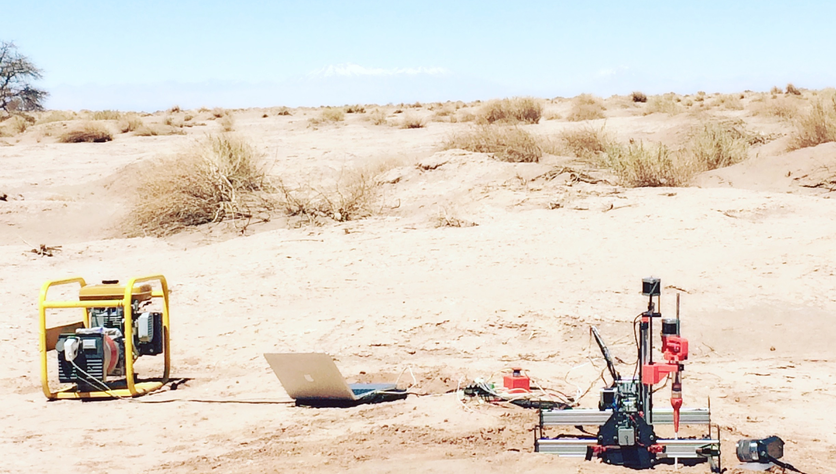
SANBOT_ mobile 3d sand printing system | a distributed manufacturing technique
WHAT WE DO?

Slide 6
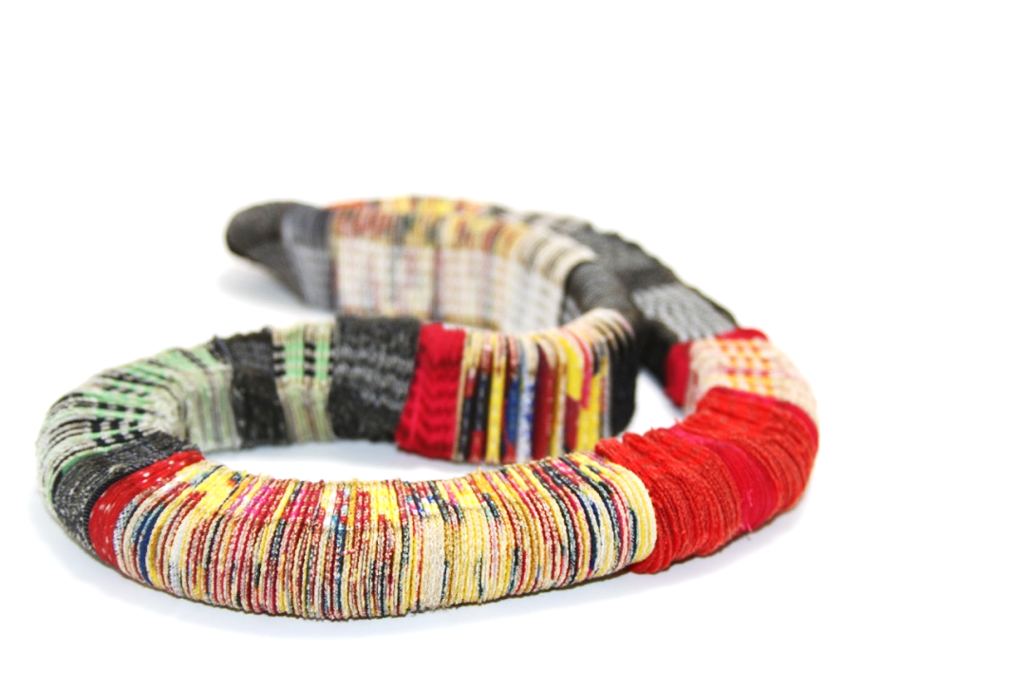
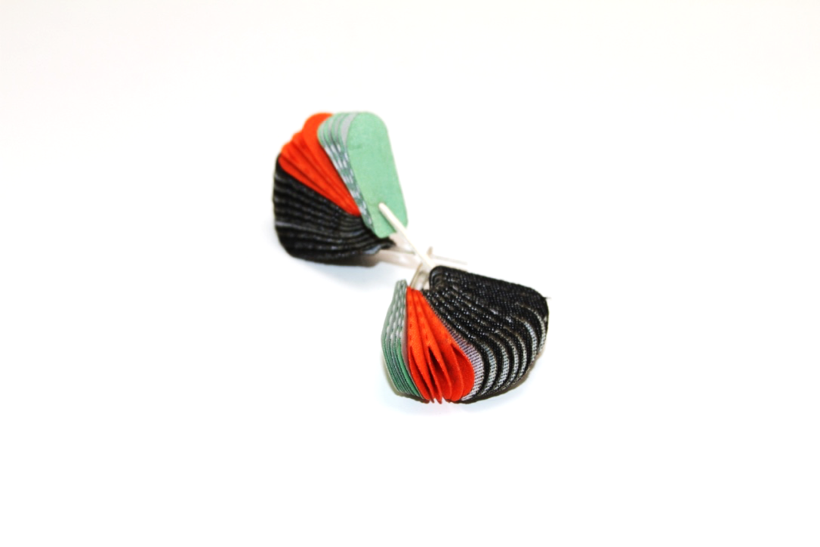
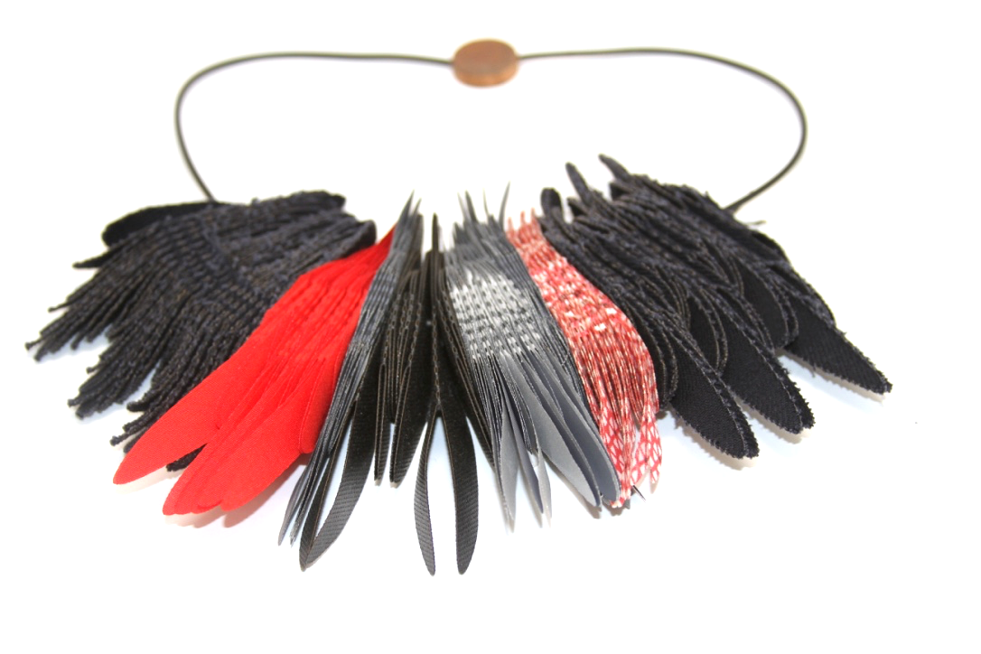
MATERIOM
Open Bio-materials platform.
materiom.org
ORNAMENTAL
Circular Economy Advanced Contemporary Jewelry .
ornamentalab.cl
OPEN TEXTILES
Circular Economy Textile Research
opentextiles.org
WHAT WE DO?

Slide 7
Thanks!
Design Advanced Center, Santiago, Chile
Andrés Briceño Gutiérrez,
andres@fablabsantiago.org

