Slide 1
Green Growth Knowledge Platform Country Pages & National Documents Database (NDD)
Benjamin Smith Senior Knowledge Management Officer Green Growth Knowledge Platform
bsmith@ggkp.org

Slide 2
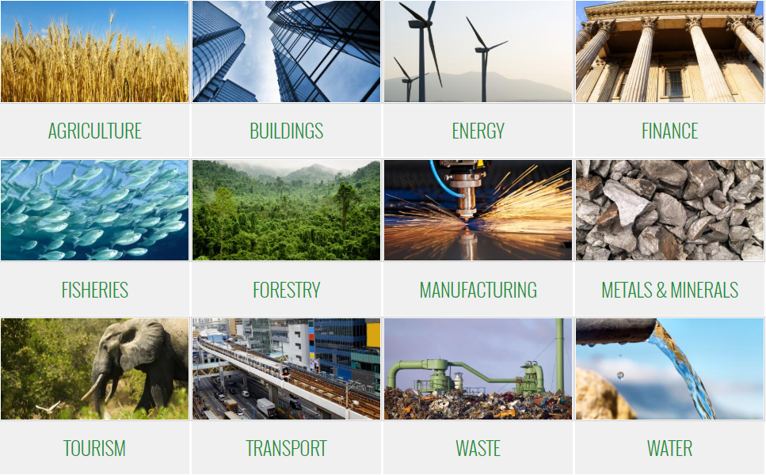
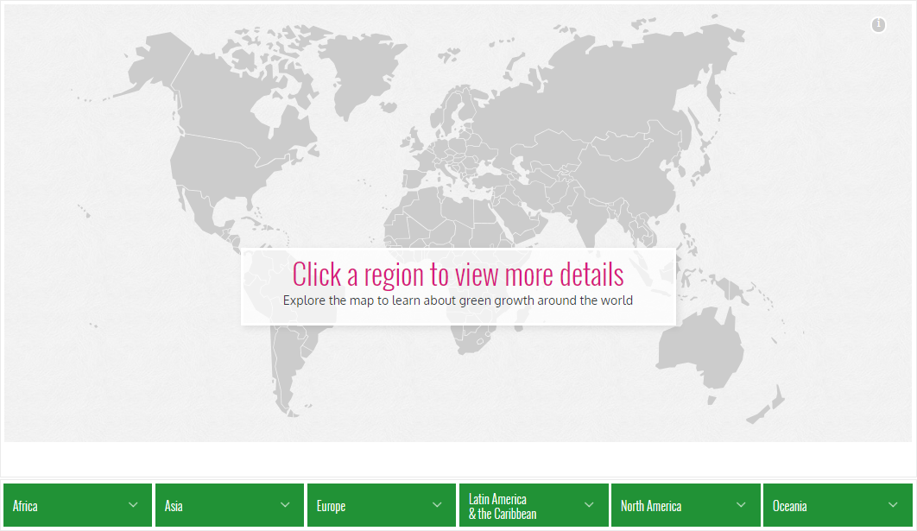
Steering Committee
Knowledge Management
3000+ Knowledge Resources on ggkp.org
33 Sector and Theme pages
400,000+ page views per year
138,000 data points
Joining as Steering Committee
in Q4 2018
Knowledge Sharing
6 Flagship GGKP Annual Conferences, 1000+ Participants
6000+ newsletter subscribers
25 world-leading green growth experts available to policy makers on Expert Connect
Knowledge Partners
Knowledge Generation
60 leading IOs, research institutions and think tanks
100 experts addressing knowledge gaps
37 Publications produced to date

Slide 3
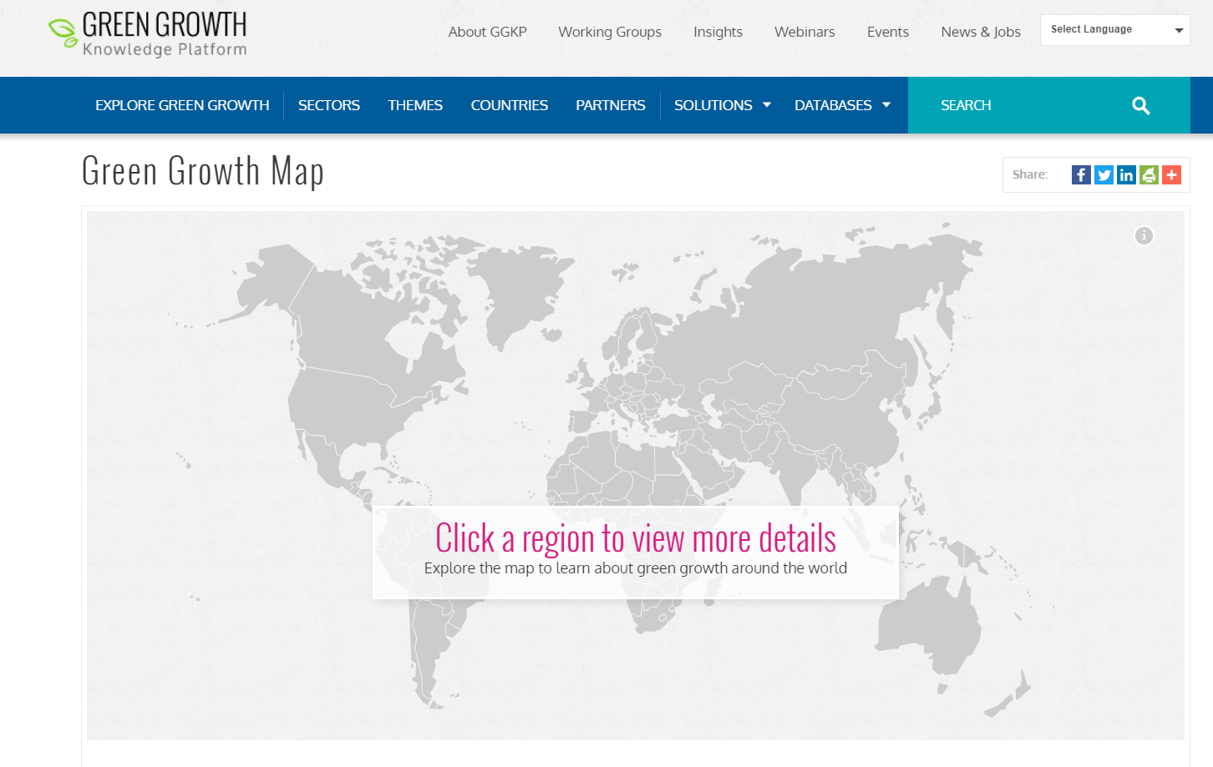
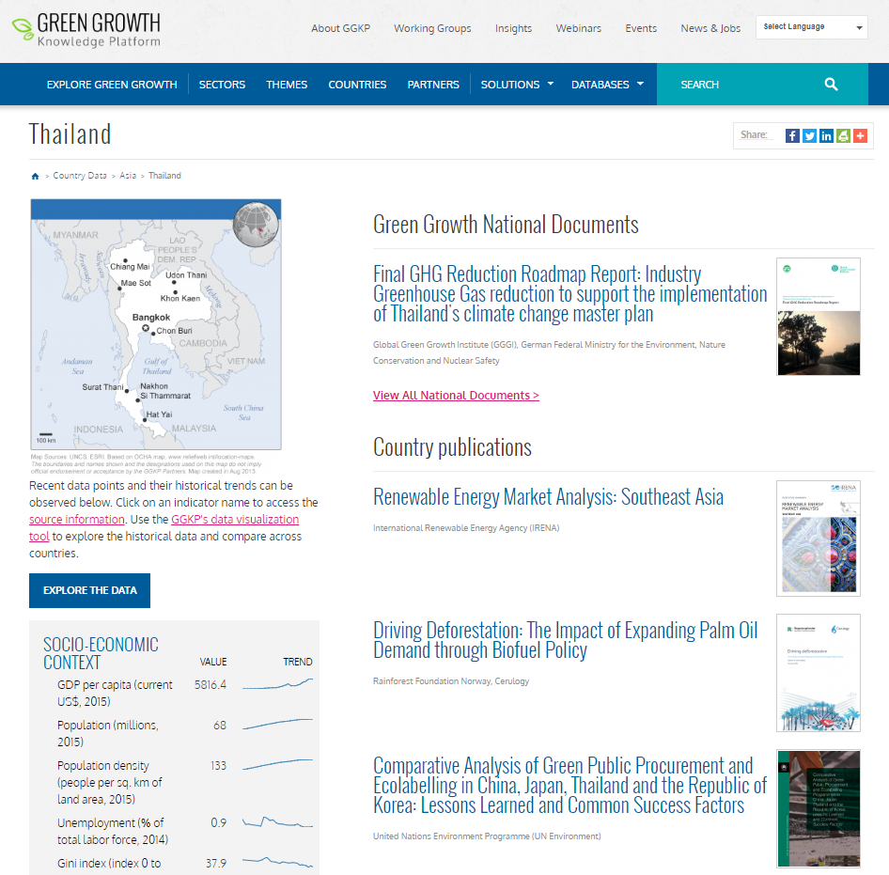
ggkp.org/map
193 Country Pages
133,000 Green Growth Data Points
Data Types
Country Publications
Regional Publications
Case Studies
Learning
National Documents

Slide 4
UN Environment 2014:
70 countries are either involved in green economy initiatives or hold a national green economy-related strategy

Slide 5
NDD Goals
The National Document Database:
Highlights governments’ actions on the green growth.
Provides access to relevant national green growth policies.
Builds better understanding of the global topography for green growth.

Slide 6
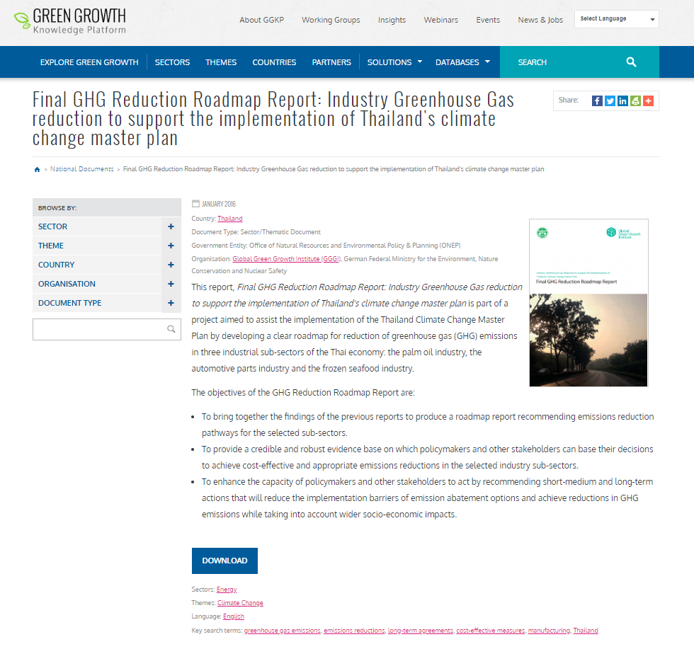
ggkp.org/national-documents
Progress:
300+ Documents Identified
143 Documents Uploaded
Document Types
Climate Change Plan
Green Growth Document
Growth Plan
National Development Plan
Sector/Thematic Document
Sector/Thematic Plan
Sustainable Development Plan

Slide 7
Thank You
Benjamin Smith Senior Knowledge Management Officer Green Growth Knowledge Platform
bsmith@ggkp.org

