Slide 1
Eco – Industrial Parks for Green Industry
Dr. Bharat Jain
Member Secretary
Gujarat Cleaner Production Centre
Gandhinagar, Gujarat, India

Slide 2
Industrial Development in Gujarat

Slide 3
3 Step EIP Approach at Nandesari & Dahej Industrial Estates

Slide 4
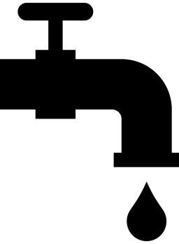
Anticipated Savings at Nandesari & Dahej ( Micro Level )
20
Nandesari
28
Dahej
19427
Tons/Year
Investment
126366.19
USD/Year
Reduction in GHG Emission
1800
KWh/Year
45006
M³/Year
Savings in Electricity Consumption
Savings in Water Consumption
4269.56
Tons/Year
86014.34
USD/Year
Material & Product Recovery
Monetary Savings

Slide 5
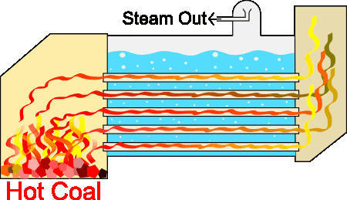
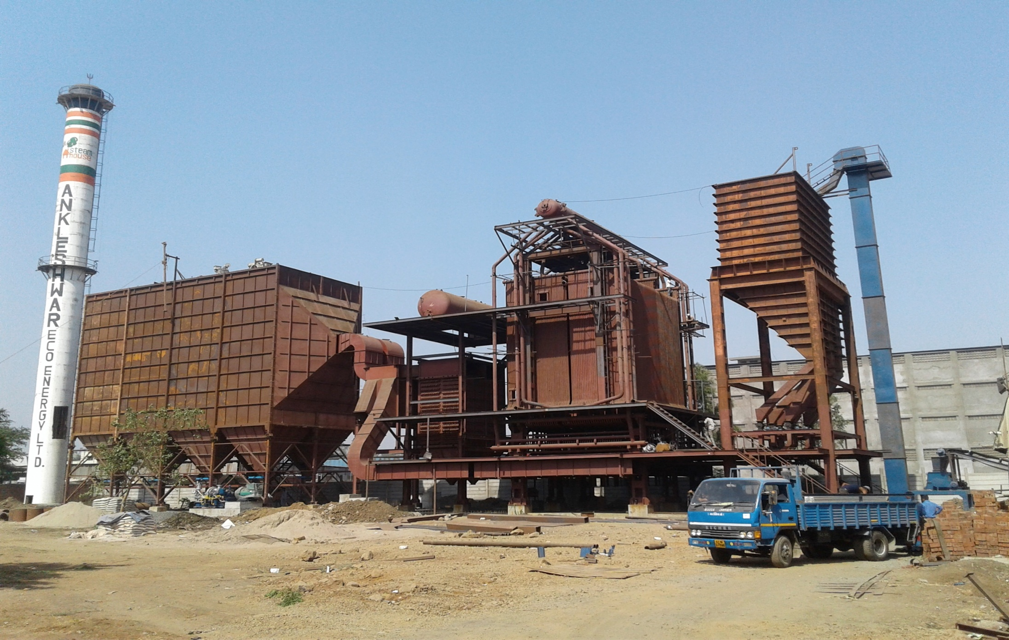
Macro Level Common Infrastructure Facility at Nandesari
Steam a major requirement in the production process
Units have individual boilers in their premises
It is proposed to install a single common boiler in Industrial Estate.
Common Boiler
Figure- Mechanism of Steam Production
Reduced Carbon Footprint
Reduce in Space, Capital Investments and Formalities
Reduced Fugitive Emissions

Slide 6
Proposed Infrastructure at Nandesari
Spent Acid Management
Forward Osmosis Technology
&

Slide 7
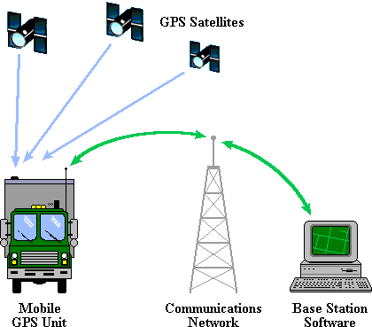
Drum Decontamination Facility
&
GPS Vehicle Tracking System
To ensure that no vehicle carrying waste which is meant to be sent to CETP goes out of the track or is mismanaged.
This will ensure sustainable development in the estate.

Slide 8
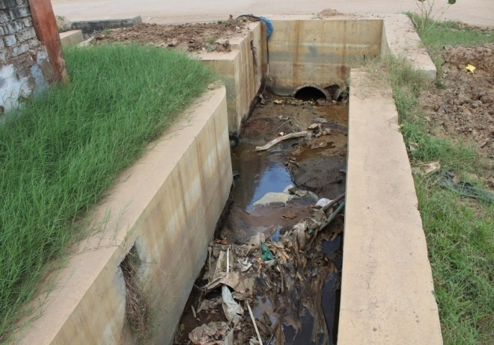
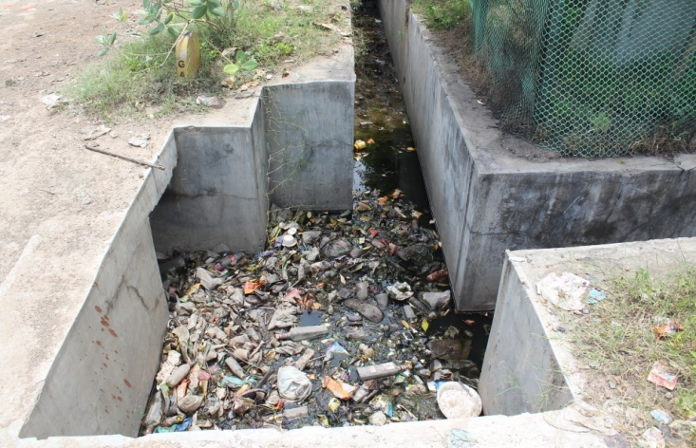
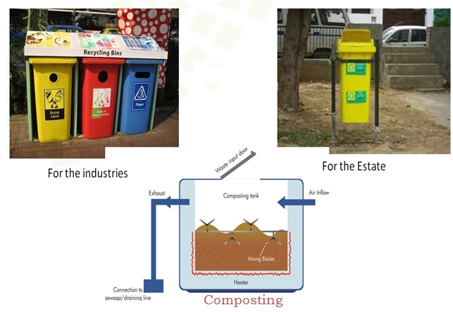
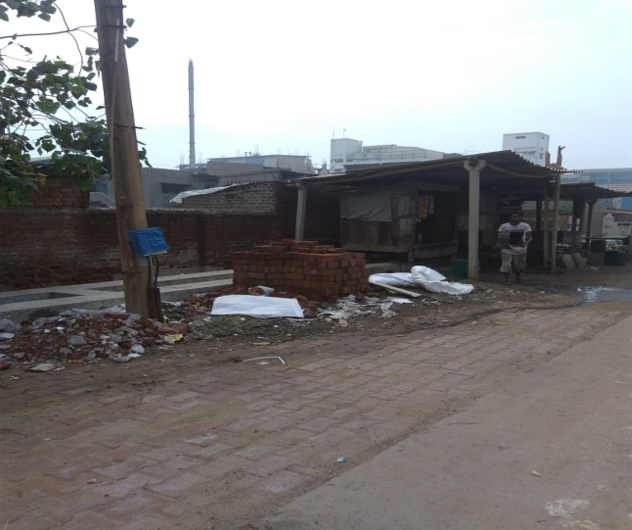
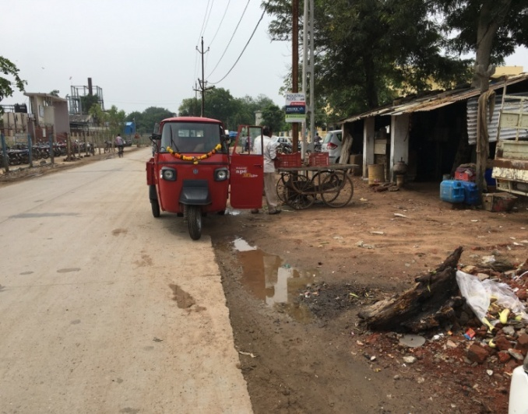
Solid Waste Management at Nandesari
Existing
Proposed

Slide 9
Road, Rail, Airport & RO-RO Ferry Services at Dahej
Existing:
50 km four-lane Dahej-Bharuch State Highway connecting Delhi-Mumbai National Highway and National Expressway.
Road network within estate constructed with storm water drainage system
In Vilayat and Vilayat Expansion, 67 stretch of road are planned along with 17 km village roads.
Fly ash used in road construction.
Proposed:
6 lane Dahej - Bharuch road (due to increased traffic of trucks after launching of RO RO Ferry Service
42 km of State Highways within PCPIR to be upgraded to four lane
Construction of 25 km of coastal roads
Up-gradation of Dahej – Vagra – Bharuch Road

Slide 10
Smart Logistics Park
RAIL Infrastructure
Existing:
An SPV – called “Bharuch Dahej Railway Company Limited (BDRCL)” has been operating the line.
Railway line at Bharuch connected to Delhi-Mumbai Broad Gauge
Not operated at full efficiency
Proposed:
Integration of Road, Rail & Port
Smart Parking, Loading & Unloading Facility
Customized warehouses as per storage needs
Lodging, Canteen & Toilets for drivers
Hazard Prevention Readiness
Proposed:
Bharuch-Dahej rail line (62 km) – Conversion to broad gauge (under construction), touching the Delhi-Mumbai Dedicated Freight Corridor (DFC) on the eastern side.
Increase usage efficiency by connecting the rail to the port and multimodal logistics park

Slide 11
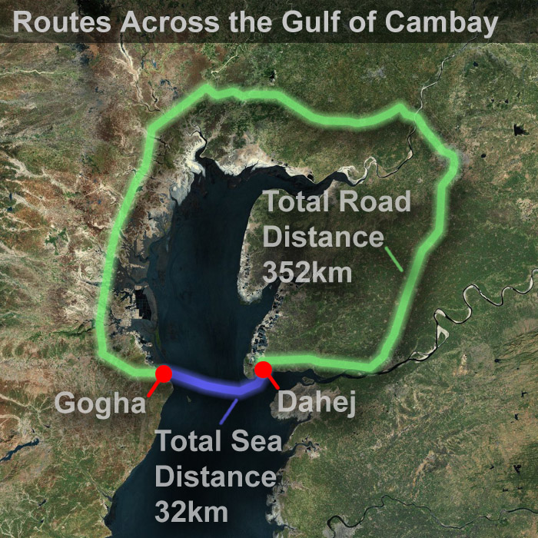
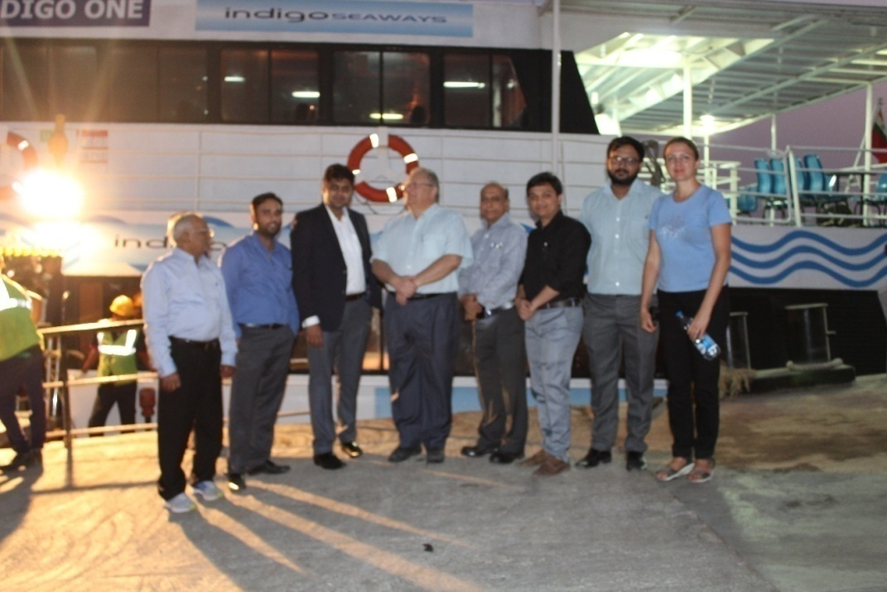
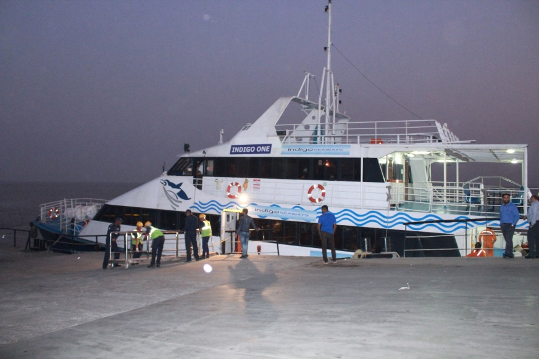
RO – RO Ferry service (Dahej to Ghogha)
Airport
Existing
250 km from international airport at Ahmedabad.
90 km from international airport at Vadodara.
85 km from domestic airport at Surat.
Proposed
Greenfield airport for PCPIR.
Airstrip at Ankleshwar.
Sea port
Proposed
40 MMTPA Solid Cargo, Liquid Cargo and Container Port, integration with the multimodal logistics park.
Marine Shipbuilding Park

Slide 12
Public Utilities
Suggested Common infrastructure for both estates
Food & Living
Infrastructure for Safety

Slide 13
Modifications need to be done so as to control impurities going into the green area or the storm water system.
Need of filtration to avoid dirt and have a water suitable for non-portable use

Slide 14
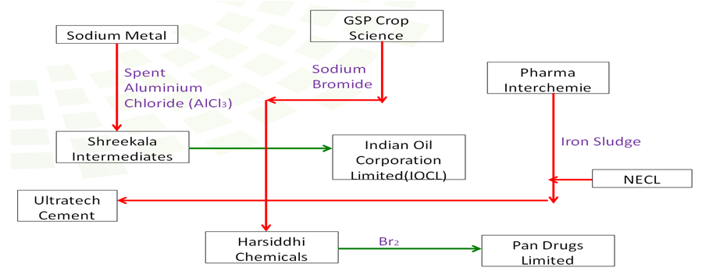
Industrial Symbiosis at Nandesari & Dahej
Collection of information on:
Waste generated from industries.
Waste disposal or utilization
Utilization of Hazardous waste according to Rule-9 of Hazardous Waste and Other Wastes (Management and Trans Boundary Movement) Rules, 2016
SOP or Guidelines required for utilization of Hazardous waste
For the waste streams identified so far, SOP available for following two category:
Contaminated drums/containers/barrels
Spent acid from Dye & Dye Intermediates industries
For other waste streams, SOP/Guidelines are under preparation.
Need to be approved by Central Pollution Control Board (CPCB) and hence requires time of 3-5 months.

