Slide 1
Greening with Jobs
Cristina Martinez
Senior Environment & Decent Work Specialist
International Labour Organization, Bangkok

Slide 2
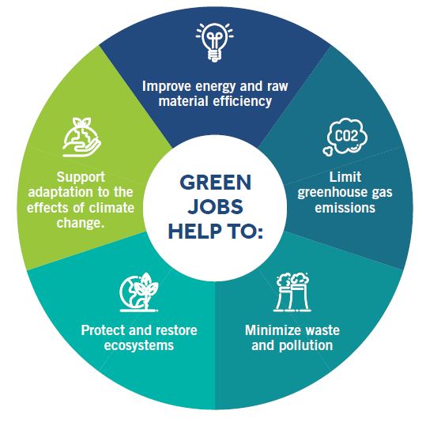
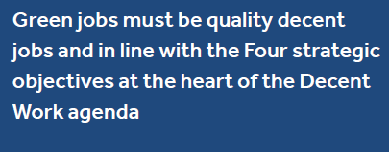
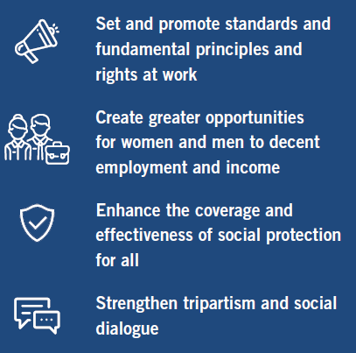
Are SMEs creating jobs that are good for the environment, good for the economy, and good for people?
Notes:
Jobs that are green are central to sustainable development and resource productivity. They respond to the global challenges of environmental protection, economic development and social inclusion. Such jobs create decent employment opportunities, enhance resource efficiency and build a low-carbon sustainable society.
Green jobs contribute towards the preservation and restoration of the environment, be they in traditional sectors, such as manufacturing and construction, or in new, emerging green sectors, such as renewable energy and energy efficiency.
At the enterprise level, green jobs can produce goods and provide services that benefit the environment, such as green buildings or clean transportation. These green outputs (products and services), however, are not always based on green production processes and technologies.
Green jobs are also distinguished by their contribution to environment-friendly processes. For example, green jobs can reduce water consumption or improve recycling systems. Green jobs defined through production processes do not necessarily produce environmental goods or services.
Green jobs must be quality decent jobs and in line with the Four strategic objectives at the heart of the Decent Work agenda:
Set and promote standards and fundamental principles and rights at work
Create greater opportunities for women and men to decent employment and income
Enhance the coverage and effectiveness of social protection for all
Strengthen tripartism and social dialogue

Slide 3
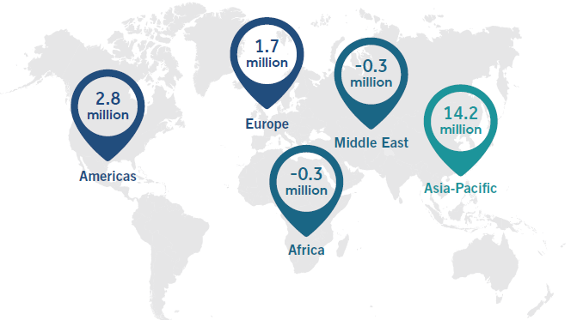
Barriers can be removed to create more green and decent jobs…
ILO (2018) WESO report
Notes:
The ILO estimates that reducing climate change through mitigation of the rise in global temperatures would have a positive net impact on jobs worldwide. Achieving the International Energy Agency’s (IEA) 2°C scenario – an energy system development pathway and emissions trajectory to limit average global temperature increase by 2°Celsius, and considering how these energy demands impact the production of electric vehicles and the construction sector – would result in a net addition of 18 million jobs worldwide by 2030, compared with business-as-usual conditions (a 6°C scenario). The vast majority (79 per cent) of the new jobs would be in the Asia-Pacific region. In fact, the net increase for Asia and the Pacific is estimated at around 14.2 million jobs, offsetting the losses derived from the reduction of carbon-emitting industries in the Middle. East and Africa as well as within the Asia-Pacific region.
Mitigation alone will not stop the climate change impacts. Adaptation and coping capacities will be equally necessary. These adjustments to the natural and human systems also have the potential to moderate harm and create new economic opportunities. Adaptation and coping capacities include infrastructure and services, such as transport, water and waste management and emergency response services, as well as the management of environmental resources, including water supply, marine and terrestrial protection and biodiversity preservation. These adjustments will come with opportunities and challenges, which, with appropriate policy action, can be shaped to build economic, environmental and social resilience.
A major challenge for greening labour markets and job creation is to make sure that workers, especially youth, have the right skills. More than eight in every ten workers in the region are in either low-skilled occupations (16 per cent) or medium-skilled occupations (67 per cent). Many countries in Asia and the Pacific will experience a surplus of low-level skills increasing by 2020. Skills shortages will continue to increase, particularly for jobs requiring highly skilled workers. Skills shortages already present a major hurdle for the just transition to environmental sustainability, particularly for certain sectors and occupations, such as wind, wave and tidal power; renewable energies for manufacturing, construction and installation; expansion of the environmental industries; and the green building and construction sector.
The just transition needs to address reform of education systems and the lack of teachers and trainers in new green areas. For less developed countries, modernizing their skills production, both in the general education system and in the specialized vocational training system, is a complex exercise in which horizontal policy coordination across ministries of education, labour and environment is needed.

Slide 4
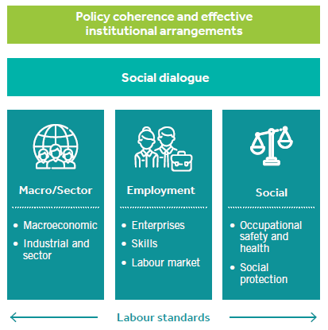
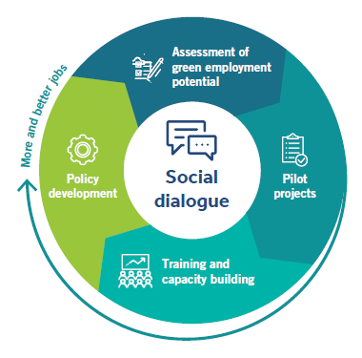
…but we also need a Just Transition Framework to guide changes
ILO Guidelines for a Just Transition
ILO support for implementation of the Just Transition Guidelines
Notes:
As was underlined by the Gender Action Plan that was adopted at the COP23, a just transition to sustainable development can only be achieved if women are actively involved in developing and implementing all aspects of climate change mitigation and adaption. Women are overrepresented among vulnerable workers and climate change risks widening existing gender gaps. At the same time, addressing gender equality as an integral part of climate action can contribute to achieving both gender equality and effective mitigation and adaptation measures. Particularly in the rural economy, for instance in agriculture and forestry, grassroots women, including indigenous and tribal women, are already playing an important role as workers and entrepreneurs. A just transition in such sectors opens up enormous avenues to strengthen the participation of women in decision-making across all levels, secure sustainable livelihoods, improve working conditions, as well as advance traditional and local knowledge necessary for strong climate action. (ILO. 2017a. Employment in the environmental sector
and green jobs in Mongolia (pilot study) (Ulaanbaatar).
The importance of decent work in achieving sustainable development is highlighted by Sustainable Development Goal (SDG) 8 to “promote sustained, inclusive and sustainable economic growth, full and productive employment and decent work for all”. In addition, the recognition in the Paris Agreement of “the imperative of a just transition of the workforce and the creation of decent work and quality jobs in accordance with nationally defined development priorities” urges countries to undertake climate change actions that equally advance job creation and social justice. Efforts to promote climate action and environmental sustainability (SDG 13) can contribute to achieving SDG 8.
ILO actions will help advance the just transition to environmental sustainability by (i) maximizing opportunities in terms of positive social and economic outcomes, on the one hand, and environmental outcomes on the other and/or (ii) by addressing the risks to the world of work associated with environmental challenges and response measures.
Based on the Conclusions of the 2013 International Labour Conference, the ILO adopted in November 2015 the Guidelines for a Just Transition Towards Environmentally Sustainable Economies and Societies for All. These guidelines offer the ILO and its constituents a framework and practical tool to ensure that national and global efforts to tackle climate change and other environmental challenges also advance employment creation goals, social justice and fair transitions for workers, enterprises and communities on an equal footing.
These guidelines can also help countries at all levels of development manage the transition to a low-carbon economy and help them achieve their Intended Nationally Determined Contributions and the 2030 Agenda goals. Designed to promote decent work on a large scale and ensure that social protection operates where needed, these guidelines also include mechanisms for social dialogue between governments and workers’ and employers’ organizations throughout policy-making processes.

Slide 5
What the JT pilot from the Philippines shows?
3 Key ingredients for implementation
5 strategic areas for action
Awareness raising
Social dialogue
Safety nets and technical assistance
Policy and institutions
Financing
Training and capacity building
Just Transition
“The major obstacle to implement the Just Transition framework reported by constituents in the Philippines is the preconceived notions and perceptions that preparation for Just Transition will entail additional cost”
Awareness raising
Social dialogue and collaboration
ILO 2018. Environmental Sustainability and Employment for Climate Resilience in Asia and the Pacific Policy Brief No. 1: Implementing The Just Transition Guidelines In Asia And The Pacific - Lessons From The Philippines
Notes:
Key ingredients to promoting and applying Just Transition include:
Awareness raising - a “continuous and aggressive awareness raising campaign” should entail communicating the definition of Just Transition, its impacts, challenges and opportunities for everyone. It is important to ensure that businesses will continue to be viable and profitable, particularly for MSMEs who may lack the capacity but also comprise a large segment of establishments in the country.
Social dialogue - is the key instrument for forging a way forward towards Just Transition. Social dialogue is rationalized across all sectors and agencies according to their mandates (rules, regulations, statues). Implementation issues need to be addressed pragmatically, with actions across all aspects of governance - from national down to the local level, from both management and worker side. Worker-management relations can be enhanced to include environmental performance in order to ensure business resilience. Social dialogue on skills training is also institutionalized through the TVET departments and agencies to develop and promote green initiatives and strengthening green technology centers.
Safety nets and technical assistance - there is a need to prepare old sectoral workers in light of greening industries through income diversification, skills training, and proper management systems to facilitate the shift. Continuous engagement with workers and employers through multi-sector dialogue is emphasized to promote the exchange of ideas across sectors, working towards unity of purpose. Small business technical assistance is also important in the form of capacity building and training to address skills gaps.
ILO. GLOBAL FORUM ON JUST TRANSITION (Geneva, 5 December 2017): Main Messages for the Asia-Pacific Region and Some Open Issues. Summary Note for ROAP.

