Slide 1
Waste Management Initiatives General Santos City South Cotabato, Mindanao Philippines
Ferdinand Juanico Pareja, MPA
Solid Waste Management Office
General Santos City

Slide 2
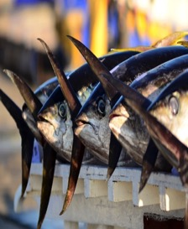
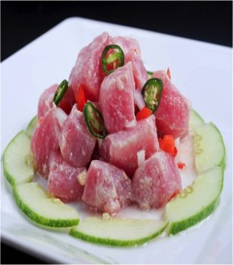
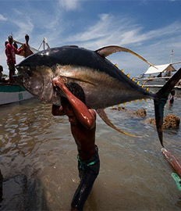
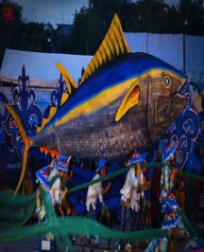
WELCOME TO
GENERAL SANTOS CITY-
TUNA CAPITAL, CITY OF CHAMPIONS,
CITY OF OPPORTUNITIES

Slide 3
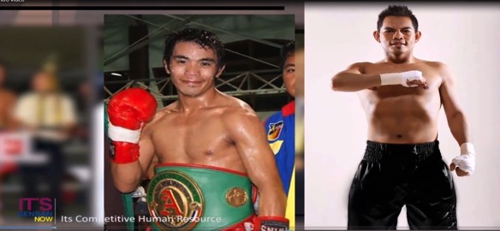
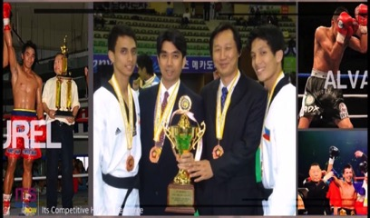

Slide 4
GREEN TO C.L.E.A.N GENSAN

Slide 5
QUALITY AIR
The current administration of the Local Government of General Santos City is gearing towards a vision that by 2030, General Santos City, the Home of Champions, is a globally competitive and livable city where prosperous, healthy, friendly, well-educated and responsible citizens actively participate in effective governance for a sustainable future. Thus, its major development strategy is define in its banner slogan,
GREEN to
Creating a Livable Environment for All towards Nation-building in Gensan.
CLEAN COMMUNITIES
SAFER WATER

Slide 6
WASTE MANAGEMENT OFFICE (WMO)
IMPLEMENTING DEPARTMENT
ORDINANCE NO. 13, SERIES OF 2012
Implements and manages the systematic, efficient, integrated and sustainable City Waste Management Program, projects and initiatives;

Slide 7
MANDATES
Republic Act No. 9003: Philippine Ecological Solid Waste Management Act of 2000
Republic Act No. 8749: Philippine Clean Air Act of 1999
Republic Act No. 9275: Philippine Clean Water Act of 2004
Notes:
RA 9003: Section 10, Segregation and Collection of solid waste shall be conducted at the barangay level specifically for biodegradable, compostable and reusable wastes; Provided, that the collection of non-recyclable materials (residuals) shall be the responsibility of the city.
RA 8749: Section 24, Prohibits the smoking inside a public building or an enclosed public place including public vehicles and other means of transport or in any enclosed area outside of one’s private residence, private place or work or any duly designated smoking area. This provision shall be implemented by the LGU; Section 36, LGUs share the responsibility in the management and maintenance of air quality within their territorial jurisdiction
RA 9275: Section 20, LGUs share the responsibility in the management and maintenance of water quality within their territorial jurisdiction

Slide 8
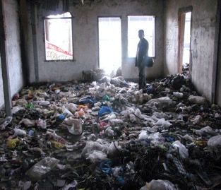
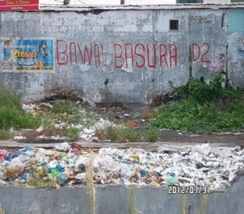
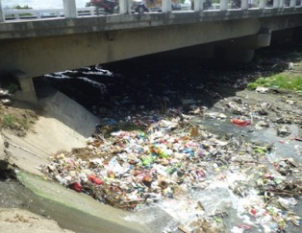
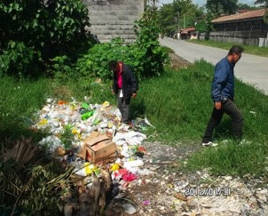
Challenges
WHERE DOES OUR WASTE END UP?
Abandoned Buildings
Vacant Lots
Riverbanks
Street sides

Slide 9
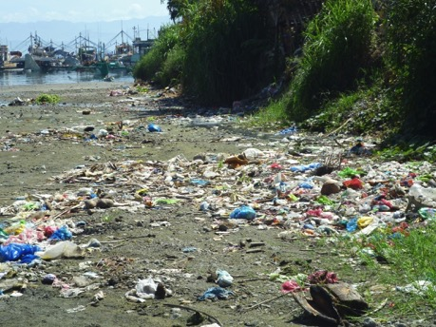
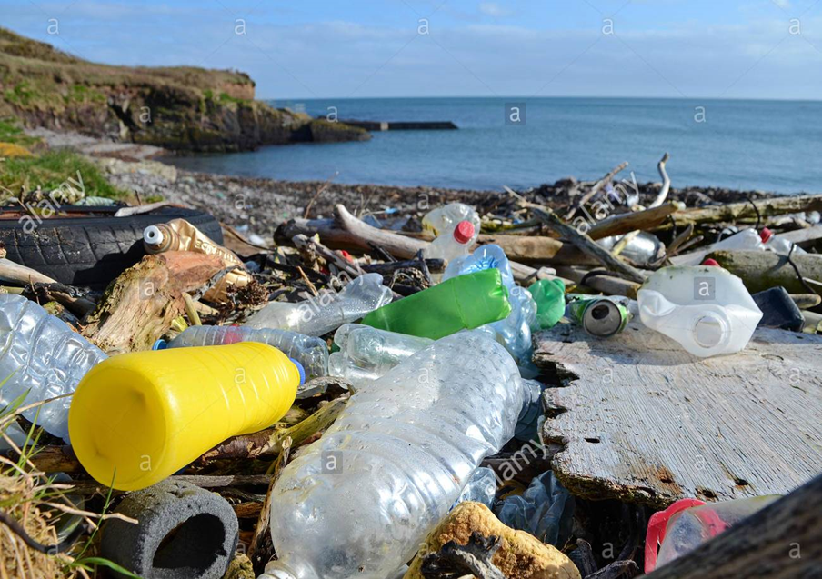
Rivers
Shorelines

Slide 10
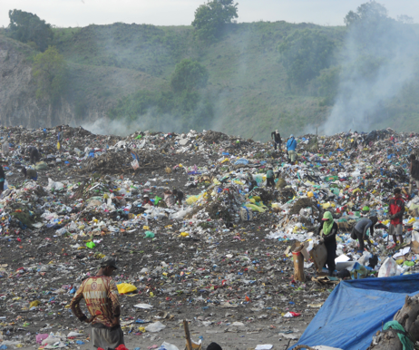
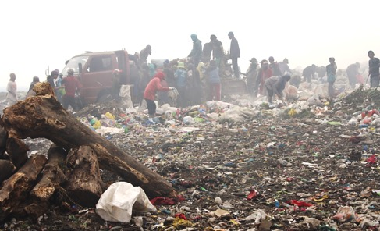
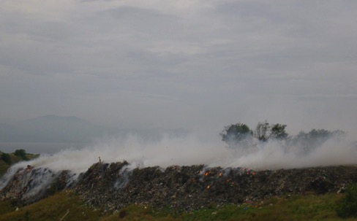
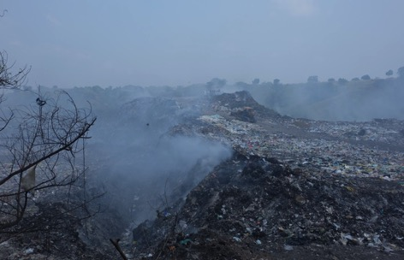
FINAL DISPOSAL

Slide 11
THE CHALLENGE
WASTE ANALYSIS AND CHARACTERIZATION STUDY |  |  | POPULATION
YEAR | WASTE GENERATION PER DAY (TONS PER DAY) | CONDUCTED BY
2008 | 169,961 | ECOGOV LGU GSC | 577,491
2012 | 158.252 | PHIL ECO | 547,610
2016 | 181.150 | PHIL ECO | 603,839
INCREASING WASTE GENERATION

Slide 12
WASTE ANALYSIS AND CHARACTERIZATION STUDY 2016 (END OF PIPE) PHIL ECO
AVERAGE WASTE DISPOSAL @ SLF | 80.12 TONS PER DAY
plastic | 51.25 % | 41.065 tons
papers | 28.53% | 22.85 tons
Yard waste | 11.83% | 9.48 tons
kitchen waste | 2.74% | 2.19 tons
Others (special waste, glass, metal, rubber and hazardous waste) | 5.65% | 4.52 tons
 |  | 80.12 tons

Slide 13
MANAGEMENT APPROACHES WHAT HAVE WE DONE SO FAR?

Slide 14
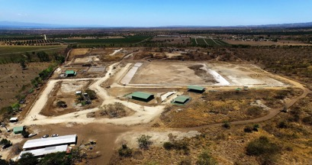
WASTE SOURCE MANAGEMENT, INTERVENTIONS AND APPROACHES
MAY OF 2016, OPENING OF THE CATEGORY FOUR GSC SANITARY LANDFILL FACILITY located at Barangay Sinawal and SIMULATENOUSLY CLOSE THE TAMBLER OPEN DUMPSITE

Slide 15
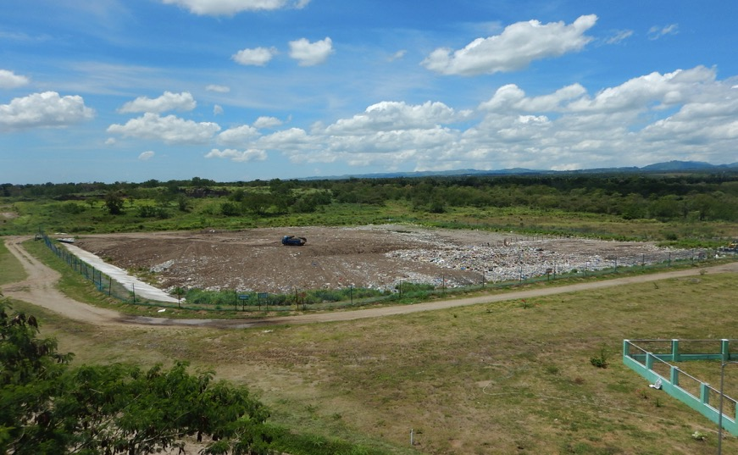
GSC SANITARY LANDFILL FACILITY
ACTIVE CELL REAL TIME PHOTO AT NORTHEAST VIEW
Photo Taken March 20, 2017

Slide 16
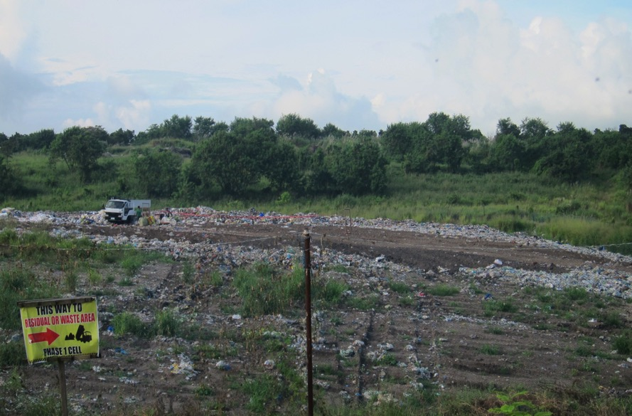
WASTE DISPOSAL @ SLF (JANUARY TO NOVEMBER 2017)
AVERAGE WASTE DISPOSAL @ SLF | 89.00 TONS PER DAY |  | Current management interventions
plastic | 51.25 % | 45.61 tons | Waste sorting @ a rate of 0.1365 tons per day (0.19%)
papers | 28.53% | 25.39 tons
Yard waste | 11.83% | 10.52 tons | Windrow composting (14.57%)
kitchen waste | 2.74% | 2.43 tons
Others (special waste, glass, metal, rubber and hazardous waste) | 5.65% | 5.02 tons | Temporary storage area (5.65%)
 |  | 89.0 tons
Total waste diverted |  |  | 14.41 tons (20.41%)

Slide 17
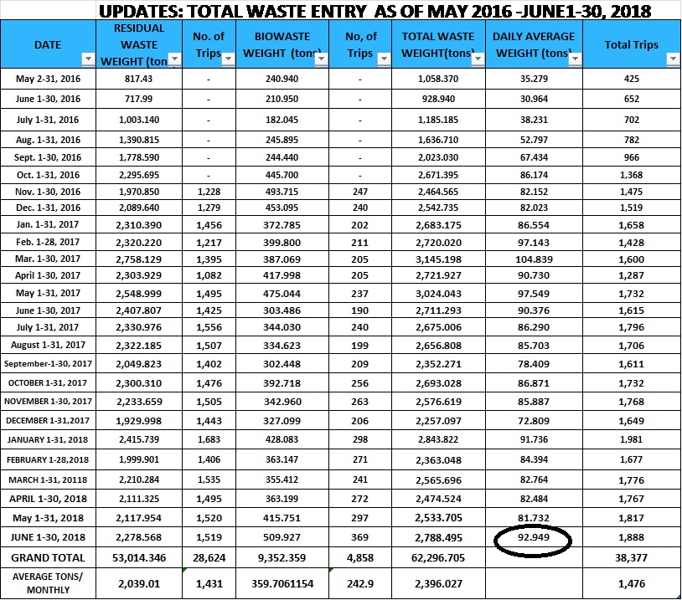
DISPOSAL AVERAGE
92 TONS OF WASTE PER DAY AT SANITARY LANDFILL FACILITY
(JANUARY TO JUNE, 2018)

Slide 18
In 2017 - GENSAN IS A RECIPIENT OF UNIDO’S Demonstration Project on BAT/BEP in Open Burning Activities in Response to the Stockholm Convention on POPs. The establishment of the first large scale CENTRAL MATERIAL RECOVERY FACILITY (CMRF

Slide 19
UNIDO INTERVENTION
DEMONSTRATION of Best Available Techniques (BATs) and Best Environmental Practices (BEPs) in Open Burning Activities in response to the Stockholm Conference on POPs

Slide 20
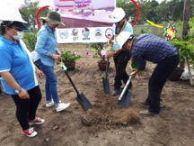
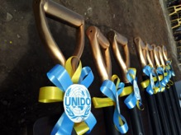
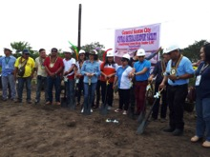
On going construction of a Mechanized Central Materials Recovery Facility in General Santos City
Groundbreaking Ceremonies

Slide 21
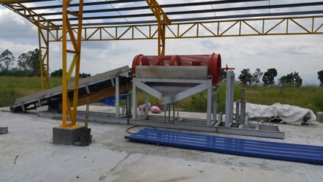
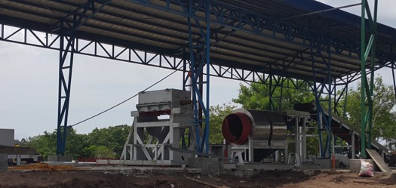
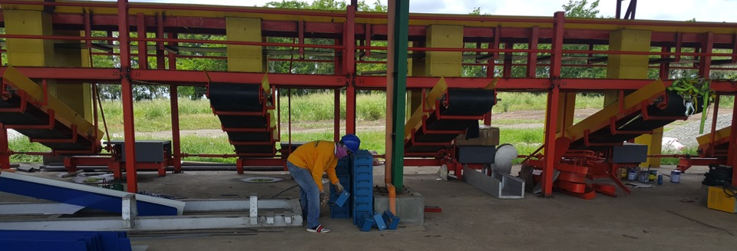
Fabrication of machines and on-going construction of the CMRF in General Santos City (expected to be complete and operational by the end of 2018)

Slide 22
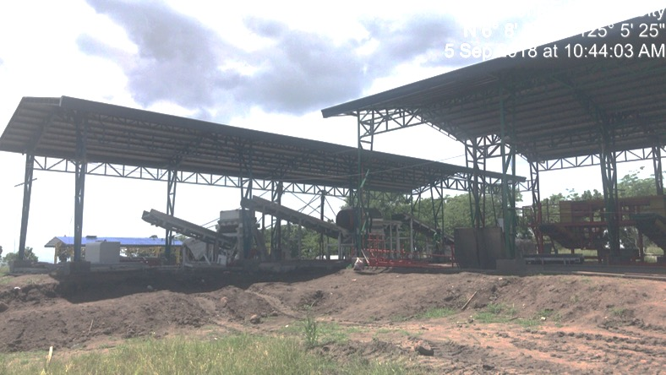
“The CMRF, to be located in Barangay Sinawal, will be the Philippines’ first large scale mechanized CMRF capable of processing up to 40 TPD of municipal solid waste,”

Slide 23
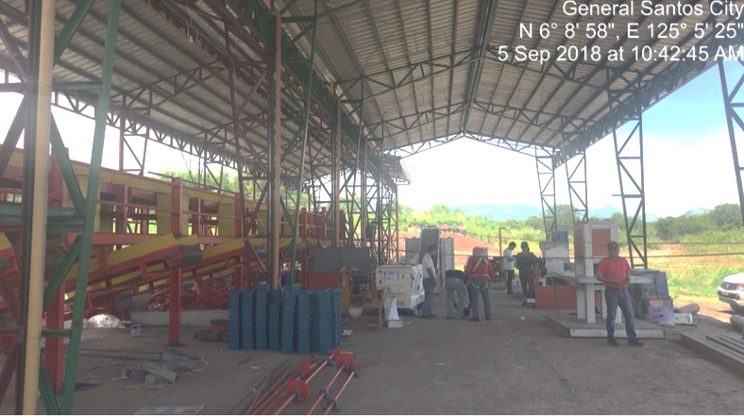
It is foreseen that with the establishment of this CMRF, aside from the additional 40TpD waste that shall be processed and diverted, partnerships and joint projects with other sectors (NGOs, Private etc.) shall be formed with the expected by-products that will be produced from the MRF.

Slide 24
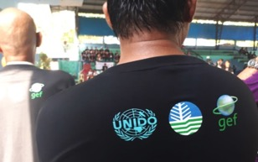
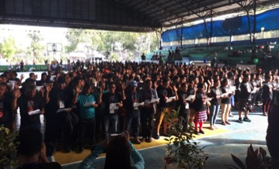
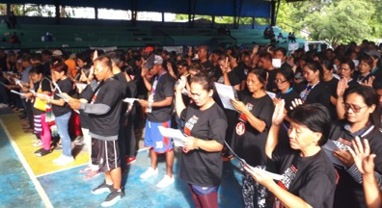
Other Activities conducted under the UNIDO-GEF Project
Issuance of IRR – Environmental City Ordinances e.g. no segregation no collection; regulating of plastics etc. )
Deputation of 800 Barangay Enforcers

Slide 25
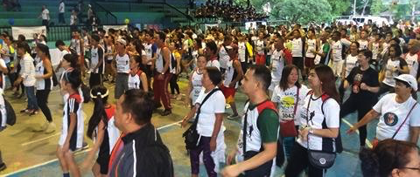
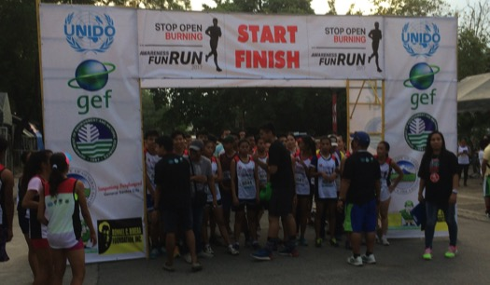
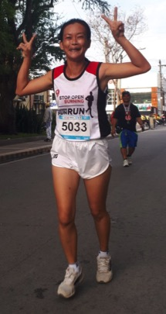
Education and Awareness Raising
Awareness Fun Run – General Santos City

Slide 26
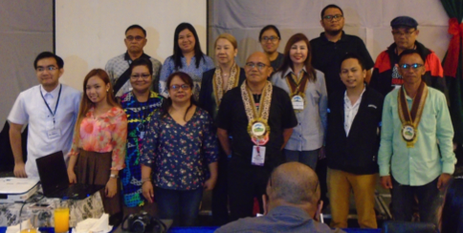
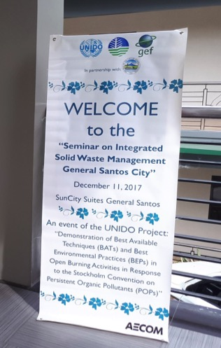
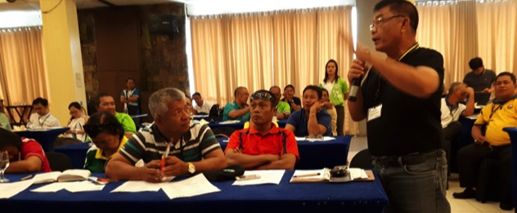
Education and Awareness Raising
Seminar on Integrated Solid Waste Management – GenSan

Slide 27
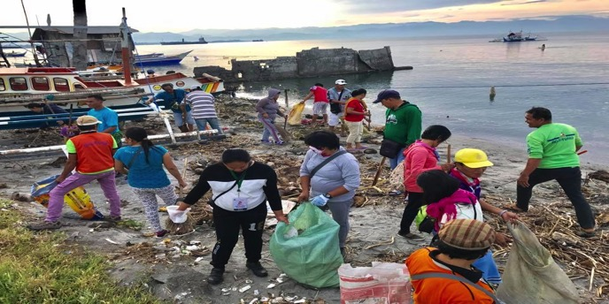

Slide 28
ADVOCACY AND IMPLEMENTATION
STOP OPEN BURNING
Ordinance 12 Series 2008
“GSC Ecological Solid Waste Management Ordinance”
Ordinance 6 Series 2015
“Comprehensive Anti- Smoking Ordinance of GSC"

Slide 29
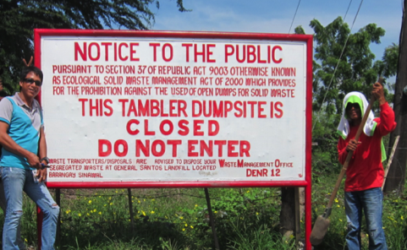
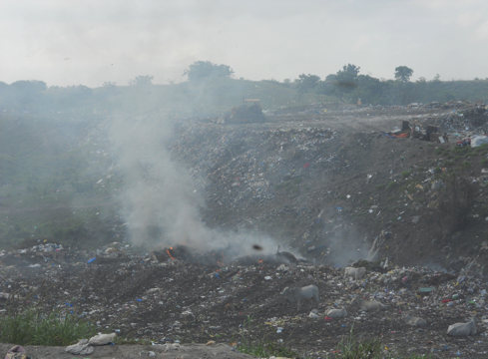
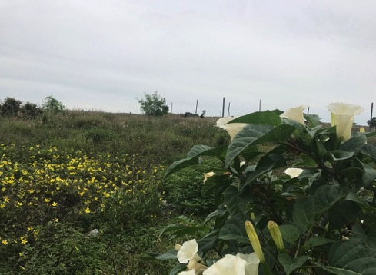
As a catalyst to totally close the Open Dumpsite
Then…
Now…

Slide 30
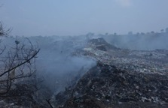
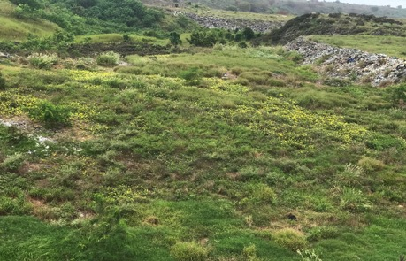
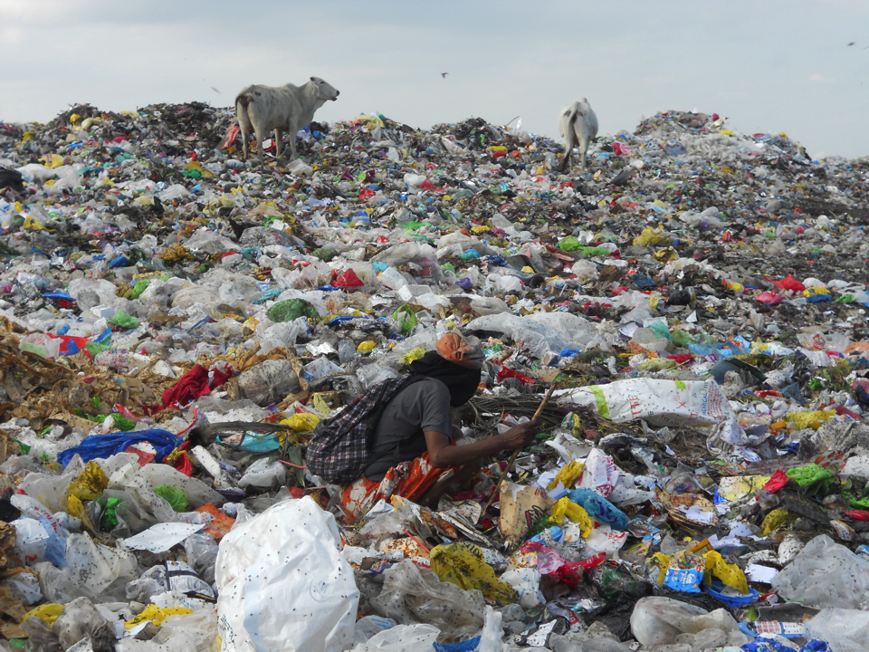
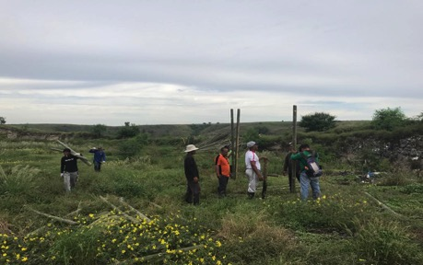
Former Tambler Dumpsite Rehabilitation
Then…
Now…

Slide 31
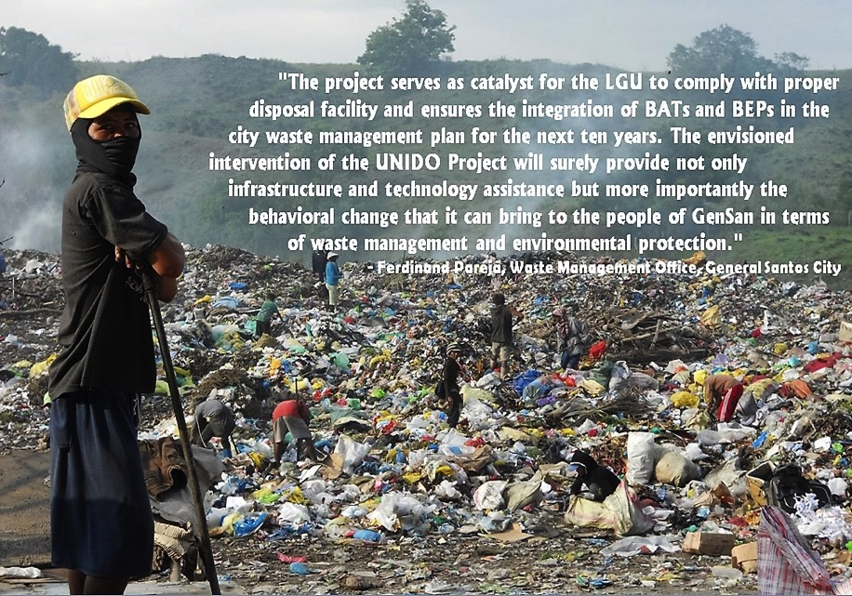

Slide 32
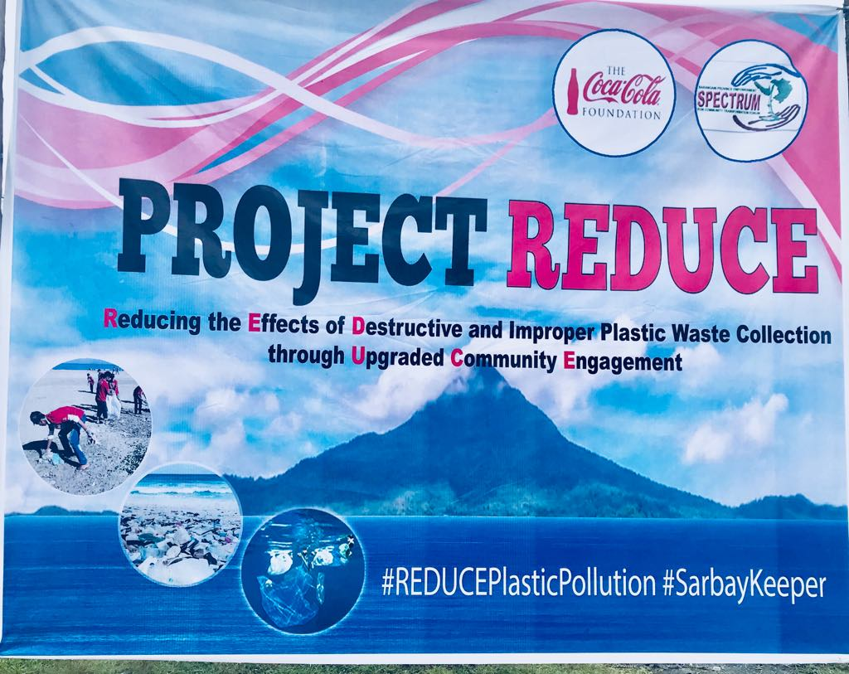
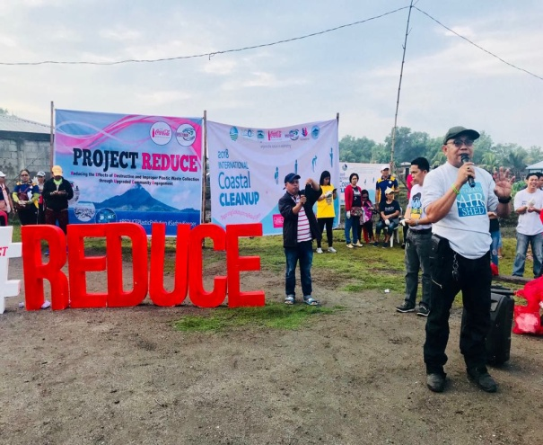
Projects and activities in the Pipeline…
Re-strengthen ALL IEC activities
focus on households, Public Markets, institutions,Schools commercial and industrial establishments

Slide 33
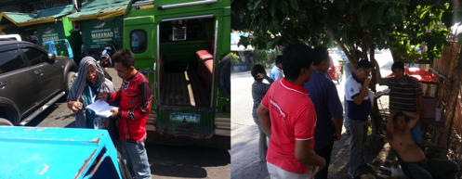
Projects and activities in the Pipeline…
Continuous SWM Enforcers Training and Deputation of barangay enforcers; PNP (regular, auxiliary and volunteers)
Formulation of Enforcement Mechanism and allocating funds for the implementation
Implement Rewards and Incentives for Enforcers and the share of the barangays from the penalties, to sustain enforcement system

Slide 34
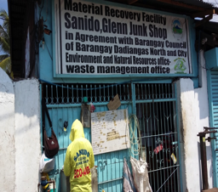
Projects and activities in the Pipeline…
RECYCLABLE – 15.6% of the Total Waste generation or about 26,513.91
14 Junkshops serves as material recovery facility of the barangays (21 junkshops, 2017 business listings )
sustain partnership with junkshop operators
Sustain operation of MRFs in all barangays or cluster of barangay
Conduct of Recyclable waste fair annually (during earth day celebration) in partnership with barangays, private sectors, malls, junkshops, DENR-EMB XII and industries

Slide 35
Ordinance No. 26, s. 2015- An Ordinance establishing the General Santos City Plastic Recycling Facility within the SLF complex, prescribing guidelines on its operation and providing funds therefor.
Residual waste will be process into plastic chairs, foot pavers, wall claddings through plastic densifiers, granulators
explore environmental friendly technology such as: WTEs and other innovative technologies in the future

Slide 36
Projects and activities in the Pipeline…

Slide 37
Creating a Livable Environment for All towards Nation-building in Gensan.

Slide 38
Kill nothing, but time.
Leave nothing, but footprints
Take nothing, but pictures
Keep nothing, but memories.
-John Muir
(1838-1914)
“John of the Mountain”
Environmental Philosopher

Slide 39
MAGANDANG GENSAN!
MARAMING SALAMAT PO!
THANK YOU VERY MUCH!

