Slide 1
GGGI and the BRI: Challenges & Opportunities
Inhee Chung
Sustainability & Safeguards Manager
4 October 2018

Slide 2
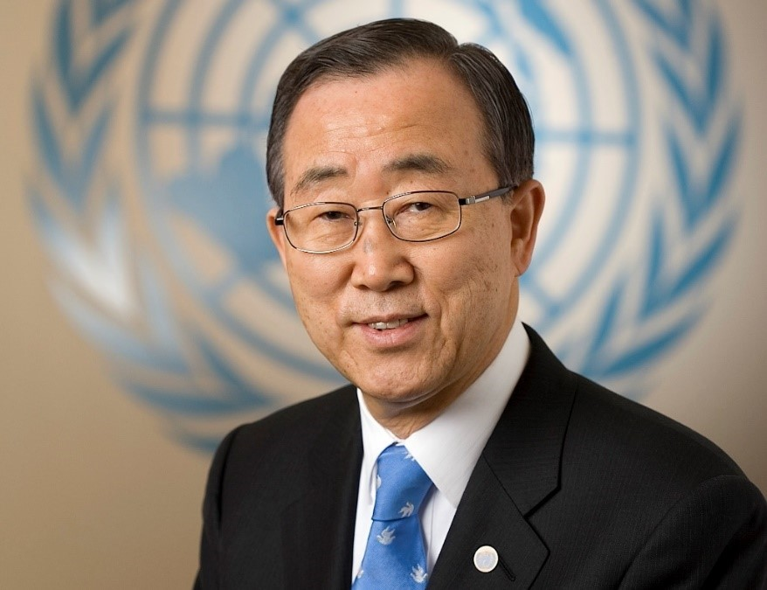
Global Green Growth Institute (GGGI) Mission & Vision
Vision
A resilient world
of strong, inclusive, and sustainable growth
What
Who
Economic performance
Social Inclusion
Environmental Sustainability
Least developed and developing countries
Emerging economies
Dr. Ban Ki-moon, 8th Secretary-General of the United Nations has been elected as the President of the assembly and chair of the Council of GGGI in February 20th, 2018.
Notes:
Mission GGGI is dedicated to supporting developing and emerging countries in demonstrating new pathways to climate resilient and pro-poor economic growth that simultaneously targets transformational aspects of economic performance, social inclusion and environmental sustainability.
GGGI Vision: A resilient world of strong, inclusive, and sustainable growth.

Slide 3
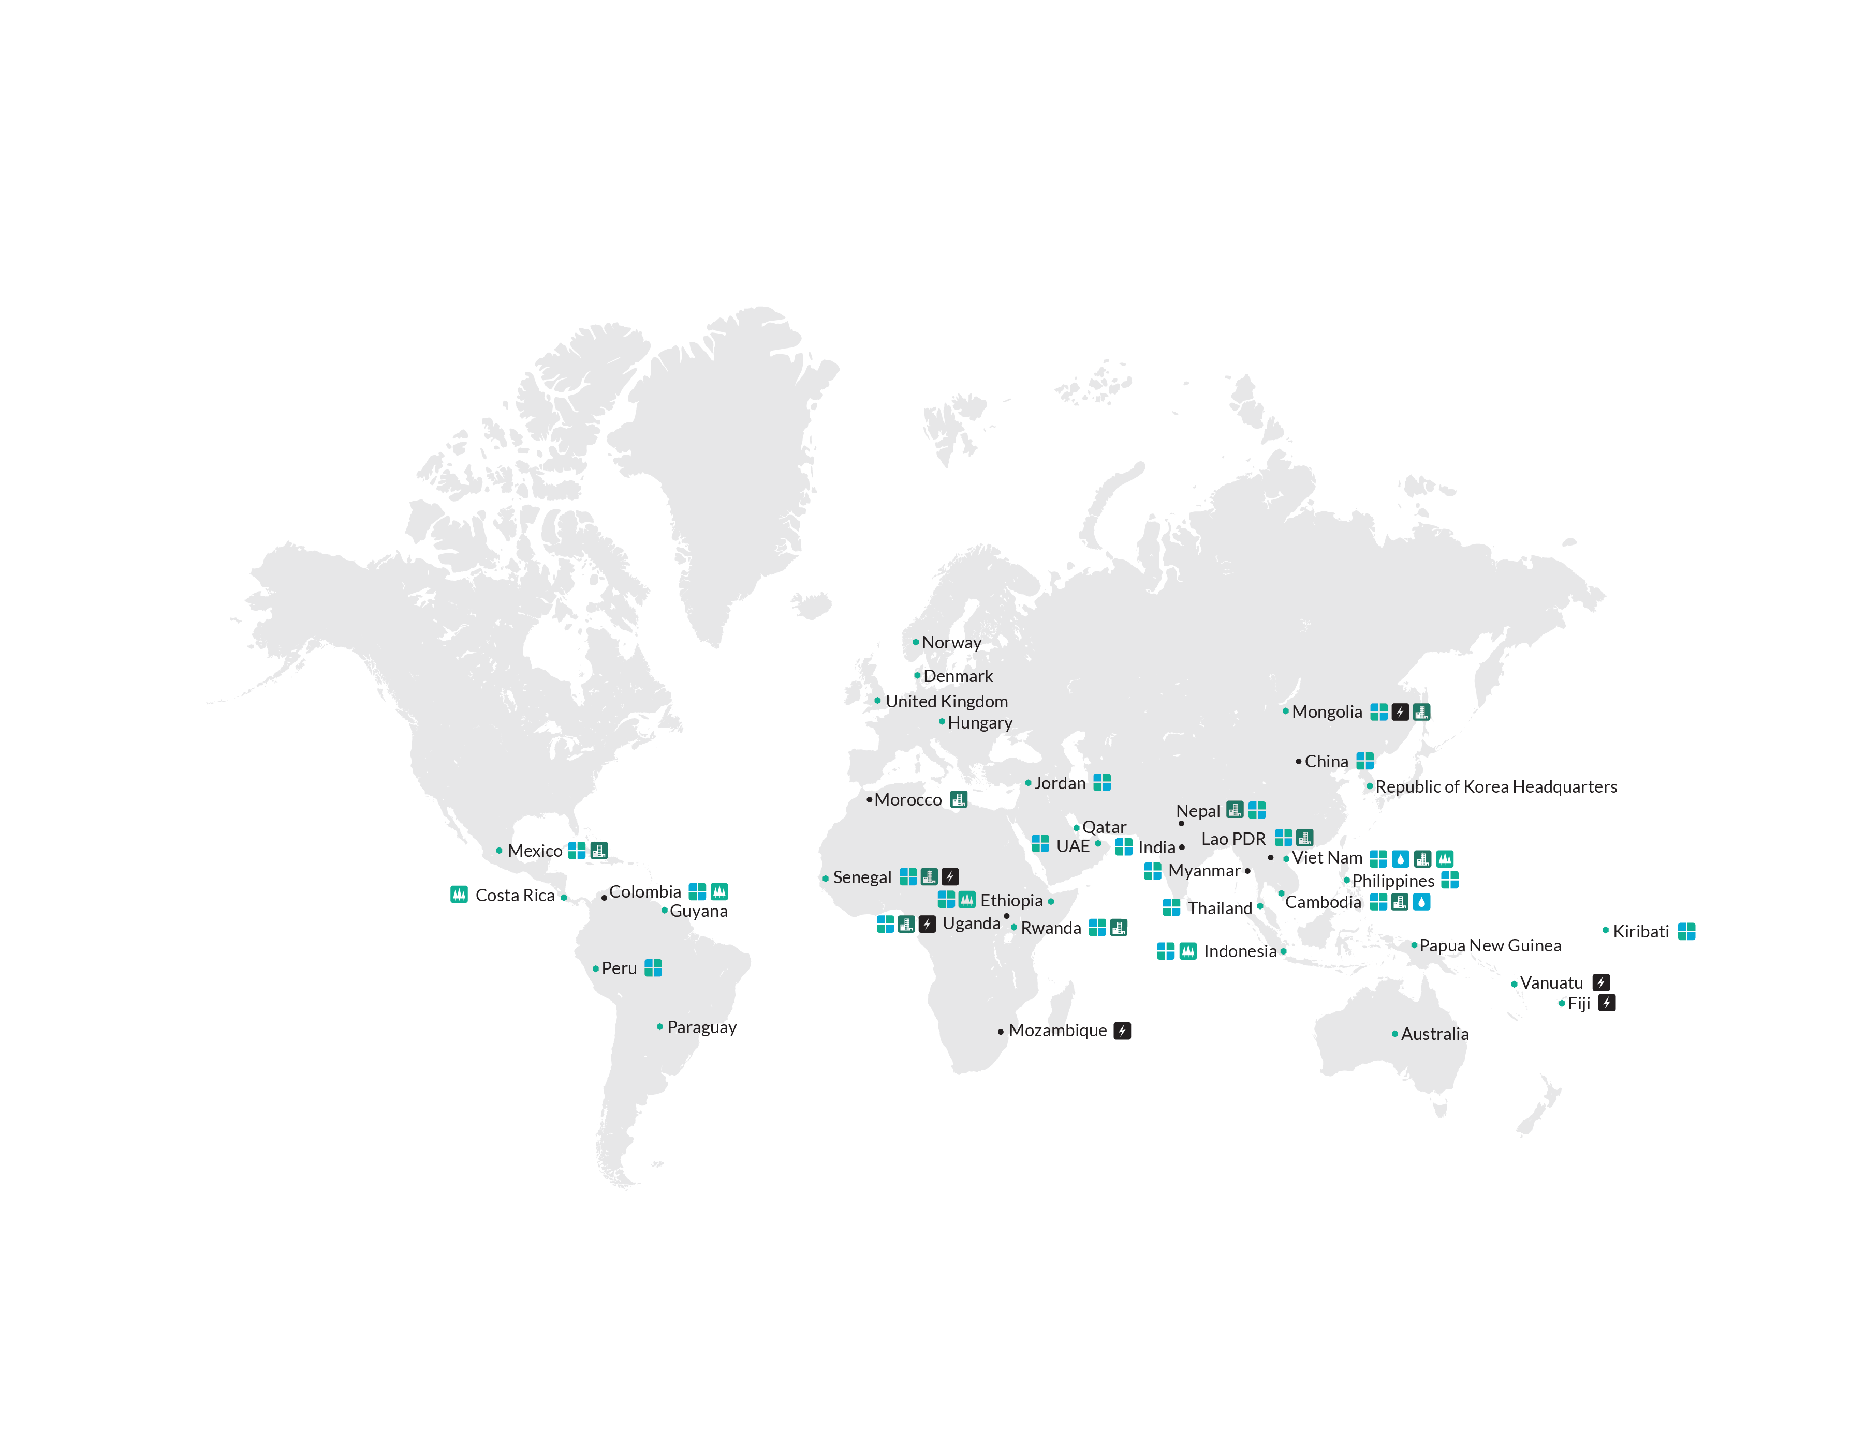
GGGI at a Glance
28 member countries plus
another 20 on the road to membership
27 Country programs,
moving to 30+ by end 2018
$55M/annum budget and >300 staff, 200 in country
Maximizing
Impact through
Four Thematic
Priorities:
Sustainable Energy
Water & Sanitation
Sustainable Landscapes
Green Cities
Multi-Sectoral
Member Countries
Notes:
June 16, 2010: Established as a non-profit foundation under Korean Law.
October 18, 2012: Converted into a treaty-based international organization.
Vision: A resilient world of strong, inclusive and sustainable growth.
Mission: GGGI Member countries move towards a model of green growth.
The core is to build strategies that simultaneously achieve poverty reduction, social inclusion, environmental sustainability and economic growth.

Slide 4
GGGI’s Value Chain based Delivery Model
Diagnosis, Sustainability Impact Assessment
Sector/Sub-Sector Strategy & Planning
Design, Financing & Implementation
Develop green growth strategies and plans
Mainstream green growth into existing policies and plans, at the
National
Sub-national
Sectoral/Sub-Sectoral levels.
Structure green growth projects to be “bankable”
National Financing Vehicles
Support countries access climate and green finance (2017: ~ US$520M; targeting US$2~2.5Bn by 2020)
Notes:
GGGI’s value chain based delivery model enables a systematic approach for Green Growth
Moving towards securing investments for implementation
Replication of successful models at national, provincial and local level (e.g. district, municipalities) as well as regional and global level
GGGI’s delivery model is based on in-country projects with service offerings along the value chain and global products and services integrated in a reinforcing and virtuous circle.

Slide 5
Belt and Road Initiative
Promotes economic co-operation, primarily through infrastructure investments, among countries among the proposed Belt and Road routes.
Aims to reduce poverty, create jobs and promote green growth and sustainable development.
Consists of 2 main components:
Silk Road Economic Belt
21st Century Maritime Silk Road.
Notes:
The Belt and Road Initiative is a significant development strategy launched by the Chinese government with the intention of promoting economic co-operation among countries among the proposed Belt and Road routes. The initiative consists of two main components: the Silk Road Economic Belt and 21st Century Maritime Silk Road. The Silk Road Economic Belt is envisioned as three routes connecting China to Europe (via Central Asia), the Persian Gulf, the Mediterranean (through West Asia), and the Indian Ocean (via South Asia).

Slide 6
Green Investment: Opportunities
China
GGGI
Member States
Country List
Mongolia
Indonesia
Ethiopia
Vietnam
Sri Lanka
……
Myanmar
India
Philippines
Methods and best practices
Technology
Investment (AIIB, Silk Road Fund etc.)
Enhance green growth policies
Deploy green and climate-friendly projects
Notes:
GGGI Initiative: China for Others under Belt and Road Initiative
Purpose: using Chinese methods, technologies and investments to enhance green policies and deploy green projects in “other” countries, particularly GGGI member countries

Slide 7
Green Investment:
Challenges
Gap between BRI country demand and China supply (finance scale): Projects China seeks to finance is much larger than projects we are finding in developing world.
Many stakeholders to coordinate within on project
Need to cooperate with multiple investors and comply with requirements (e.g. safeguards)
Language barriers and high price with middleman

