Slide 1
RECP Finance for SMEs South Project experience By. Ndivhuho Raphulu, NCPC-SA

Slide 2
Content
Who is the NCPC-SA?
What does Resource Efficient Cleaner Production (RECP) Finance for SMEs Project entail?
Outcomes of the project
Training material
Workshops
Databases
Financial instruments
Bankable projects
Projects implemented with external funding
Summary

Slide 3
Who are we?
The National Cleaner Production Centre South Africa (NCPC-SA) supports South African industry to improve competitiveness and reduce environmental footprint through the implementation of resource efficient and cleaner production (RECP) methodologies.
A programme of the dti hosted by the CSIR

Slide 4
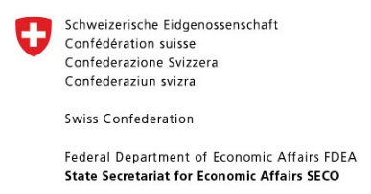
Other partners and donors

Slide 5
Thematic approach – flagship projects
The NCPC-SA applies RECP in three main thematic areas. Each of these is driven through a flagship project or programme:
NCPC-SA
+ partners
Water
Industrial Water Efficiency Project
Materials & waste
Industrial Symbiosis Programme
Energy
Industrial Energy Efficiency Project

Slide 6
Services to industry
The NCPC-SA services are highly subsidised, and are aimed at stimulating and supporting the uptake of RECP by industry:
Assessments &
Implementation
Energy, water, materials, waste efficiency
Skills development
Training courses
Internship programme
RECP Tools
Online tools and sector guides
Advocacy
Workshops, awareness & policy advice

Slide 7
RECP Finance for SMEs
Under the global RECP programme, the Finance work-stream aims to:
raise awareness; and
facilitate access to funding mechanisms; and
at the same time promoting (innovative) finance instruments for mainstreaming RECP into the operations of manufacturing enterprises.
Five target countries which are Colombia, Morocco, India, China, and South Africa.
Ernst and Young (EY) was awarded a contract to deliver tailored advisory and consulting services to NCPCs on behalf of UNIDO.
EY collaborated with the abovementioned NCPCs on the following thematic areas:
i. The development of primers on RECP Finance;
ii. Conceptualization and development of training materials;
iii. Delivering of training sessions; and
iv. Proposing and developing effective strategies on RECP planning and investment in targeted countries.

Slide 8
Outcomes: The Primer Document
Primer document is in the final stages of development.
This document provides an overview of the RECP Finance Project.
It contains information regarding
Why and how to invest in RECP projects;
The role of the NCPC-SA;
How to identify financial sources;
How to prepare bankable projects;
How to develop an enabling environment.

Slide 9
Outcomes: Training materials
The training material (and tools) was developed by EY
The material and tools will be adapted to the South African context and the information will then be disseminated through:
RECP finance for SMEs workshops in major centres throughout the country (delivered by the NCPC-SA);
Distribution of the primer document; and
Provision of updated databases of financial instruments, bankable projects as well as past success stories.

Slide 10
Outcomes: Training material – Business Plans structure and tools
Business Plan Structure
Project description
Management Team
Budget and schedule
Financial analysis of project
Financial plan
Risk management strategy
Financial institution’s role
Context overview and analysis
Non-financial analysis

Slide 11
Outcomes: Databases
Three distinct databases were developed:
Financial instruments database;
Database of projects implemented using financial instruments; and
Database of bankable projects.

Slide 12
Outcomes: Workshops
Two workshops were held in:
Pretoria and (63 delegates) –> 23-25 May 2018
East London (52 delegates)-> 28-30 May 2018
Delegates from the following sectors were invited:
SMEs,
government institutions, and
financial institutions.

Slide 13
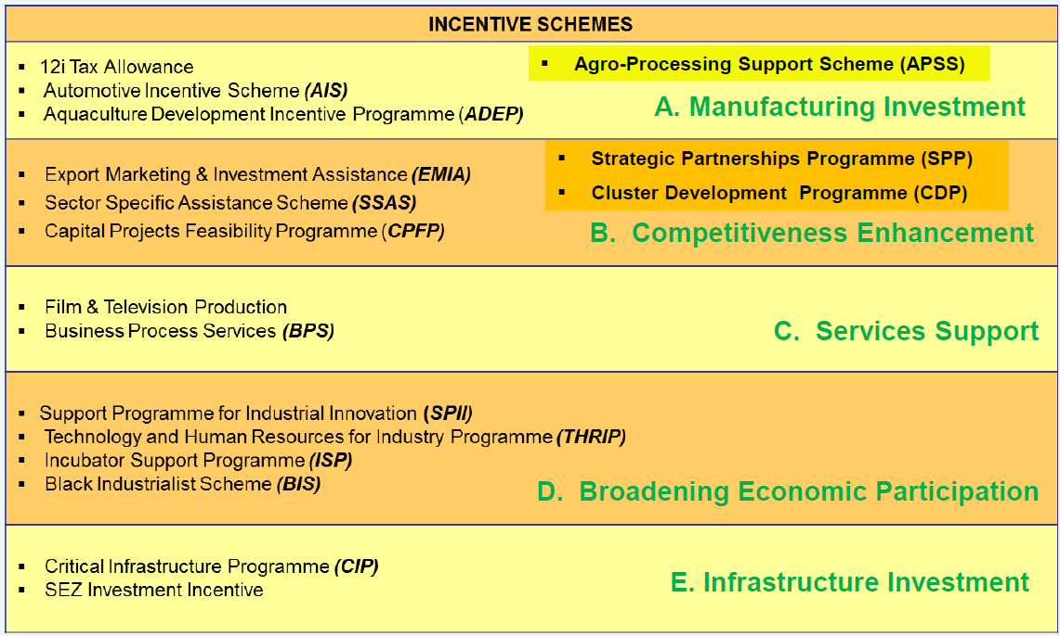
Outcomes: Workshops – dti incentive schemes
The dti presented on their incentive schemes

Slide 14
Outcomes: Workshops – Bank financing available
Three of the four major banks attended the workshops and provided input as well as information regarding available financing.

Slide 15
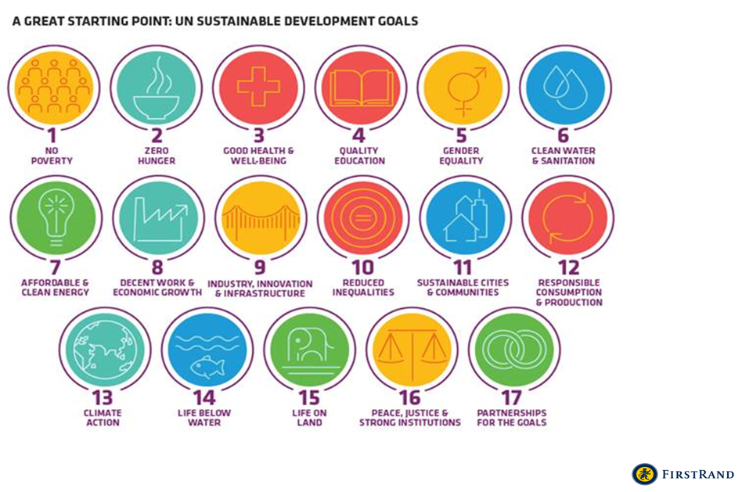
Outcomes: Workshops – Bank financing available continued

Slide 16
Outcomes: Workshops – Bank financing available continued

Slide 17
Outcomes: Workshops – IDC funding model

Slide 18
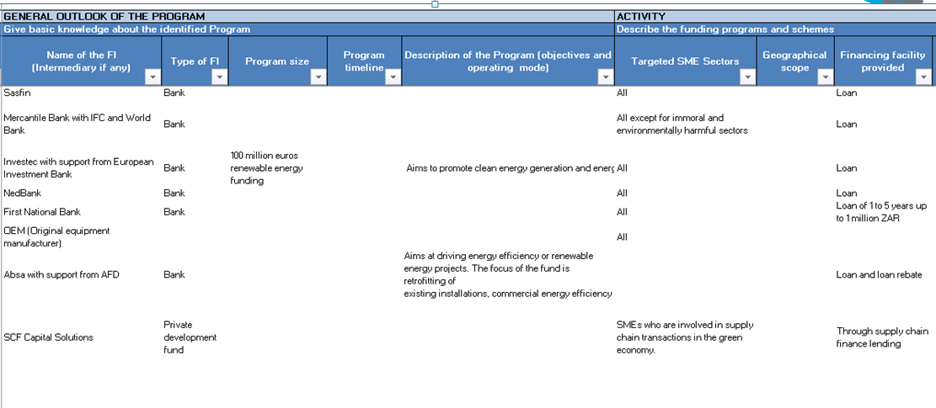
Outcomes: Databases – Financial Instruments

Slide 19
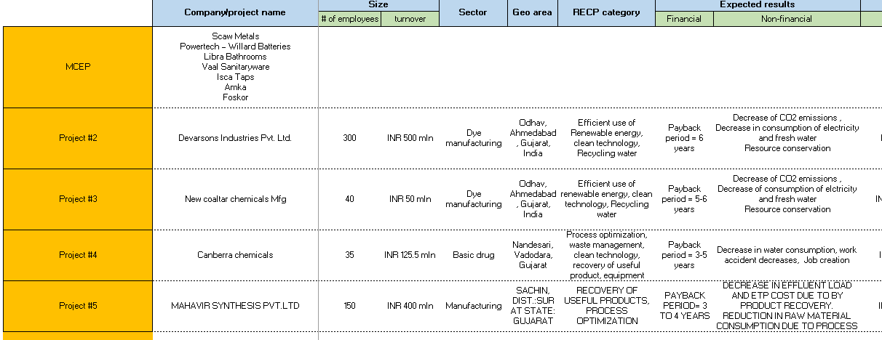
Outcomes: Databases – Bankable Projects

Slide 20
Outcomes: Databases – Past case studies

Slide 21
Summary
One of the obstacles to implementation of RECP projects is the financing of projects.
The NCPC-SA’s potential role in supporting SMEs has been identified to include:
Raising awareness on both sides (SMEs as well as Financial institutions) to fill in the information gap;
Support SMEs in their applications for funds;
Advise financial institutions to adapt their financial offers to RECP projects; and
Establish an enabling environment for RECP projects.
The NCPC-SA plans:
To roll out workshops to major centres in South Africa;
Keep databases updated and have these available on a platform for SMEs; and
Provide assistance to SMEs in the development of business plans.

Slide 22
THANK YOU
NATIONAL CLEANER PRODUCTION CENTRE
SOUTH AFRICA
ncpc@csir.co.za  www.ncpc.co.za
@NCPC_SA

