Slide 1
Hinrich Foundation Sustainable Trade Index
Stephen Olson
Research Fellow, Hinrich Foundation

Slide 2
Sustainable Trade
Engaging in international trade in a way that not only generates balanced economic growth, but also strengthens social capital and provides for environmental stewardship.
Although trade is an indispensable ingredient in economic development, it cannot be sustainably pursued without responsible environmental stewardship and a commitment to fully developing social capital
Based on UN Brundtland Commission
3 pillars: economic, social & environment

Slide 3
Creating the STI
Evaluates 19 Asian economies + USA across the 3 pillars
Process
Produced by EIU, based on literature review, expert consultations & workshops
Indicators structure
14 indicators under economic pillar
4 under social
6 under environmental
All pillars & indicators equally weighed
Hong Kong
South Korea
Singapore
Japan
USA
Taiwan
Sri Lanka
China
Vietnam
Philippines
India
Malaysia
Thailand
Indonesia
Brunei
Pakistan
Bangladesh
Laos
Cambodia
Myanmar

Slide 4
2018 Overall Results
Broad regression in sustainable trade
Most notable among richer economies
Improvements in economic pillar offset by backsliding on social & environmental
Top performer Hong Kong was a bright spot
Technological infrastructure and labor force
Steady increases in educational attainment, political stability

Slide 5
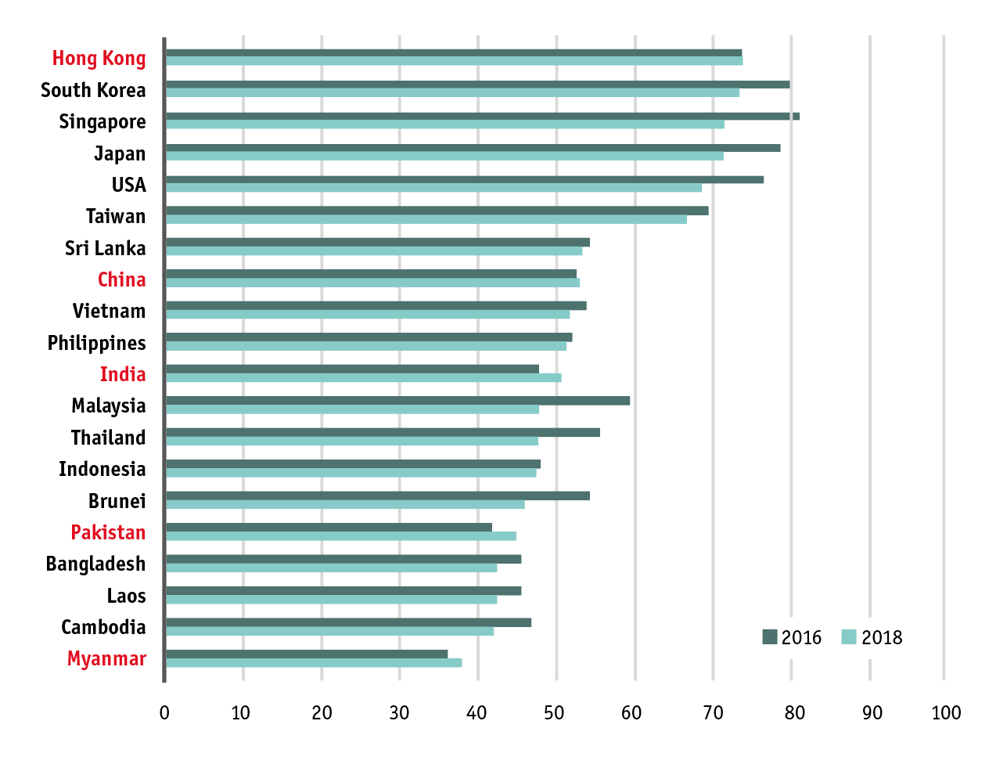
Overall Results

Slide 6
Key take-aways
Sustainability drives competitiveness
Important for FDI
Companies taking more leadership
Sustainability codes of conduct, audit procedures, company to industry wide initiatives
Profound shift over past 20 years
Trade sustainability is NOT just a luxury for wealthy countries
Low and middle income countries embracing sustainability

Slide 7
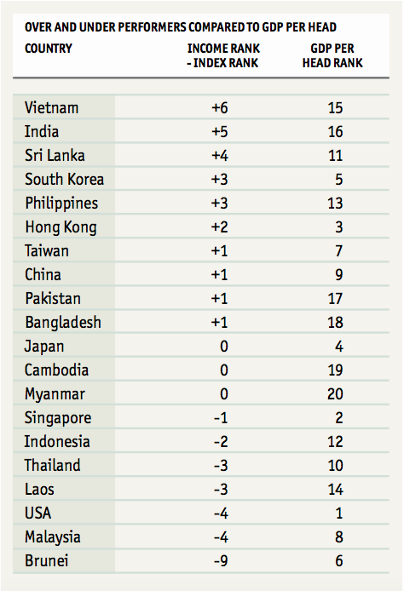
Over/under performers
Over / under-perform an alternative measure
10 economies over-perform
6 underperform
USA underperforms by 4 places

