Slide 1
Greening Infrastructure Investments Along the Belt and Road Initiative
Prof. WANG Jinnan
Chinese Academy of Environmental Planning
4 October, 2018

Slide 2
“一带一路” 海外投资状况
Investment in the BRI countries
中国企业积极参与国际基础设施建设，对外承包工程保持稳定发展
Chinese enterprises take an active part in the construction of international infrastructure， and maintain stable development of foreign contracted projects.
2017年，中国对外承包工程业务完成新签合同额2652.8亿美元，同比增长8.7%；营业额1685.9亿美元，同比增长5.8%。其中，“一带一路”沿线国家新签合同额、完成营业额分别占54.4%和50.7%
In 2017, China‘s foreign contracted projects completed the new contract amount was $265280 million, an increase of 8.7% over the same period last year. And complete turnover was $168590 million, an increase of 5.8%. Among them, the number of new contracts signed by the BRI countries accounted for 54.4% and 50.7% respectively.
中国对外承包工程业务
China's foreign contracted projects

Slide 3
“一带一路”投资面临的生态环境挑战
Ecological and environmental challenge of infrastructure investments in BRI countries
投资行业易影响生态环境
Industries can easily affect the ecological environment
沿线生态环境脆弱
Fragile ecological environment
投资的基础设施建设项目规模大、建设周期长、运营周期更长，多属于高生态环境影响和高污染排放行业，对生态环境的影响较大，有时甚至是不可逆的影响。
部分国家经济发展方式和资源开发利用方式仍比较粗放，人类活动强度剧烈，生态环境比较脆弱，环境承载能力较低，人与自然之间的矛盾尖锐
with long construction cycle and longer operation period, large infrastructure investments are mostly high ecological environment impact and high pollution emission industries, which have a great impact on the ecological environment, sometimes even irreversible impact.
In some BRI countries, the mode of economic development and resource exploitation is still extensive, and the intensity of human activities is intense, while the ecological environment is fragile and the contradiction between man and nature is sharp.
Notes:
比如，水库大坝建设，对于被淹没的文物古迹、生物多样性、河谷地质地貌等的影响；道路桥梁等基础设施建设往往需要砍伐森林、开山凿洞，对植被、地下水、动物迁徙等也会产生影响；城市基础设施建设对肥沃农用地的占用，地下管道铺设不当和绿地的减少，增加了城市内涝的频率等等。

Slide 4
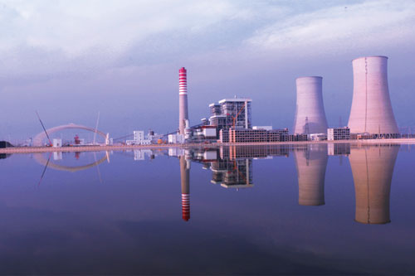
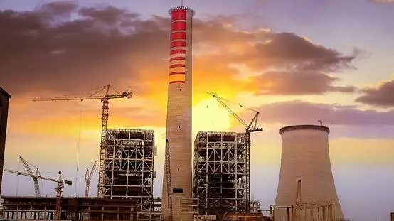
巴基斯坦萨希瓦尔燃煤电站项目
Csathy Val Coal-fired Power Generation in Pakistan
萨希瓦尔燃煤电站项目于2015年7月正式动工，2017年6月8日两台机组全面投产
该电站是中巴经济走廊首座投产发电的高效、清洁、环保大型燃煤电站，也是目前巴基斯坦单机容量最大、技术最先进、环保指标最优、建设速度最快的燃煤电站，被巴基斯坦政府誉为“巴电力建设史上的奇迹”
This project was officially launched in July 2015, and put into operation in June 8, 2017.
This project is the first large-scale coal-fired power station with high efficiency, cleanliness and environmental protection in China-Pakistan economic corridor. It is also the largest single-machine capacity, the most advanced technology, the best environmental protection index and the fastest construction speed coal-fired power station in Pakistan. It is praised by the Pakistani government as "the miracle in the history of Pakistan's power construction"

Slide 5
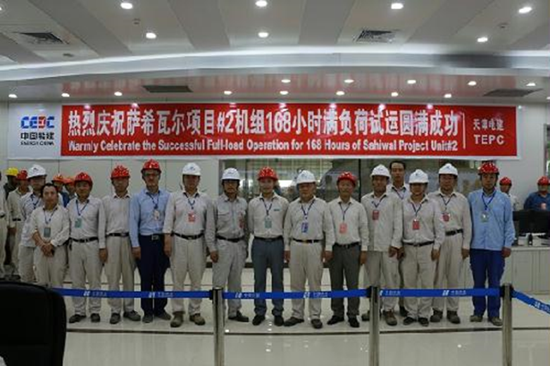
萨希瓦尔燃煤电站项目环保经验
Environmental experience of Csathy Val Coal-fired Power Generation
建立良好政企关系，坚持共商原则
Establishing a good relationship between government and enterprises and adhering to the principle of cooperation
健全环保制度，强化监管手段
Improving environmental protection system and strengthening supervision means
定期进行环境监测，接受社会各界环保监督
Carrying out environmental monitoring and accepting supervision of the community
严格执行东道国环境质量标准
Implementing the host country's environmental quality standards
煤耗和污染物排放指标达到国际先进水平
Coal consumption and pollutant emission were reached the international advanced level
宣传环保理念，消除政府和公众的环保顾虑
Publicize the concept of environmental protection to eliminate the environmental concerns of the government and the public
积极维护当地生态环境
Maintaining the local ecological environment

Slide 6
推进绿色基础设施投资的建议
Suggestions for building green industry Infrastructures along BRI
投资前Before investment
政府部门：加强顶层设计，包括完善法律法规标准、开展综合生态环境影响评估等
Government：Strengthening top-level design
投资企业：加强政策学习，包括系统收集和熟悉国内、国际和投资东道国环境保护相关法律法规标准、加强项目可研阶段环境影响评价等
Enterprise：Strengthening policy learning
金融机构：加强绿色金融服务，主要是探索建立海外绿色投融资机制等
Financial institution：Strengthening green financial services
社会组织：加强咨询服务，包括分区域或国别系统介绍环境管理机构、法规标准、基本环境制度、环境执法、环境仲裁诉讼及环境应急管理等信息
Non-governmental organization: Strengthening advisory services

Slide 7
推进绿色基础设施投资的建议
Suggestions for building green industry Infrastructures along BRI
投资中During investment period
政府部门：加强动态监管，包括引导投资企业提升环境保护能力、引导企业加强与当地利益相关方的沟通、实施环境引导类政策工具包等
Government：Strengthening dynamic supervision
投资企业：认真履行社会责任，包括加强企业内部绿色运营管理体系建设、重视和遵守当地环境法律法规、加强项目全过程环境评价、注重援助社区发展等
Enterprise：Fulfilling their social responsibilities
金融机构：加强风险控制，主要是加强贷款项目绿色绩效评估、发行绿色债券等
Financial institution：Strengthening financial risk control
社会组织：加强服务援助，包括开展形式多样的生态环保公益活动，搭建投资者与当地沟通合作的桥梁等
Non-governmental organization: Strengthening service assistance

Slide 8
推进绿色基础设施投资的建议
Suggestions for building green industry Infrastructures along BRI
投资后After investment
政府部门：加强评估总结，包括及时总结典型案例及经验教训，推广先进做法和成功经验等
Government：Strengthening evaluation summary
投资企业：加强能力建设，包括总结经验教训，提升和完善环境保护管理能力等
Enterprise：Strengthening capacity building
金融机构：完善绿色金融，包括调整完善绿色金融体系、强化环境损害鉴定评估程序和技术规范等
Financial institution：Improving green finance
社会组织：加强科普宣传，包括积极宣传报道典型案例、推广相关成功经验等
Non-governmental organization: promotion of popular science knowledge

