Slide 1
Sustainable Environmental Management
Country Programme for
Inclusive and Sustainable Industrial Development in the Republic of Moldova
2019 - 2023
Launch Event
Tuesday, 14 May 2019

Slide 2
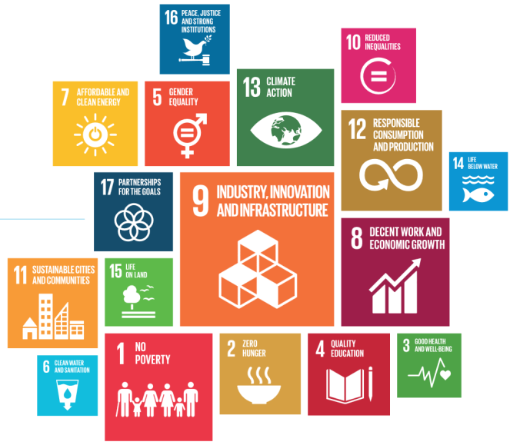

UNIDO’s Mandate:
Inclusive and Sustainable Industrial Development (ISID)
Advancing Economic Competitiveness
  Advancing economic and industrial growth
Creating Shared Prosperity
  Advancing poverty eradication and inclusiveness
Safeguarding the Environment
  Advancing environmentally sustainable growth
Management Priority
  Promoting Green Industry and a Circular Economy

Slide 3
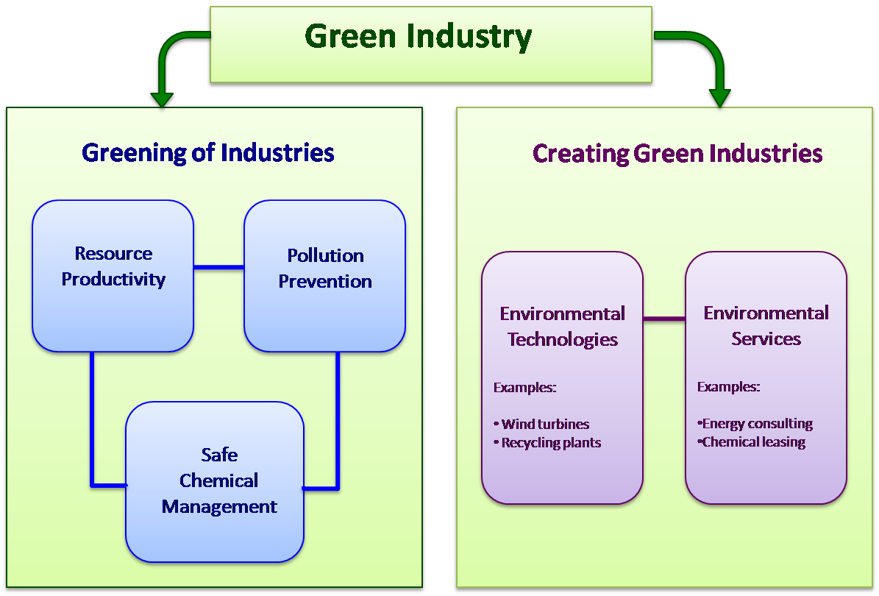
What does it mean practically?

Slide 4
One Solution: Circular Economy
UNIDO promotes a model of industrial development that is inclusive and sustainable
The Department of Environment helps transform industries into contributors to the circular economy by:
  Reducing or eliminating the production of pollution or waste
  Re-using resources or ensuring their safe re-absorption by the environment
A circular economy is restorative and regenerative by design
Cleaner production with less resource use
Green products – no hazardous substances, long life, easy to recycle
Extending lifetime through better service
Collect at end-of-life
Separate waste, reuse resources

Slide 5
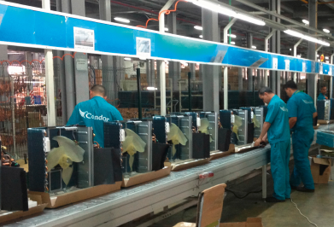
Phase-Out of Ozone Depleting Substances (ODS)
Scope of Work
  Upgrading industry and converting production lines
  Building capacities and skills of technicians for servicing
  Increasing product useful lifespan
Key Programmes, Projects and Activities
  HCFC Phase-Out
    Conversion of production lines in foam, refrigeration and air-conditioning sectors
  Methyl Bromide
    Identifying and implementing MB alternatives
  Climate Impact
    UNIDO activities under the Montreal Protocol saved
    340 million tonnes of CO2 equivalent
  Industrial Upgrading
    Deployment of clean technologies/equipment and
    training of technicians for better environmental
    footprint and improved market access
5

Slide 6
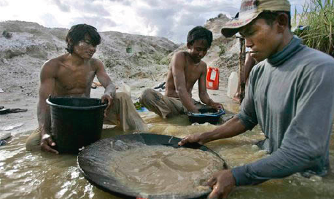
Compliance with Emerging Environmental Regulations
Scope of Work
  Promoting proactive standards conformity to meet regulatory and market demands
  Reducing toxic emissions of industrial activity
  Creating economically sustainable industries and industrial production models
Key Programmes, Projects and Activities
  Minamata Convention on Mercury
    Reducing mercury use in small-scale gold mining and eliminating mercury from processes and product
  Other Heavy Metals: Lead, Cadmium, etc.
  Nitrous Oxide (N2O)
    Mitigating N2O releases by agro-industries
  Kigali Amendment to the Montreal Protocol
    Hydrofluorocarbons (HFCs) - Scoping prevalence of HFCs for
    eventual phase-out
6

Slide 7
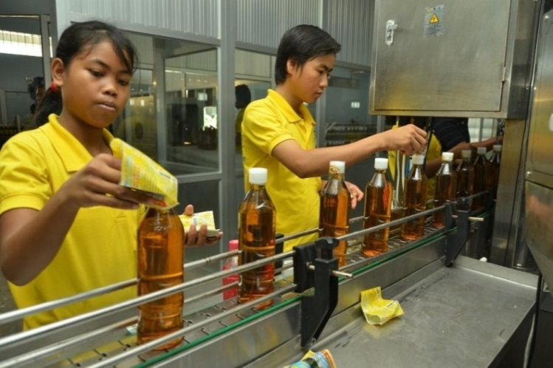
Resource-Efficient Industrial Production
Scope of Work
  Optimizing production efficiency /use of natural resources
  Improving eco-efficiency and resource productivity
  Reducing waste, emissions and negative environmental impacts
  Mitigating risks to workers, communities and consumers
Strategy: Transfer of Environmentally Sound Technology (TEST), Capacity building, awareness raising, demonstrations & pilots
Key Programmes, Projects and Activities
  Resource Efficient and Cleaner Production (RECP)
    Promoting RECP in 60+ countries through network of 70+ members (RECPnet)
  SWITCH Med / Med-TEST
    Fostering social and eco-innovations for circular economy promotion in
    the Mediterranean
  Eco-Industrial Park Development
    EIP establishment in Africa, Asia, Latin America
  Chemicals Management
    Innovation and alternative business models
7

Slide 8
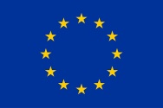
Greening Economies in the EU’s Eastern Neighborhood
EaP GREEN
This project is funded by the European Union
  EU-funded action: 10 million EUR (UNIDO, 2.5 M EUR)
  Duration: 2013 – 2016
  Countries: Armenia, Azerbaijan, Belarus, Georgia, Moldova & Ukraine
  Implementing agencies: OECD, UNECE, UNIDO, UN Environment
UNIDO component - Regional RECP Demonstration Project
Improve the resource productivity and environmental performance of SMEs thereby contributing to a Green Economy & Sustainable Industrial Development in the EaP region .
Results (regional)
133 RECP experts trained
RECP applied in 341 SMEs and other organizations
9.4 M EUR in RECP savings identified
5 M EUR in RECP investments implemented by project end
www.green-economies-eap.org

Slide 9
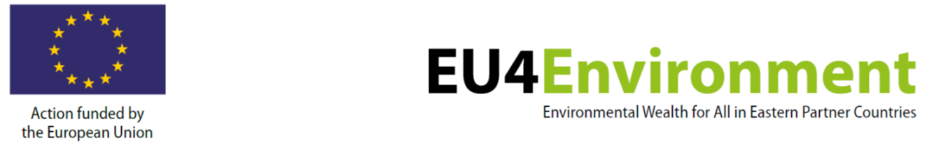
  EU-funded action: 19.5 million EUR (UNIDO, 3.8 M EUR)
  Duration: January 2019 - November 2022
  Countries: Armenia, Azerbaijan, Belarus, Georgia, Republic of Moldova and Ukraine
  Implemented through three contracts with five international organisations: OECD, UN Environment, UNECE, UNIDO, World Bank
  UNIDO Outputs:
    Output 2.1: Resource Efficient and Cleaner Production and eco-innovation among SMEs scaled up
    Output 2.2: Concept and tools of the EU Single Market for Green Products initiative introduced and promoted

Slide 10
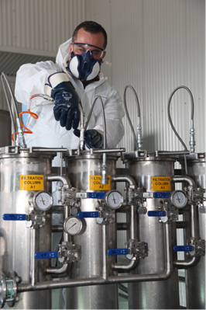
Elimination of Persistent Organic Pollutants (POPs)
Scope of Work
  Re-tooling industries for better POPs management
  Building local technical capacities and creating awareness
  Transfer of environmental technologies and practices
  Developing new POPs-free industries
Key Programmes, Projects and Activities
  Eliminating Unintentional POPs
    Increase efficiency and reduce POPs releases in key sectors
  Non-Combustion Technology
    Environmental management of PCB equipment and waste
  POPs-Free Industries
    Promoting alternatives to POPs in product manufacture
  Recycling Chains
    Reducing potential for POPs releases in recycling industries
10

Slide 11
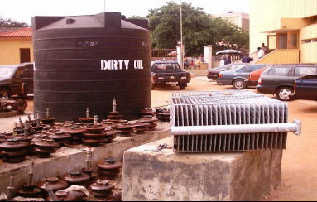
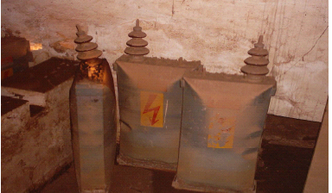
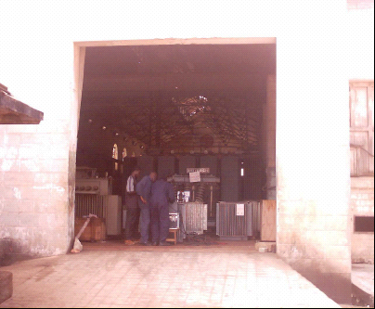
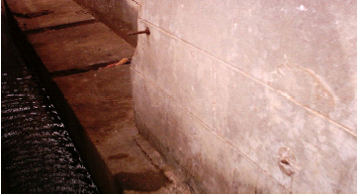
PROJECT DESIGN
Environmentally Sound Management (ESM) and Disposal of PCBs
Overcome the barriers that impede the implementation of PCB-related obligations of the SC
  Capacity building
  Regulatory/Policy framework
  Information dissemination and awareness raising
Disposal Technologies
Public Private Partnerships
GEF-funded

Slide 12
PCB Decontamination and Disposal
Traditional option -> INCINERATION
  Still cost-effective for pure or high concentration PCBs oils (> 2,000 ppm) and capacitors
Non-combustion technologies offer
  On-line or on-site treatment
  Cleaned equipment and oil are reusable
Therefore, a resource-efficient and practical option.

Slide 13
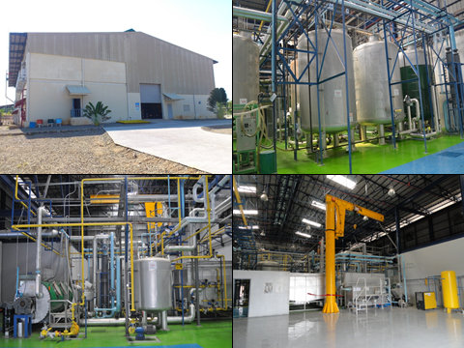
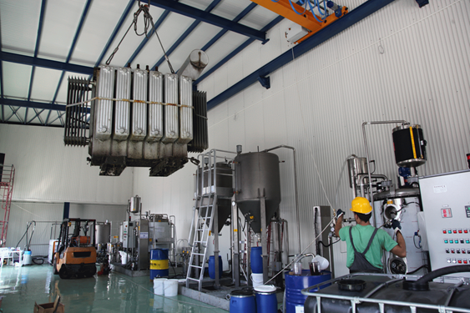
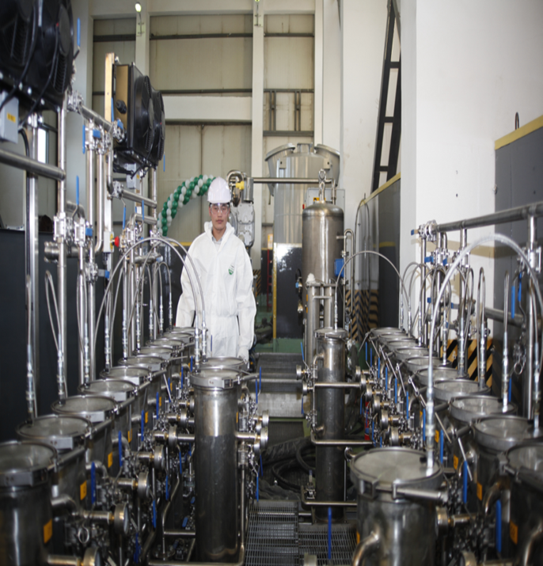
Macedonia noncom facility
Philippine noncom facility
Mongolia noncom facility

Slide 14
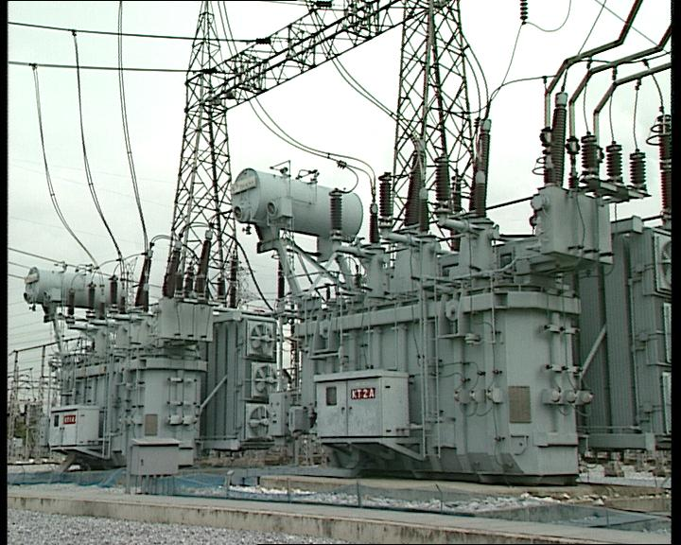
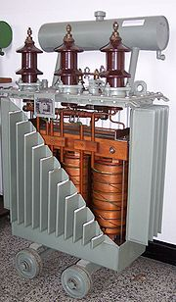
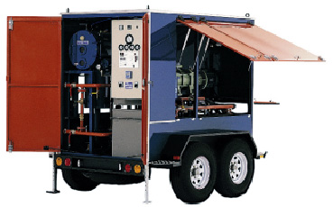
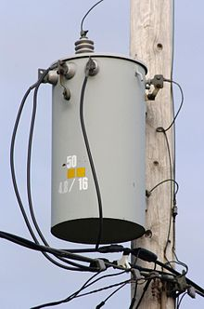
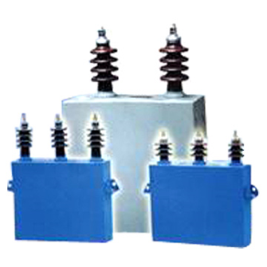
PCBs may still exist in the oil system
New oil
Power transformers
Oil regeneration unit
Capacitors
Distribution transformers

Slide 15
THANK YOU FOR YOUR ATTENTION
Adegboyega AJANI
Industrial Development Officer
UNIDO Stockholm Convention Division
A.Ajani@unido.org

