Slide 1
Component II Productive employment for rural communities and entrepreneurship development
UNIDO Country Programme for ISID in the Republic of Moldova 2019-2023
Launch event
Chisinau
Ms. Milica Dimitrijevic
Rural Entrepreneurship, Job Creation and Human Security Division
Department of Agri-Business

Slide 2
UNIDO Department of Agri-Business (PTC/AGR)
The Department provides a wide range of technical cooperation services:
analyses of agri-business value chains;
vocational training and industrial skills development activities;
youth and women empowerment and entrepreneurship;
food safety and security;
agricultural mechanization and innovation;
modern processing technologies;
Design and development of Agro-industrial parks, Agro poles, Staple Crops Processing Zones (SCPZ), etc.
The Department consists of three Divisions:
Rural Entrepreneurship, Job Creation and Human Security Division (PTC/AGR/RJH)
Food Systems and Nutrition Division (PTC/AGR/FSN)
Agro-Industries Technology Division (PTC/AGR/AIT)

Slide 3
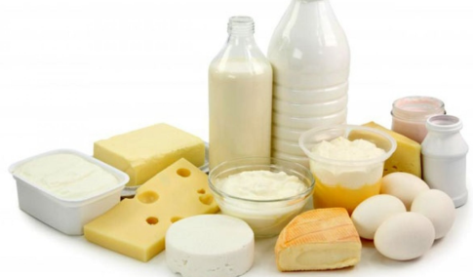
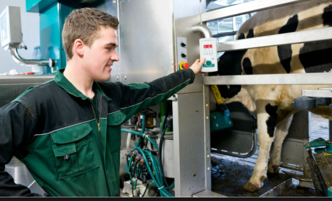
Component II Productive employment for rural communities and entrepreneurship development
Key challenges:
High (youth) unemployment, causing increasing informal employment and outward migration
Scarce processing capacities and fragmented value chains
Poor organization among farmers and lack of efforts to promote their products on domestic and international markets
Underdeveloped organic traditional agri-food niche with unexploited export potential
Low technological preparedness and lack of post-harvest infrastructure
Underutilized tourism sector
Indicators:
Annual increase in the turnover of MSMEs and agri-food clusters focusing on milk and meat clusters
Number of locally produced and processed agri-food products
Number of jobs in the food processing industry
Employment rate at the local level
Increased average monthly wage in rural areas

Slide 4
UNIDO’s response
Linking agricultural producers and handicrafts makers with the tourism sector
In accordance with the national priorities UNIDO’s intervention will be threefold focusing on the following
sub-components:
Empowering Moldova’s youth through enhanced employability and entrepreneurship promotion;
ii. Livestock-sector development– revival of the milk and meat production in Moldova;
iii. Linking agricultural producers and handicrafts makers with the tourism sector in Moldova.
Livestock-sector development– revival of the milk and meat production
Empowering Moldova’s youth through enhanced employability and entrepreneurship promotion
Partnership building
Innovative financing

Slide 5
Scope of Intervention
Overall Objective
The proposed intervention aims to contribute to job creation and the revival of the dairy and meat sectors through capacity building, skills development and entrepreneurship promotion, while applying environmentally friendly farming practices and developing linkages with the tourism industry.
Target beneficiaries
Young women and men, VET graduates, farmers and agricultural producers, MSMEs operating in milk and meat sectors;
Farmers groups and producer networks (focus on milk, meat, hides, skins, wool sectors)
Business support institutions, relevant sectorial associations.
Geographical focus
To be determined

Slide 6
Empowering Moldova’s youth through enhanced employability and entrepreneurship promotion
Objective:
to engage local young women and men in productive processes by:
enhancing their entrepreneurial skills and employability,
providing necessary tools to effectively start and run (social) enterprises in the formal sector,
mitigating outward migration and rural-urban mobility among youth.
Expected Outcome:
Social and economic participation of youth will be improved by strengthening the entrepreneurial environment, particularly with a view to fostering youth-led entrepreneurship.
Key Outputs (*KPIs):
Targeted tailor-made skills development trainings provided for rural entrepreneurs and emerging MSMEs
*at least 500 beneficiaries received training (70% of assisted youth successfully establish enterprises (i.e. develop business plans and benefit from innovative financing) or found employment in emerging MSMEs
*at least 50 MSMEs benefited from the project
*at least 400 new jobs created
Enterprise development programme developed in collaboration with the public, private sector and business support institutions at the meso level
Incubation centers populated with necessary equipment and Incubation/acceleration services provided to targeted beneficiaries
*At least 6 of the existing centers operational
An operational manual for a business incentive mechanism developed

Slide 7
Innovation, Development and Entrepreneurship for All (IDEA)
comprised of 5 modular steps:
Market assessment and value chain analysis
skills development
soft incubation
networking, clustering and strengthening of business linkages
sustainable enterprise growth

Slide 8
Livestock sector development – revival of the milk and meat production
Objective:
technical assistance to the development of milk, meat, leather and wool value chains - for increased food security and safety, move towards the production of high value-added products, rather than focusing on export of raw products.
Expected Outcome:
Livestock sector will be revived through the implementation of the National Livestock Sector Development Strategy, contributing to higher productivity and marketability of high-quality traditional products.
Key Outputs (*KPIs):
TA provided in National Livestock Sector Strategy implementation;
*degree of implementation of the Strategy’s Action Plan (75% of envisaged activities for that duration)
Upgraded VET curricula in milk and meat sectors;
*new generation of students enrolled under the new curricula by 2023
Skills development on good farming practices for dairy and meat sectors for production of high-quality products and by-products;
*at least 200 farmers & processors able to apply innovative practices and technologies
*increase in meat and milk-products supply and exportability
*at least 5 new high-quality/ value added products developed by 2023
Relevant government institutions and MSMEs operating in targeted sectors supported in attracting investments;
*at least 50 MSMEs accessed finance as a result
*amount of investment leveraged

Slide 9
Linking agricultural producers and handicrafts makers with the tourism sector in Moldova
Key Outputs (*KPIs):
The tourism services in each of the targeted regions have increased competitive advantage by highlighting flagship products
*20 of traditional products mapped, branded and marketed
*Increase in sales of traditional products by 2023
Value chain performance around selected agri-food and handicraft flagship products is strengthened in relation to market access, job creation, innovation and value addition.
*At least 200 jobs created through the project interventions
*At least 2 Marketing and Product Development exposure events held & at least 150 B2B meetings held throughout the project period
Capacity building for marketing and umbrella branding based on best practices
*Territorial umbrella brand created for the selected flagship products (at least 70% of the newly developed products branded and marketed)
Objective:
to enhance territorial competitiveness based on flagship traditional products for at least two regions/municipalities (with touristic potential).
Expected Outcome:
Producers of traditional products will enhance access to buyers through the development of strong linkages with tourism industry and territorial branding.

Slide 10
Indicative Planning Figures
Foreseen Overall Budget € 7,250,000 over the period of four years
Subcomponent | Duration | Budget
Empowering Moldova’s youth through enhanced employability and entrepreneurship | 3 years | EUR 2,000,000
Livestock-sector development – revival of the milk and meat production | 4 years | EUR 4,500,000
Linking agricultural producers and handicrafts makers with the tourism sector | 3 years | EUR 750,000

Slide 11
Development Partner Mapping
Multilateral
European Union (EU)
World Bank
European Bank for Reconstruction and Development (EBRD)
Technical
FAO, IFAD, ILO, UN Women, UNDP, UNICEF, IOM, UNFPA
Bilateral
Romania,
Sweden, Germany, Austria, Switzerland, China, Poland,
Hungary, Georgia

Slide 12
Examples of successful UNIDO interventions in livestock sector across the world

Slide 13
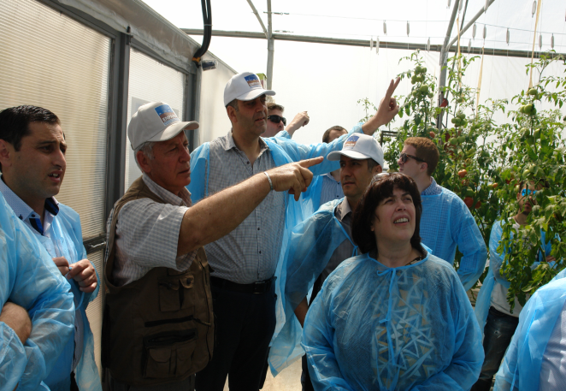
Armenia Producer Group and Value Chain Development joint UNIDO/UNDP component under ENPARD (2012-2018) Budget: EUR 3,700,000
Objective:
to provide services to improve the capacity of farmers associations and cooperatives
to establish and strengthen livestock, fruits and vegetables value chains contributing to the improved agricultural inputs and production systems in rural areas, while applying environmentally friendly farming practices.
Results:
45 new business-oriented farmers groups are officially registered and operational, with approved business plans, covering both agricultural and non-agricultural activities;
Of these, more than 40% are women-led;
51 cooperatives registered/ 2 cooperative-of-cooperatives registered;
The groups received training and coaching at least 1,000 farmers are trained on matters of improved primary production and group organization;
Products from assisted producer groups attained at least 20% increase in annual turnover.
Support provided to governmental agencies and partner organizations to better coordinate, support and link value actors;
Producer groups introduced to financing schemes, and supported to secure loans
*206,220 euro of additional grants mobilized
*115,301 euro of borrowing by farmers

Slide 14
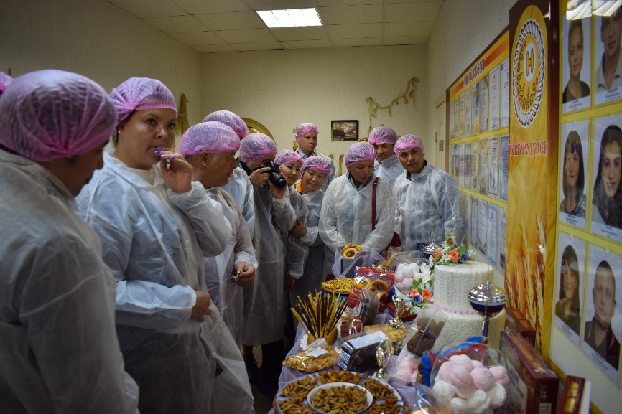
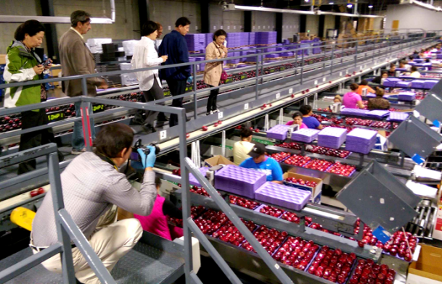
Kyrgyz Republic Linking the tourism industry to productive activities in the Issyk-Kul region (2015-2019) Budget: USD 2,000,000
Objective:
to stimulate economic growth and employment through promoting tourism sector and related productive industries in the Issyk-Kul region.
Exposure to best practices and results:
More than 300 people trained on Food Safety and Security Standards and implementation of HACCP principles for food processors and catering service providers
180 on Sustainable eco tourism
4 Study tours for agro-processors to Uzbekistan, Russia, Spain and Slovenia (45 beneficiary companies)
2 Marketing and Product Development exposure events (184 participants and 162 B2B meetings)
Communication strategy developed and is implemented - design and launch of marketing campaigns for promotion of the newly developed and upgraded products in target markets.
Provision of new equipment, facilities and machineries with Industry 4.0 elements:
Productivity improvement, export growth and new products for tourists
Additional income for more than 300 households
Establishment of the modern training-production center for herbal tea manufacturing according to HACCP
Local sourcing of raw materials (more than 150 households – 75% woman)
Employment and income generation
Promotion of positive image of Issyk-Kul region
Export promotion

Slide 15
Thank you for your attention!
For more information please contact:
Mr. Bashir Conde, Industrial Development Officer or
Ms. Milica Dimitrijevic, Project Associate
Rural Entrepreneurship, Job Creation and Human Security Division
UNIDO
Email: b.conde@unido.org / m.dimitrijevic@unido.org

