Slide 1
TRANSITION SYSTEM PERSPECTIVES ON A CIRCULAR TOURISM ECONOMY
JESPER MANNICHE
CENTRE FOR REGIONAL AND TOURISM RESEARCH/DENMARK
UNIDO CONFERENCE, “CIRCULAR TOURISM IN SOUTH EAST EUROPE”, LJUBLJANA, MAY 8, 2018

Slide 2
CONTENT
Introduction to the different dimensions of the Circular Economy
A multi-level transition perspective on the emerging circular economy
The implications of the circular economy in tourism – at production and consumption side

Slide 3
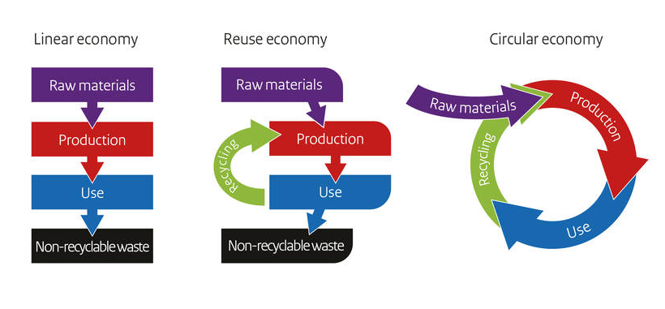
What is the Circular Economy? From the linear via the sustainable to the circular economy
Definition of Circular Economy (Kirchherr et al. (2017):
”A circular economy describes
an economic system
based on business models which replace the end-of-life concept with reducing, alternatively reusing, recycling and recovering materials
in production/distribution and consumption
thus operating at the micro-level (products, companies, consumers), meso-level (eco-industrial parks, supply chains), and macro-level (city, region, nation and beyond)
with the aim to accomplish sustainable development, which implies creating environmental quality, economic prosperity and social equity to the benefit of current and future generations.”
Notes:
Et alternativ til den lineære økonomiske vækst model - Producér, brug, smid-væk
Værdiskabelse baseret på vækst i forbruget – både i mængden og i kvaliteten
Det er ikke bæredygtigt for vores klode, vi har simpelthen ikke ressourcer nok til at fortsætte.
Men den forbrugende del af verdens befolkning er stigende, hvorfor vi kan forvente øget produktion.
Den bæredygtige økonomi lægger vægt
Ikke i udgangspunkt drevet af forbrugere – men meget overlap på forretningsmodel niveau med andre forbrugertrends
Primært tænkt i industrien og i relation til teknologiske løsninger (Kina)
EU: de nye forretningsmodeller som vækstpotentiale.
Ellen MacArthur: ikke et alternativ til vækst, men et alternativ til hvordan vi tænker og gør vækst
Fordrer et nyt økonomisk paradigme på system-niveau
Vindere og tabere…

Slide 4
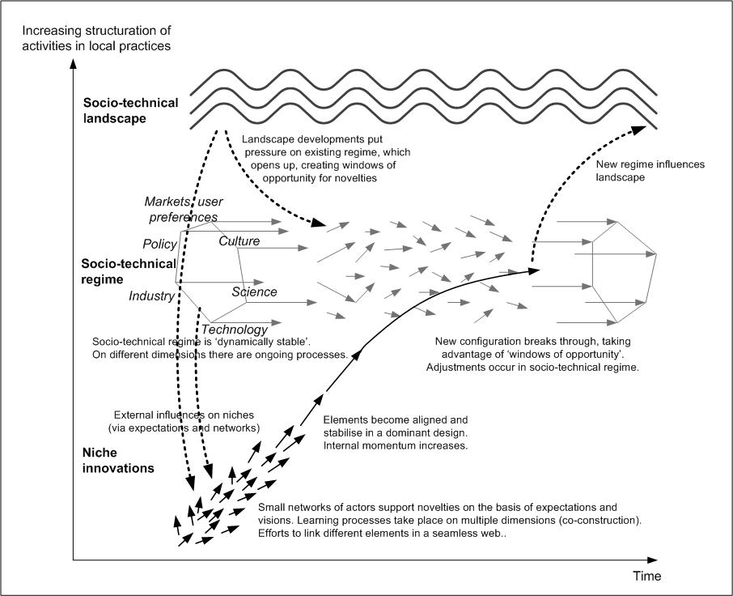
THE EMERGING CIRCULAR ECONOMY: A TRANSITION SYSTEM PERSPECTIVE
The circular economy is (maybe) emerging through change processes at multiple levels:
niches, regime, landscape (Geels & Schot, 2007).
Currently, the linear economy forms a dominant socio-technical regime, sustained by laws, regulation, infra-structures, markets, knowledge, cultural norms etc. (“dynamically stable”).
Innovations of circular technologies/solutions are realized in smaller niches by networks of actors (social, practice-based learning). Gradually, technological elements become aligned and integrated.
At overall landscape level, economic, political, social, environmental developments (e.g. climate change, rising prices of resources, the Paris agreement, globalization, new medias, new consumption patterns) put pressure on the linear regime (“windows of opportunities”) and encourage niche-level innovations.
In combination, landscape-level developments and niche-level innovations challenge the linear regime and provoke systemic re-configuration.
Source: Geels & Schot, 2007, p. 401

Slide 5
THE IMPLICATIONS OF CIRCULAR ECONOMY IN TOURISM
Tourism is a sector with a bad sustainability reputation (big CO² footprint due to the traveling element; vast use of energy, water and natural resources; destructive impact on local cultures and communities).
However, tourism has potentials in terms of encouraging transition to a circular, more sustainable economy – at production as well as consumption side
Production side opportunities: saving costs and reducing use of resources: Tourism businesses such as hotels and restaurants use a lot of natural resources (building materials, energy, water, food, furniture, electric equipment, etc.) and thereby have opportunities of saving costs and reducing use of resources by implementing circular principles (reduce, reuse, recycle) in their operation and supply chains. For examples: - Energy efficient buildings and electrical equipment
- Water-saving laundry technologies
- Extending the life of furniture, fixtures and equipment through repairing/remanufacturing
- Reducing food waste through new practices (produce on demand, smaller buffet plates, staff awareness, etc.)

Slide 6
THE IMPLICATIONS OF CE IN TOURISM (II)
Production side opportunities: new products/revenue sources:
Sale/redistribution of food “waste”
Sale/redistribution of used furniture, matrasses, building materials, fixtures and “bi-products” (remanufacturing and up-cycling)
Rental of electrical cars and other sustainable means of transportation
Etc.

Slide 7
THE IMPLICATIONS OF CE IN TOURISM (III)
Compared to other sectors, tourism has special opportunities of encouraging transition towards more sustainable consumption, i.e. “Transformative Tourism” (UNWTO, 2016).
Tourism is “Experience Economy” (Pine & Gilmore, 2007), i.e. co-creation of producers and consumers of intrinsic, memorable experiences.
Tourism relies on an interpersonal host/guest relationship, which gives opportunities for ‘deep’, value-based interaction and for influencing the way guests think and behave not just during but also after their holiday.
The Sharing Economy:
As tourists, we carry very little with us, let ourselves immerse in new surroundings and socio-technical setups, and use the properties of other people, e.g. a room and a bed to sleep in. This means that tourism has the capacity to experiment with the way daily life is organized. It presents an opportunity for tourists to enter into “Living Labs”, in which they can experience, play with and radically re-think the organization of daily life. This is not only interesting from a societal perspective, but represents a market opportunity for tourism businesses and tourism destination organizations.

Slide 8
SUMMING UP:
A multi-level transition system perspective is needed in order to understand the open-ended social dynamics through which a new Circular Economy regime (maybe) emerges. Overall “landscape” developments and technological innovations in “niches” put pressure on the prevailing linear “regime” and provoke systemic re-configuration.
Tourism has potentials for encouraging transition to a circular economy, especially regarding the consumption side. The term “Transformative Tourism” (UNWTO, 2016) refers to the opportunities of exploiting the host/guest relationship for creating “Living Labs” in which tourists experience, play with and radically re-think the organization of their daily life.

Slide 9
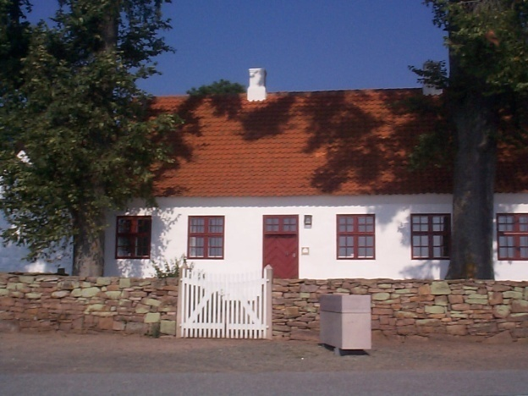
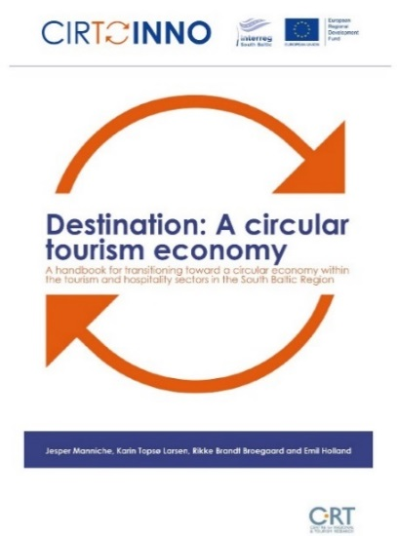
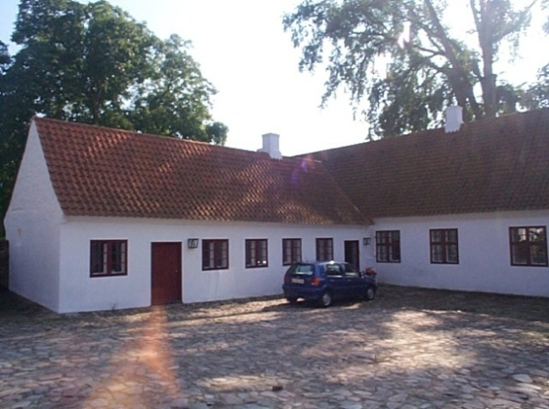
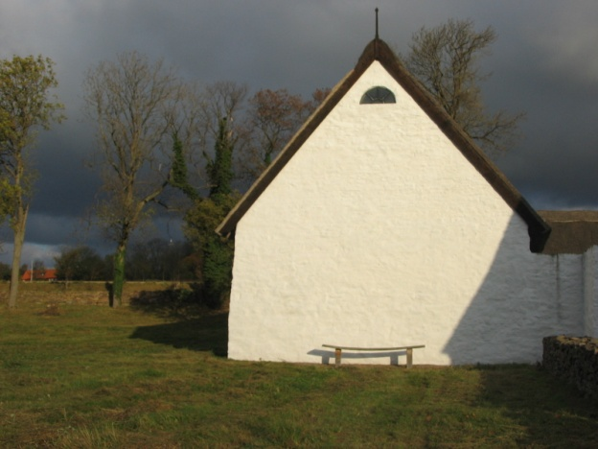
That you for your attention!
Jesper Manniche
Senior Researcher
manniche@crt.dk
www.crt.dk
http://cirtoinno.eu/ce-handbook
9

