Slide 1
Product-service System – Business Strategy for the Circular Economy
Ljubljana, 08.04.2018.
Vojislavka Šatrić

Slide 2

Circular Economy
Economic model are based among other on
sharing,
leasing,
reuse,
repair,
refurbishment and
recycling,
in an almost closed loop,
Idea is to retain the highest utility and value of products, components and materials

Slide 3


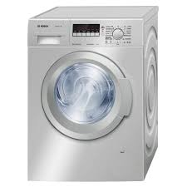
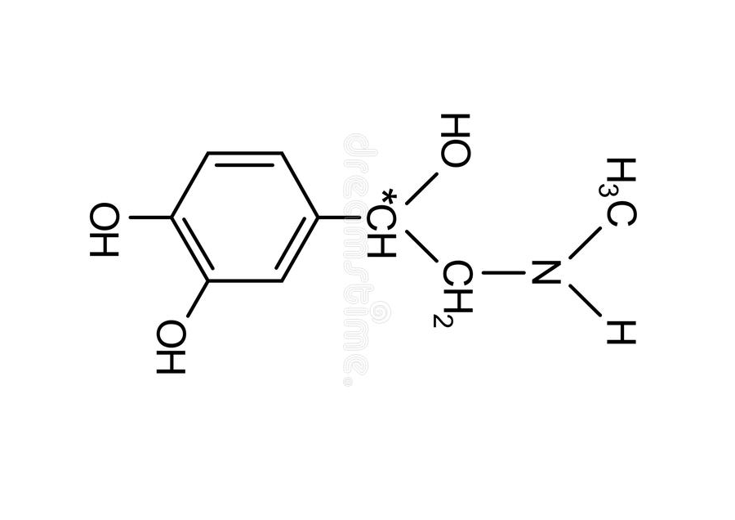
The Circular Economy is about performance
It is not about volume or chemical formula of detergents, but about its washing performance or about mechanics of washing machine but about how well and how long it can wash the laundry

Slide 4

It is possible to meet these requests only through new business models and collaboration
Move from a product-based economy to a performance-based economy involving greater use of services around products.
Product / service provider takes the responsibility for the performance of the product provided
PRODUCT-SERVICE system supposed to have the potential to be environmentally friendly.

Slide 5
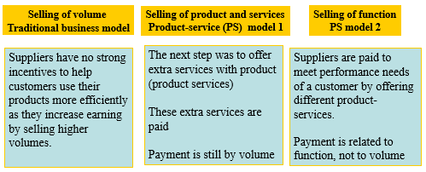
Product-service System
Product-service system represents a restructuring of the traditional relationship between supplier and user towards shift in focus, from selling volume, to selling function of products

Slide 6
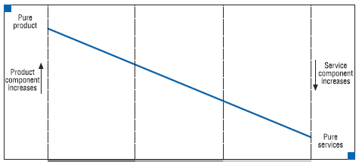
The gradual transition from the traditional business models to the product-service models
Traditional
model
Product-service
model 1
Product-service
model 2
Source: Chemical product services in the EU, European Commission 2006

Slide 7

Business Model
ChL is a service-oriented business model that shifts the focus from increasing sales volume of chemicals, toward a value-added approach.
The producer mainly sells the functions performed by the chemical, and functional units are the main basis for payment. Functional unit could be e.g. number of pieces cleaned, surface of coated area….
In essence, the business model implementation decouples payment from volume

Slide 8
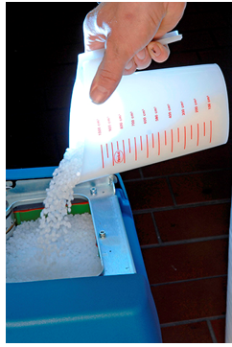
Business Model
Chemical Leasing (ChL) = Leasing of Chemicals?

Slide 9
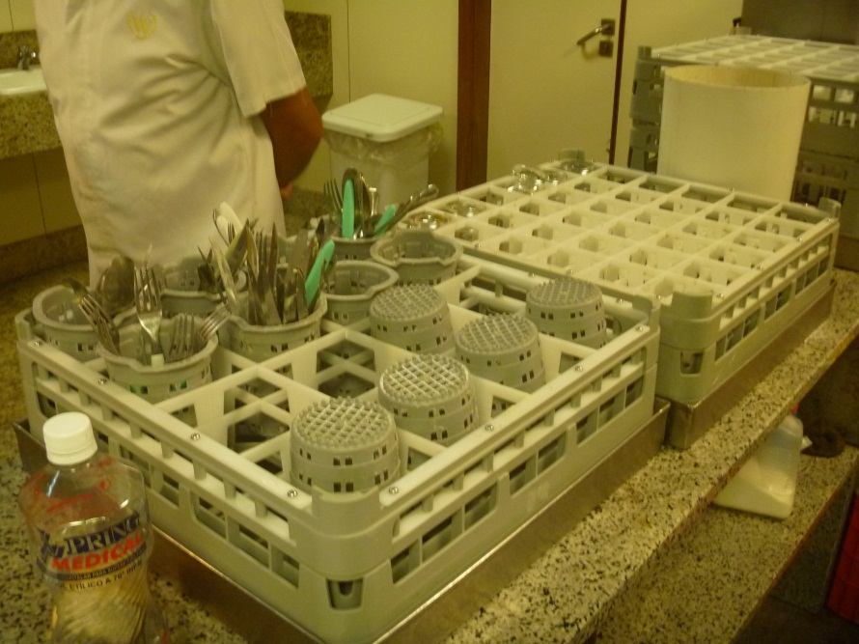
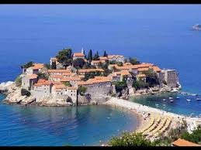
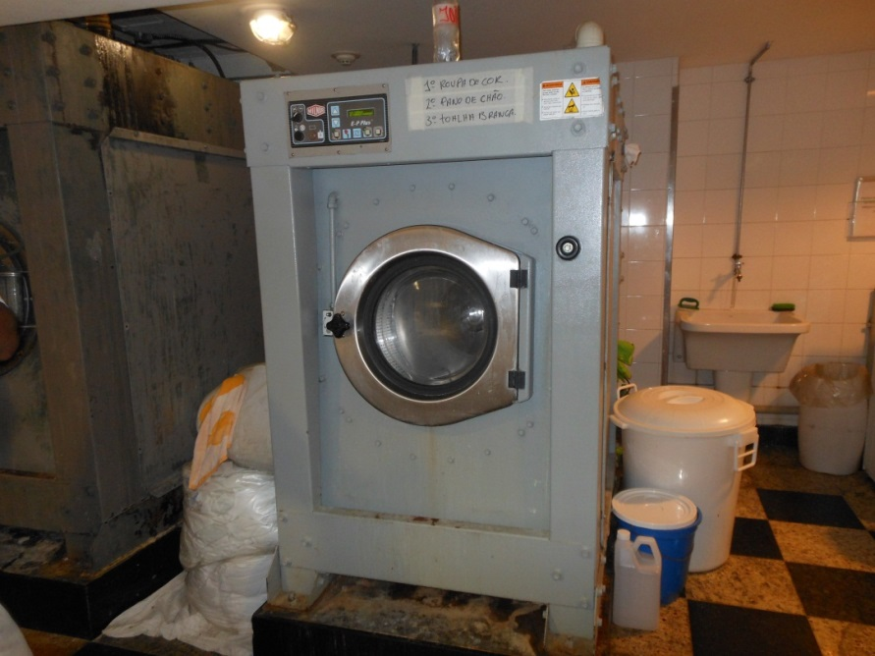
Case Studies – ChL in Hotels

Slide 10
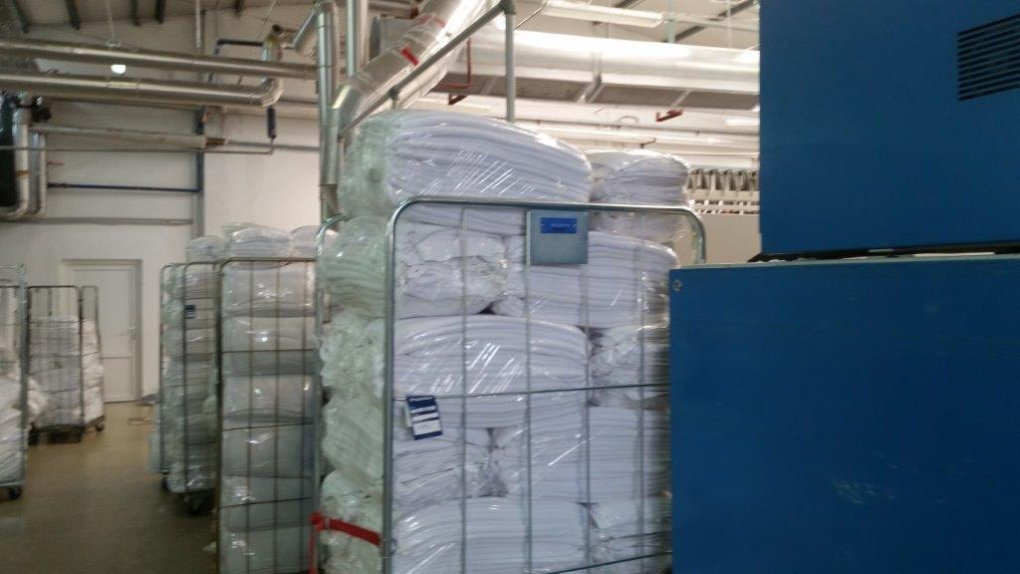
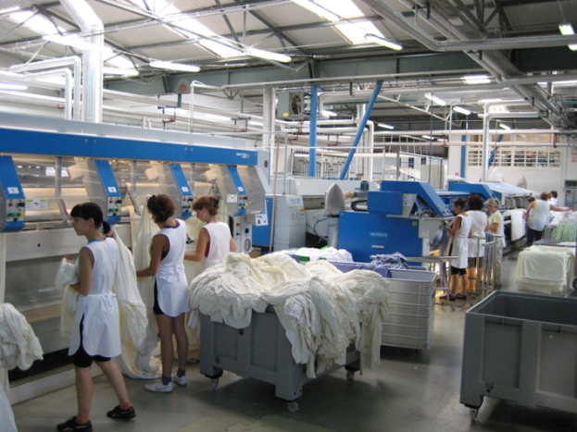
Case Study – Hotel’s Laundry
Partners: Hotel chain in Croatia and “Ecolab”

Slide 11
Case Study – Hotel’s Laundry
What was changed?
Washing process was optimized by automatic dosing of liquid detergents, providing lower consumption (powdered laundry detergents were in use and were dosed manually before);
Number of washing cycles was reduced;
Hazardous chemicals were substituted by eco-friendly chemicals;
Reuse of waste water was introduced (only from white laundry);
Heat recovery was introduced (water preheating by steam condensate from dryer and waste heat from roller)

Slide 12
Case Study – Hotel’s Laundry
What was achieved?
Chemical Leasing business model is focused on optimization of the chemicals consumption, but the result is a reduction in the use of other resources (water, energy, other chemicals)
Water savings
Year | Washed textile (kg) | Water consumption (l/kg textile) | Difference (l/kg textile) | Savings (m³)
2008 | 4 100 000 | 13,88
2015 | 4 400 000 | 5,09 | 8,79 | 38 676

Slide 13
Case Study – Hotel’s Laundry
What was achieved?
Electricity savings
Year | Washed textile | Consumption kWh/kg textile | Difference kWh/kg textile | Saving in kWh
2008 | 4 100 000 | 1,83
2015 | 4 400 000 | 1,58 | 0,25 | 1 100 000

Slide 15
Case Study – Hotel’s Laundry
What was achieved?
Consumption of chemicals for waste water treatment is reduced
Occupational health and safety is improved as employees cannot get in contact with chemicals
Economic savings (EUR)
Average savings (EUR/year)
Water | Electricity
59,525 | 46,462

Slide 16
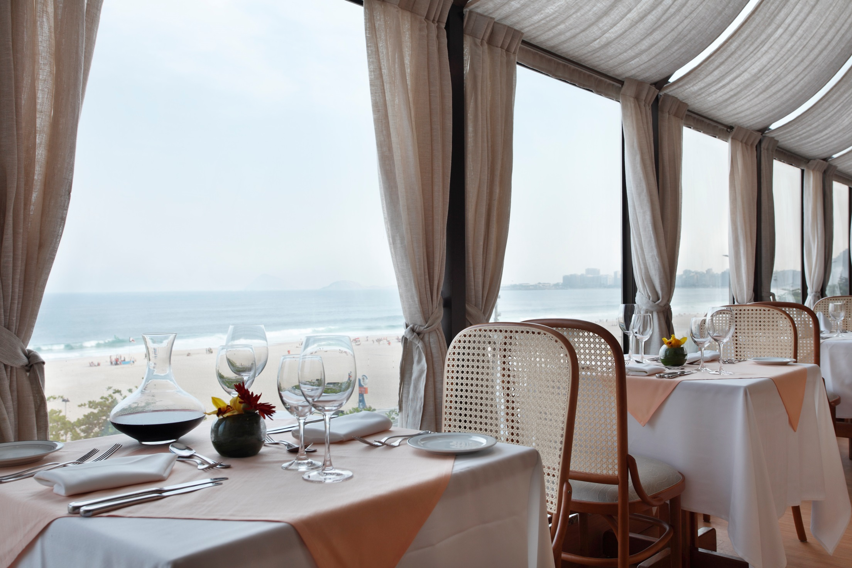
Windsor Hotel Atlântica

Slide 17
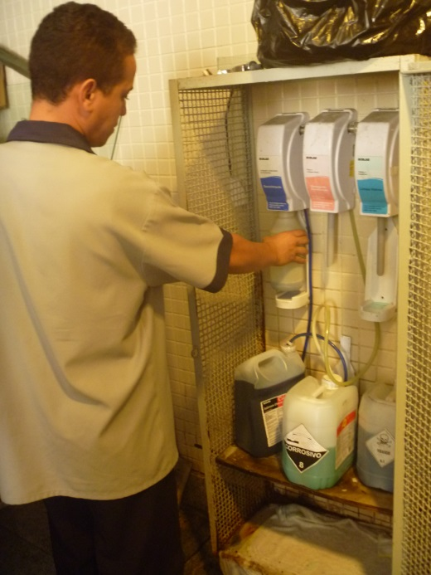
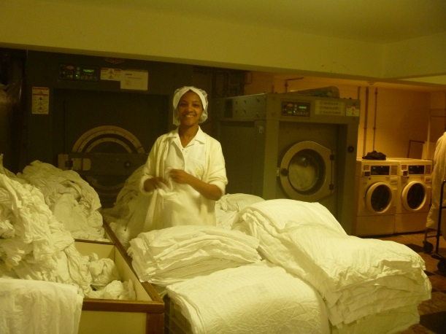
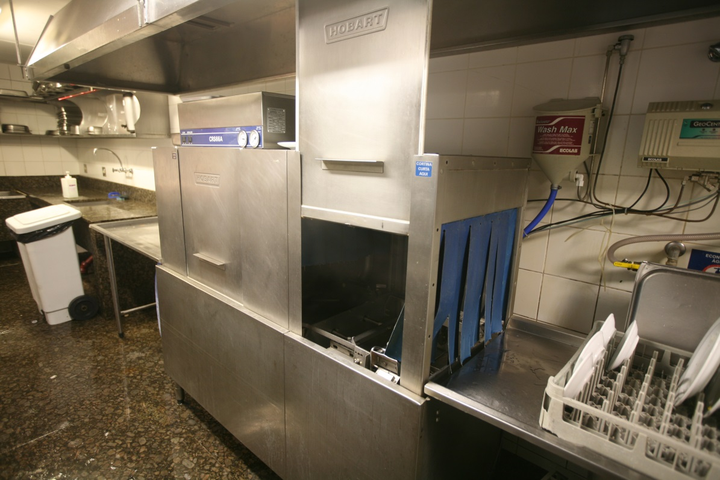

Unit of payment – number of occupied rooms
In this hotel consumption of chemicals per occupied room is 0.28 kg – 40% less than in other hotels in the group

Slide 18
Exchange of expertise and
process optimization
Less consumption
of chemicals
Less consumption of
other resources
Less hazardous
chemicals
Less negative effects to
the environment, health
and safety
Less risks
More added value
More benefits
More quality
More supplier’s responsibility
More incentives for reuse and recycling of chemicals and other resources

Slide 19
Thank you for your kind attention!
Vojislavka Šatrić

