Slide 1
Financing Circular Economy
Assoc. prof. dr. Rebeka Kovačič Lukman
Expert on CE financing, European Commission
University of Maribor
Assoc. prof. dr. Andrej Lisec
University of Maribor
Maja Rosi
University of Maribor

Slide 2
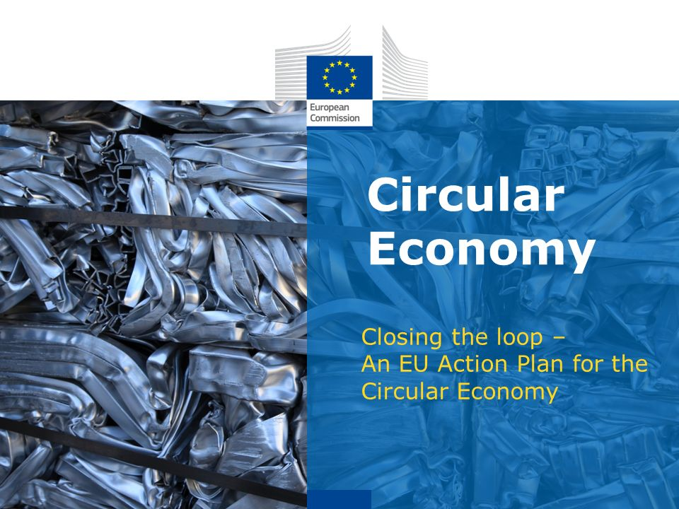
5,5 bn EUR – ESIF
650 mio EUR H2020 „Industry 2020 in the circular economy“
100 mio EUR LIFE

Slide 3
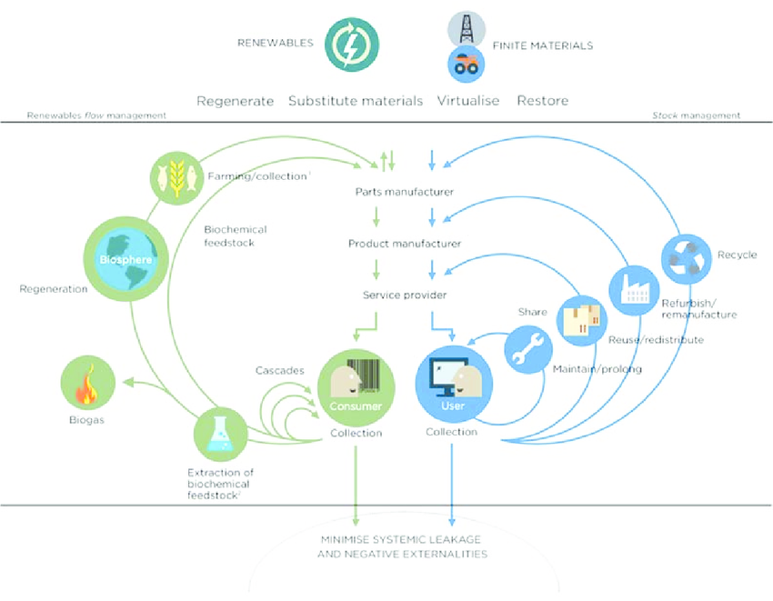
Circular economy - “a generic term for an industrial economy that is, by design or intention, restorative, and in which material flows are of two types - biological nutrients, designed to re-enter the biosphere safely, and technical nutrients, which are designed to circulate at high quality without entering the biosphere”.

Slide 4
Web of science

Slide 5
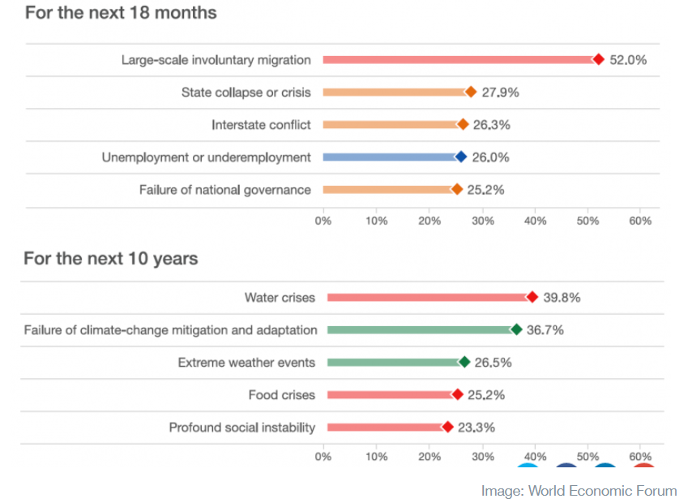
State-of-the-world

Slide 6
Deep ecology:
2nd order change – transformation of the system itself
Radical break or logical jump from the status quo
Consider complexity, innovative and creative solutions
Environment as a system of dynamic changes
Shallow ecology:
Treating symptoms of ecological crisis (pollution, resource degradation) − one-dimensional, non-systemic approach to environmental problems
Technological optimism, economic growth – all environmental problems are treated as manageable
Remedy to environmental problems is limited to economic technological, and managerial reforms
“Technical” solutions to social, political, ethical problems are viable

Slide 7
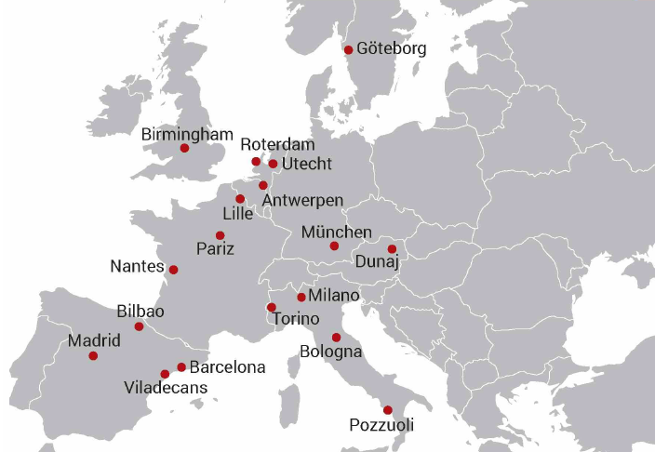
EU Funds & Distribution
H2020:
EU-13 4,4 % of EU financial contribution
EU-13 20,6 % of population
Annual EC contribution per inhabitant is 3 EUR in EU-13, and 15 EUR in EU-15.
Slovenia:
3rd out of EU-28 MSs according to project applications but only 27th when financed projects are regarded
We should move research, development, innovations and production to EU-13 instead of moving people (especially highly educated) to the EU-15.

Slide 8
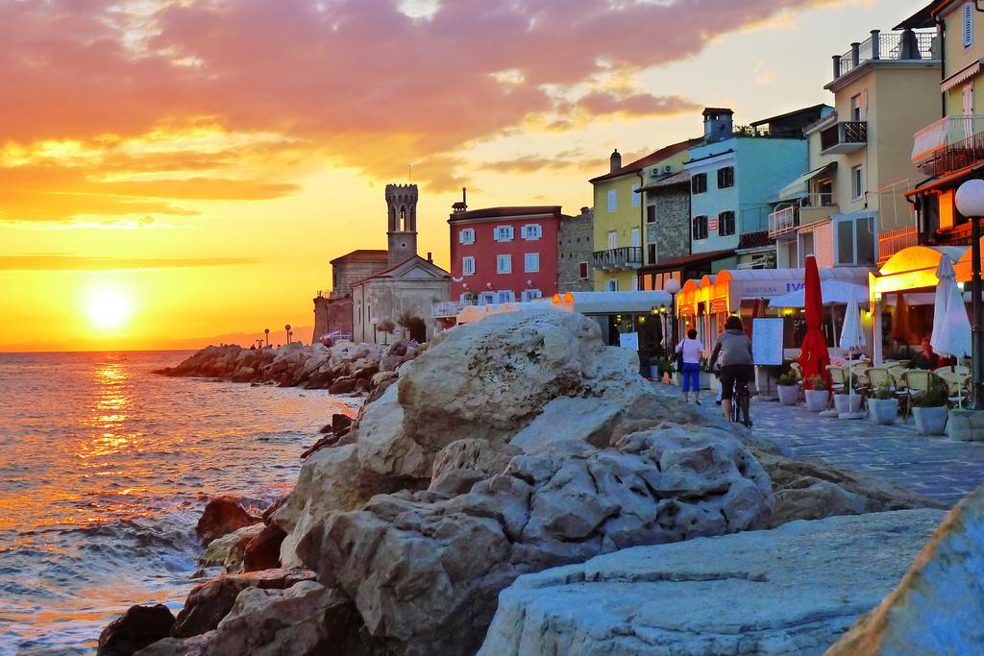
Tourism has a great opportunity in CE.
Tourism are people
CE if employed within the tourism sector has a possibility to have a huge impact on the „ciruclarity“ of human capital and keeping revenues in local/regional area.

Slide 9
How „circular“ are corporations?
New business models of sharing economy, which are not yet well regulated.
Not transfering profits to „tax haven“.

Slide 10
CE hub(s)
WEF has already recognized Slovenia’s CE activities.
In 2017, Slovenia got the invitation to join WEF’s PACE initiative as a regional circular economy hub – to share its circular knowledge and practices with Eastern and South-eastern Europe.
Priority areas (5), CE Action Plan: plastic, food waste, critical raw materials, construction and demolition, bio-mass and biobased products
Tourism?
Human Resources?
Capital?

Slide 11
Conclussions & Outlook
CE should be considered and implemented, based on a holistic perspective – e.g. embedded in all political, strategic and financial instruments.
FOCUS should be given to the
HUMAN and FINANCIAL resources
when discussing circular economy
Finding the balance!

Slide 12
Contact:
rebeka.kovacic@um.si

