Slide 1

08 May 2018
SLOVENIA
#CE4SEE

Slide 2
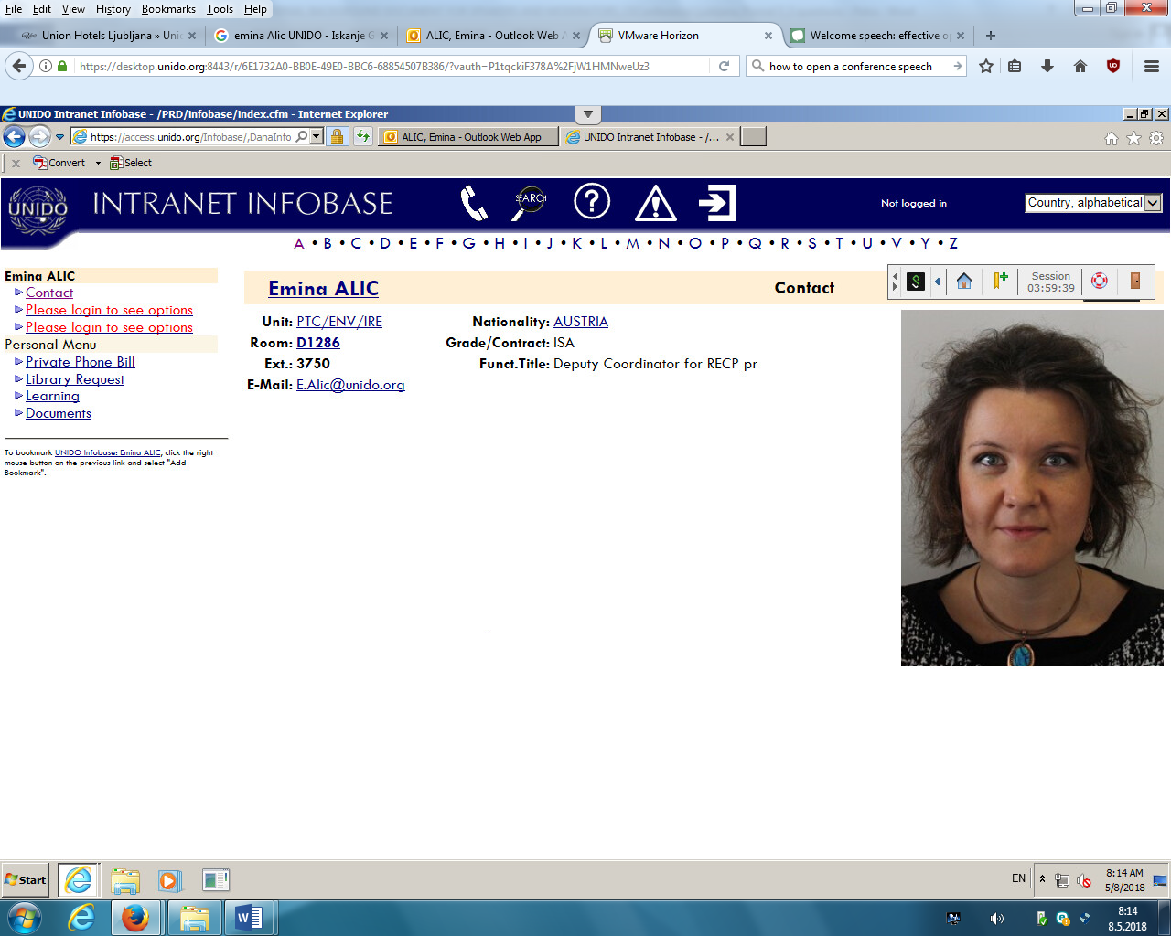
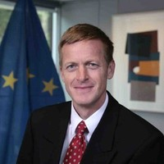
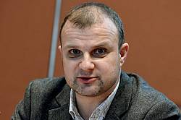
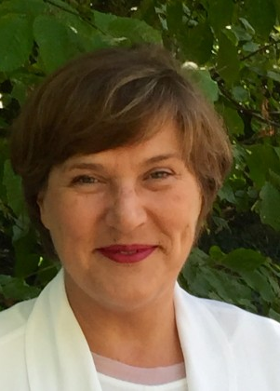
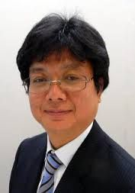
Welcome addresses and Keynote Speech
Introduction and moderation
Emina Alic
Deputy Project Coordinator
UNIDO
Welcome address
Aleš Cantarutti
State Secretary,
Ministry of Economic Development and Technology
Slovenia
Welcome address
Hiroshi Kuniyoshi
Deputy to the Director General
UNIDO
Welcome address
Zoran Stančič
Head
European Union Office
Slovenia
Keynote Speech
Zoritsa Urosevic
Representative
World Tourism Organization

