Slide 1

08 May 2018
SLOVENIA
#CE4SEE

Slide 2
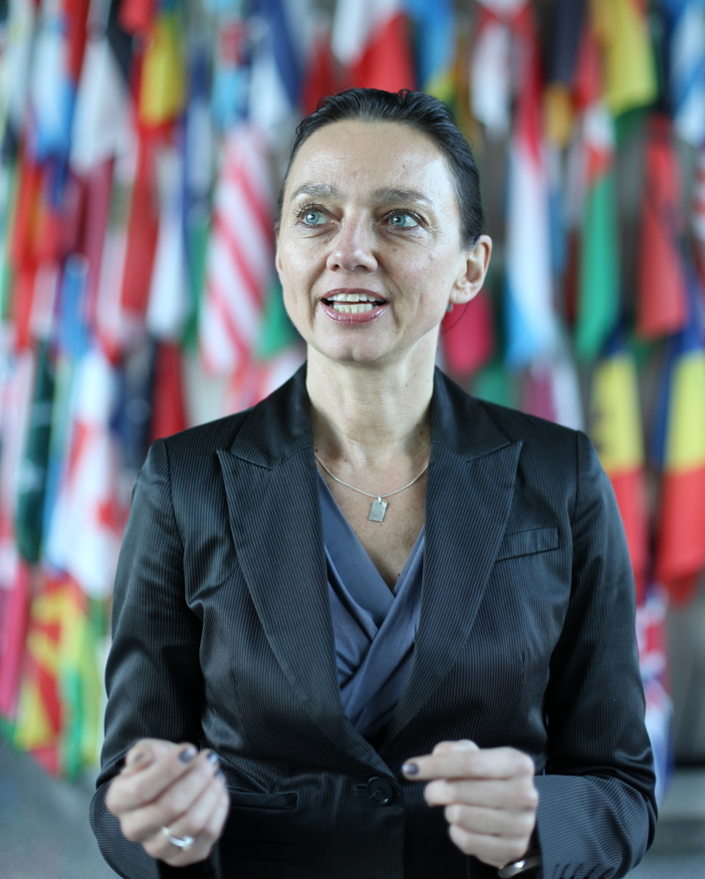
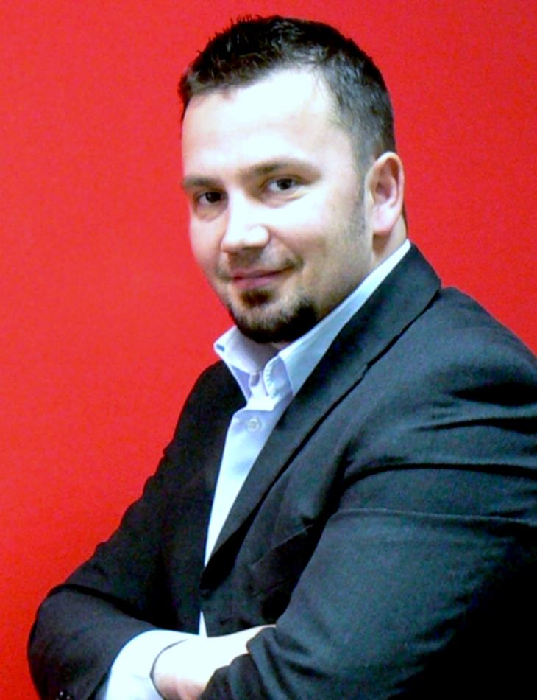
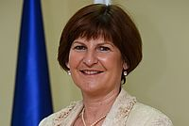
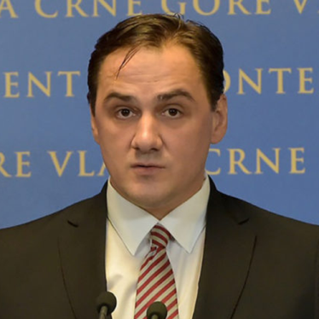
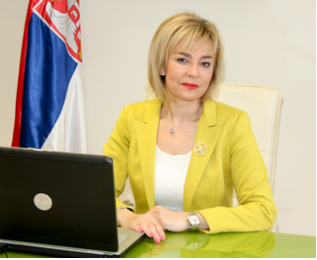
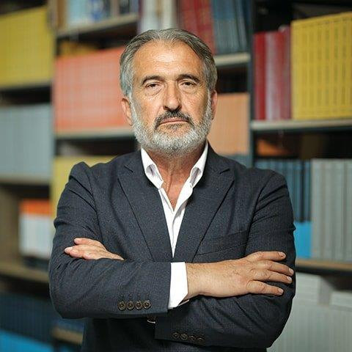
Session III: Circular Economy in Tourism and Future Developments
Introduction and moderation
Petra Schwager
Senior Industrial Development Officer
UNIDO
Eva Štravs Podlogar
State Secretary
Ministry of Economic Development and Technology Slovenia
Renata Pindzo
Deputy Minister
Ministry of Trade, Tourism and Telecommunications
Serbia
Adrian Kamenica
Secretary General
Ministry of Tourism and Environment
Albania
Damir Davidović
Secretary of State
Ministry of Sustainable Development and Tourism
Montenegro
Shovket Hazari
State Counsellor
Ministry of Economy,
FYR of Macedonia

