Slide 1
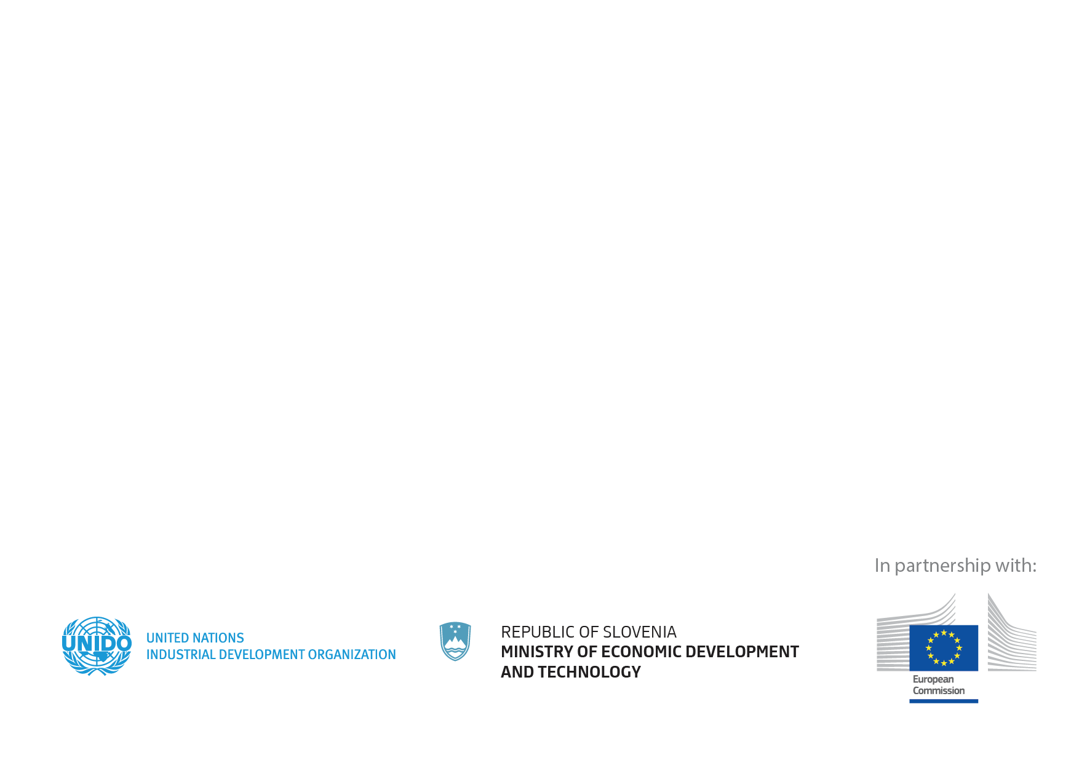
08 May 2018
SLOVENIA
#CE4SEE

Slide 2
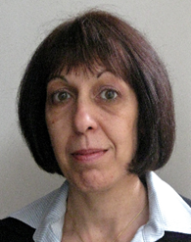
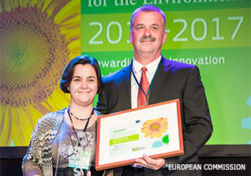
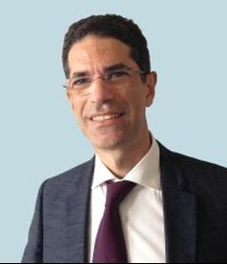
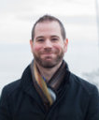
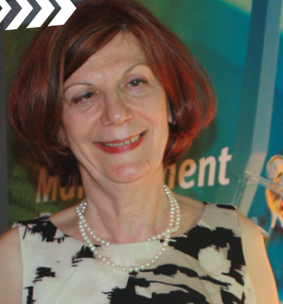
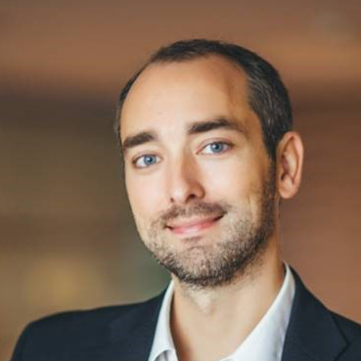
Session I: Circular Economy applied in Tourism
Introduction and moderation
Mariana Assenova
Associate Professor and Head of Geography of Tourism Department,
Sofia University
Promoting sustainable tourism through an integrated cluster approach
Fabio Russo
Senior Industrial Development Officer, UNIDO
Product-service System – Business Strategy for the Circular Economy
Vojislavka Šatrić
International Expert on Chemical Leasing, UNIDO
Sustainable waste management and recovery in tourism
János Handó
Founder & owner, Ladybird Farm-Winner of the European Business Award for the Environment
Building design with REED to improve visitor well-being “InnoRenew CoE,
Michael Burnard
University of Primorska, Slovenia
Long distance transportation as a service,
Marko Guček,
Chief Executive Officer, GoOpti

