Slide 1
Green Industry: key concepts, approaches and methods
Green Industry Summer School-2022
26 July, 2022
Ozunimi Iti
Industrial Development Officer
Department of Environment
United Nations Industrial Development Organization

Slide 2




Importance of Industry in Development and Green Agenda
High burden on natural resources
Major polluter
30% of global GHG Emissions
Improves livelihoods
25% Employment of Global Workforce
Potential for green technology and jobs
Driver of rapid economic growth
Driver of innovation
Promotes Trade
Industry

Slide 3
What is Green Industry?
Enabling Green Industry Framework
Greening of Industries
Creating Green Industries
Resource Efficiency
(materials, water & energy)
Pollution Prevention (waste & emissions)
Renewable and Efficient Energy
Materials Recovery (3RS) & Recycling
Environmental Services
Responsible Chemicals’ Solutions
Pollution Control (POPs, e-waste)
Notes:
We can define Green industry as a two-pronged endeavour to decouple resource use and pollution from industrial development and promote the growth of productive sectors and entrepreneurships in developing and transitioning countries.
UNIDO distinguishes two separate strands to green industry.
Greening of industry: a strategy all enterprises can adopt, large, medium, or small, from whatever sector and green themselves.
Green industries: equivalent (more or less) to the “Environmental Goods and Services Sector”: those enterprises which offer green products and green services to the rest of the economy

Slide 4
What are green industries?
 | Solid waste | Water pollution | Air pollution | Soil pollution
Waste processing | recycle wastes; treat wastes; landfill wastes | run centralized WWT plants |  | run soil/groundwater decontamination plants
Engineering | build recycling facilities; build treatment facilities; build landfills; manufacture the technologies | build WWT plants that: recycle, reuse, cascade wastewater; treat wastewater manufacture the technologies | build air pollution treatment plants that: reuse waste heat; treat air emissions manufacture the technologies | Build soil/gw decontamination plants manufacture the technologies
Transport | collect, transport wastes; manufacture collection/ transportation equipment |  |  | Collect, transport contaminated soil
Labs to measure Lab equip. | waste characteristics | wastewater characteristics | air stream characteristics | soil characteristics
 | manufacture the necessary lab equipment for specialized measurements in all these areas
Consulting | offer specialized consulting services in all these areas
Companies that develop, produce and install Renewable energy equipment
Industries applying and continuously improving their environmental performance
Notes:
Participants can explore extensive list of environmental goods from the OECD’s illustrative product list of environmental goods: https://www.oecd.org/environment/envtrade/35837840.pdf

Slide 5
Greening Industries: Approaches and Methods
Resource Efficient and Cleaner Production
Eco Industrial Park framework
Environmental and Energy Management Systems
Digitalisation
Circular Economy

Slide 6
Resource Efficient and Cleaner Production (RECP): What is it?
RECP is …
… a tool to answer 3 questions:
Where: is my factory losing resources in the form
of waste and pollution?
Why: is it losing them?
How: can these losses can be minimized?
    RECP assessment RECP options
    RECP options Less waste, less emission
    Less waste, Emission Improved productivity

Slide 7


RECP Techniques
OPERATIONAL CHANGES
TECHNOLOGY MODIFICATION
PRODUCTION PROCESS
PRODUCT MODIFICATION
INPUT SUBSTITUTION
WASTE &
EMISSIONS
Notes:
RECP categories
The next slides will explain in what areas CP options and measures can normally be identified, and how these can contribute to improved production efficiency and reduced environmental impact. These options can be divided into 5 categories:
1. Input substitution (changing raw material to e.g. less toxic or more suitable materials)
2. Technology change (better process control and new technologies);
3. Good operation practises (improved worker skills; good production management)
4. Product modification.
5. On site recovery/reuse.
All losses, in productivity, risks and inefficiency can be categorised in one of these areas.

Slide 8



Input Substitution
OPERATION
TECHNOLOGY
PRODUCTION PROCESS
Change INPUT MATERIALS
PRODUCTS
1/ Change inputs materials, water and energy:
> Replace toxic or harmful materials with less toxic
> Use recycled materials
> Use renewable materials
> Use materials with longer lifetime
> Use materials which are purer
WASTES &
EMISSIONS
Notes:
Option 1: Input materials substitution
The first category consists of options related to changing the input materials to materials that are:
less toxic;
renewable;
have a longer service life-time in production.
Many times companies use low quality raw materials that they are purchasing at a lower price. However, a common CP option is to pay more for better quality materials that generates better yield, fewer production disturbances and sometimes also better product quality. This is often off-setting the higher costs for the better raw materials.

Slide 9
Technology Modification
Improve equipment and process control
New technology
OPERATION
TECHNOLOGY
PRODUCTION PROCESS
Change INPUT MATERIALS
PRODUCTS
2/ Technology change:
> Replace inefficient equipment
> Modify equipment to make it more efficient
> Optimize process conditions
> Increase automation
> Improve process control
> Improve equipment lay-out
WASTES &
EMISSIONS
Notes:
Option 1: Technology change
The second category is technology change, which can be divided into:
New technology. This is often referred to as “Cleaner Technology” (CT). Note that CT is part of CP but that there are many more improvement options in CP than only technology change!!! (CT is often confused with CP!)
Equipment modification: modify the existing production equipment and utilities in order to run the processes at higher efficiency and at lower waste and emission generation rates.
Improved processing conditions: modify operational procedures (pH, T, Flow, Pressure, Dosing etc.); equipment instructions and/or process record keeping in order to run the processes more efficiently and at lower waste and emission generation rates.

Slide 10

Good Housekeeping
Improve equipment and process control
New technology
OPERATION
Improved management
TECHNOLOGY
Workers skills & process control
PRODUCTION PROCESS
Change INPUT MATERIALS
PRODUCTS
3/ Improved operational practices:
> Better production scheduling
> Energy management (peak shaving)
> Have maintenance programmes
> Have working instructions and procedures
> Give training and incentives program
> Ensure adequate process control operations
> Ensure proper maintenance and cleaning
WASTES &
EMISSIONS
Notes:
Option 3: Improved operation practices
The third category involves CP options that refers to managerial and operational actions to prevent leaks and spills and to enforce existing operational instructions. This is an important category because of it’s strong effects usually without any need for major investment. Human behaviour is often the main reason for inefficient production (but can also be difficult to change)
Good operational practices start with an efficient production planning. E.g. in a dairy plant with multi-purpose production and bottling equipment, first producing the straight and colourless products (regular milk) and then the sweet, sour and coloured products (custards, yoghurt and chocolate or fruit desserts) to reduce the equipment cleaning needs in order to prevent cross-contamination of incompatible products; eventually create or assign separate production lines for incompatible products.
Energy management is another important part of production management, especially avoiding high-peak energy consumption can save money in terms of tariffs and in terms of avoiding the need to install high load equipment. And of-course preventing the unnecessary power consumption by switching off equipment when not in use.
A well planned maintenance programme for all equipment and facilities is the third leg in this category. Run down equipment is normally not able to operate at full efficiency. Regular review and maintenance of steam systems is a good example of measures that can save substantial energy use (and costs) in many operations.
The staff themselves have to bring into practice the procedures and instructions at the work floor on a day-to-day basis. Proper maintenance and cleaning of equipment should be a day-to-day routine, resulting in a clean and tidy workplace.
Finally management should develop proper working instructions and procedures with and for the staff and provide a proper training programme with incentives (the best are financial, but also praise and awards have appeal).

Slide 11
Product Modification
Improve equipment and process control
New technology
OPERATION
Improved management
TECHNOLOGY
Workers skills & process control
PRODUCTION PROCESS
Change INPUT MATERIALS
PRODUCTS
modification
4/ Product modification:
> Have recycling-friendly design
> Extend product life
> Use more efficient, less material-intensive packaging
> Reduce use of harmful substances
WASTES &
EMISSIONS
Notes:
Option 4: Product modification
The fourth category of CP option pertains to the modification of the product characteristics in order to minimise the environmental impacts of the product during or after its use (disposal) and/or to minimise the environmental impacts of its production. Examples may include paper products with lower degrees of whiteness (with lss need for chlorinated blaching agents) if not required by the customer, minimized packaging, or mobile phones designed to allow easier disassembly and recycling of different components.

Slide 12
Reuse and Recycle
Improve equipment and process control
New technology
OPERATION
Improved management
TECHNOLOGY
Workers skills & process control
PRODUCTION PROCESS
Change INPUT MATERIALS
PRODUCTS
modification
5/ On-site reuse and recycling:
> On site recovery & re-use of raw materials or energy
in process wastes, wastewater, waste heat and
cooling water
> Transforming waste into useful by-products
> Waste segregation and storage
WASTES &
EMISSIONS
Re-use and recycling
Notes:
Option 5: Reuse and recycling
The fifth category of CP options are found in the reuse of the waste, either in the same process or for another useful application within the company. Opportunities for the Recycling of waste water, surplus energy and chemicals can often be identified.
To this category also belongs CP options on transforming waste into useful by-products. What is considered as waste in one company is often a raw material in another company (e.g. low degree fibre waste from paper making can be used for manufacturing of egg boxes).

Slide 13
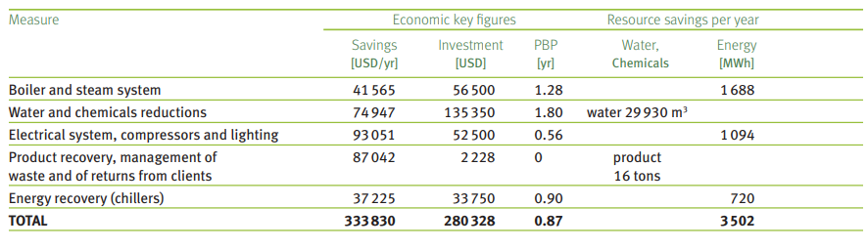
Illustrative examples of RECP opportunities
Dairy industry — Fromagerie BEL Maroc from Morocco
Notes:
The case study can be found here https://www.unido.org/sites/default/files/2012-05/12-50507_Factsheet_BEL_Ebook_0.pdf
Fromagerie BEL Maroc is a subsidiary of the international group BEL, the world leader for processed cheese. it employs 1,300 people including 40 managers and produces about 39,000 tons/ year of processed cheese (more than 40% of which is destined for export).
Detail RECP measures:
Boiler and steam system: Several measures have been implemented: insulation of hot surfaces, recovery of steam condensate, and the optimal adjustment of burners’ combustion. Other options are scheduled, including energy recovery from the boiler’s blow-down and installation of an automatic blow-down system.
Water and chemicals reduction: Several measures have been implemented to reduce water and chemicals consumption, including: NEP optimization, recovery and reuse of rinse water, use of spraying nozzles and cleaning guns, and automatic closing of cooling water circuits for equipments, like pumps. Vacuum pumps will also be replaced by dry multi-stage pumps.
Energy recovery from chillers: Recovering heat from the freezing groups’ condensers, the company is using it to defrost the butter stock before use. Recovered heat from other cold rooms will be used to heat sanitary and washing water.
Electrical system, compressors, lighting: A series of actions have been established to reduce electrical consumption, including power factor increase, optimization of site lighting and installation of a variable speed drive on an air compressor. As for compressed air, the identified actions are primarily related to leaks repair, minimization of compressors’ idle operations, installation of automatic solenoid valves on packing machines, and of pressure gauges on the air network.
Product recovery, management of waste and of returns from clients: As for process equipments (tri-blenders, paste transfer tanks), the identified measures include dry scraping and recycling of white water in production.

Slide 14
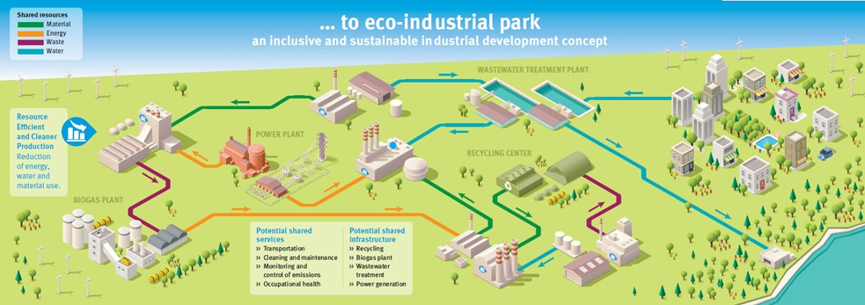
Eco-Industrial Park (EIP)
Shared resources:
An eco-industrial park is… ”A community of manufacturing and service businesses located together on common property. Member businesses seek enhanced environmental, economic, and social performance through collaboration in managing environmental and resource issues.
Notes:
Shared resources

Slide 15
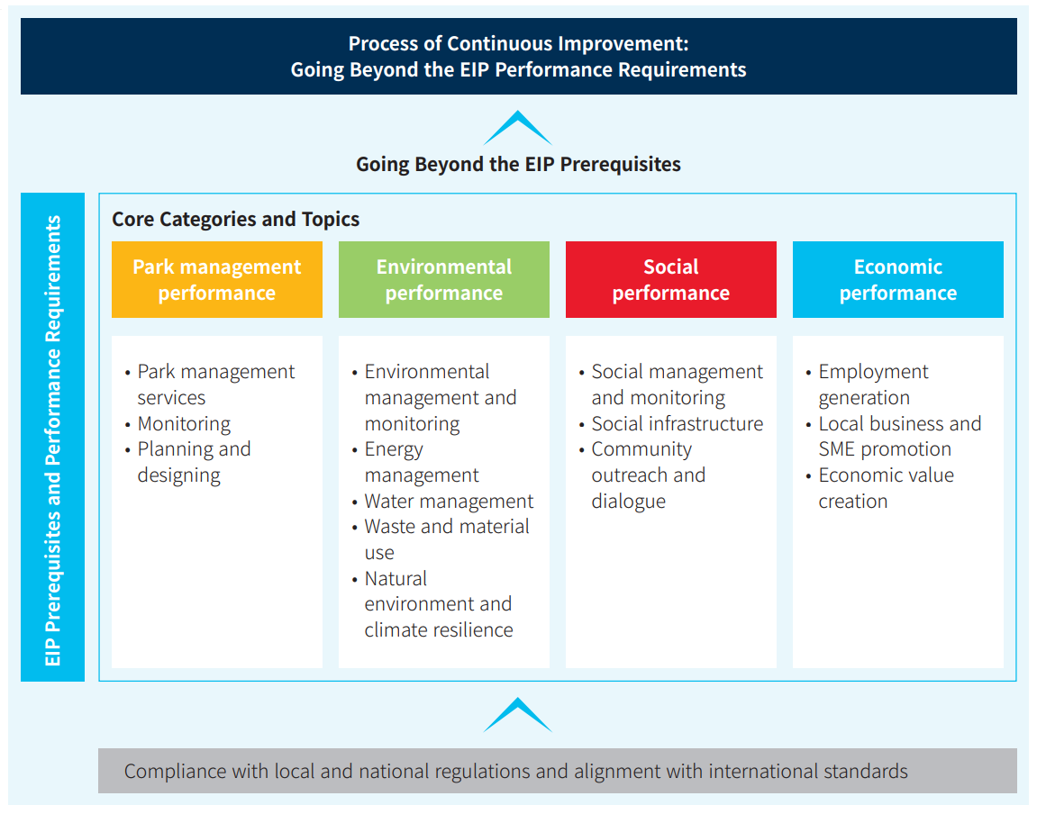
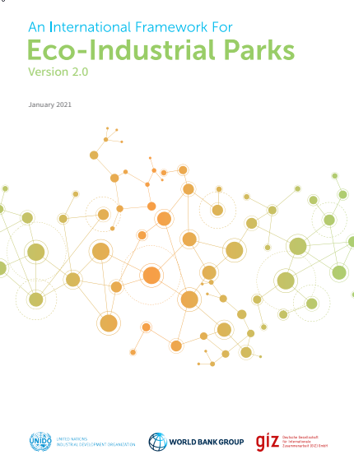
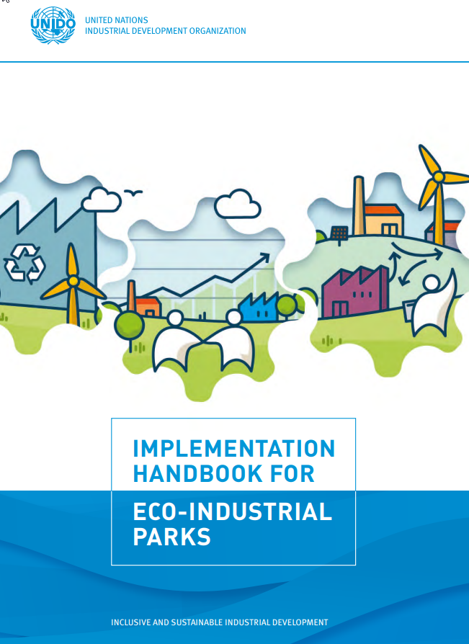
Overall framework for describing Eco-Industrial Parks

Slide 16
Thank you

