Slide 1
Circular Economy for Meeting Climate Goals: Practical Approaches and Tools
2nd PAGE Green Industry Summer School-2022
Edward Clarence-Smith
Senior Consultant on Green Industry & Circular Economy
Tuesday, 26 July 2022

Slide 2
Overview
Brief overview of the circular economy
The relationships between the circular economy and decarbonisation
Notes:
These two fundamental objectives of a circular economy can be reached by implementing three broad strategies:
We must “narrow” flows, i.e., require less materials to make product and to deliver services (remember that nearly all services need materials in their delivery). We can do this in several ways. We can be more efficient in our use of materials, products, and services. We can turn what are currently wastes into new by-products. We can extract more use out of each product we make (thus requiring less products to deliver the same amount of use), through sharing.
We must “slow down” flows. We can do this by extending the life of the products we use by maintaining them properly, by repairing them when they are broken, and by passing them on to other people to use when we no longer need them. We can also do this by extending the life of the parts making up a product by remanufacturing or refurbishing products, or by cascading them from one type of product to a different type of product.
We must “close the loops”, by recycling the materials “locked up” in used/waste products back to a new use.

Slide 3
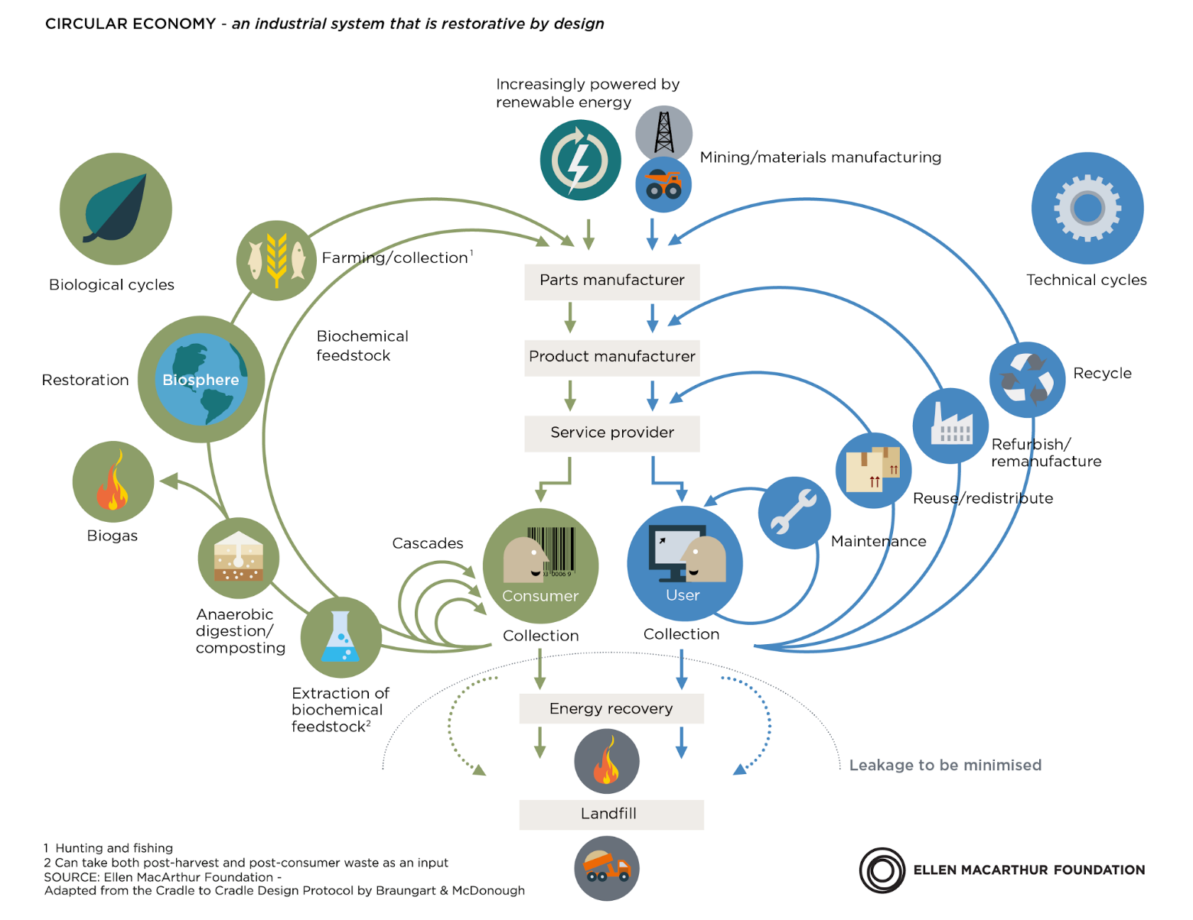
Representation of the Circular Economy
/Repair

Slide 4
Environment
Economy
Linear
Economy
“emit”
“discharge”
“dump”
“extract”
(mine, farm)
“Technical” materials
“Biological” materials
Environment
Environment
Economy
Economy
Circular Economy
“top-up”
“leakage”
KEY: Quarantining technical materials in the economy
KEY: Using the biota’s natural recycling systems to recycle these materials.

Slide 5
The Two Objectives of a Circular Economy
In BOTH cases, there are two objectives:
1) Have the materials going round and round (circularize flows)
AND (even more importantly!!)
2) Use less materials in the first place (minimize flows)
NOTE: A circular economy is NOT a recycling economy! Recycling is just one part of a circular economy.
Notes:
These two fundamental objectives of a circular economy can be reached by implementing three broad strategies:
We must “narrow” flows, i.e., require less materials to make product and to deliver services (remember that nearly all services need materials in their delivery). We can do this in several ways. We can be more efficient in our use of materials, products, and services. We can turn what are currently wastes into new by-products. We can extract more use out of each product we make (thus requiring less products to deliver the same amount of use), through sharing.
We must “slow down” flows. We can do this by extending the life of the products we use by maintaining them properly, by repairing them when they are broken, and by passing them on to other people to use when we no longer need them. We can also do this by extending the life of the parts making up a product by remanufacturing or refurbishing products, or by cascading them from one type of product to a different type of product.
We must “close the loops”, by recycling the materials “locked up” in used/waste products back to a new use.

Slide 6
The Three Broad Strategies to Circularize an Economy
To reach these two objectives, three broad strategies must be implemented:
“Narrow” flows – requiring less materials to make & use products, deliver services.
“Slow down” flows – extending the useful life of products (and product parts), which reduces the overall amount of products required => less materials.
Finally, “close loops” – recycling materials “locked up” in used/waste products back into manufacturing/farming.
These three strategies can be used everywhere in the economy.
Notes:
These two fundamental objectives of a circular economy can be reached by implementing three broad strategies:
We must “narrow” flows, i.e., require less materials to make product and to deliver services (remember that nearly all services need materials in their delivery). We can do this in several ways. We can be more efficient in our use of materials, products, and services. We can turn what are currently wastes into new by-products. We can extract more use out of each product we make (thus requiring less products to deliver the same amount of use), through sharing.
We must “slow down” flows. We can do this by extending the life of the products we use by maintaining them properly, by repairing them when they are broken, and by passing them on to other people to use when we no longer need them. We can also do this by extending the life of the parts making up a product by remanufacturing or refurbishing products, or by cascading them from one type of product to a different type of product.
We must “close the loops”, by recycling the materials “locked up” in used/waste products back to a new use.

Slide 7
Circular Economy and Decarbonisation

Slide 8
Fossil Fuels and Circularity
At the global level, fossil fuels make up 15% of the total material flows (virgin and recycled) entering our economies.
By their very nature, fossil fuels are completely linear: you extract them, you process them, then you burn them. There is absolutely no recycling.
Which means that it will be impossible to have fully circular economies which use fossil fuels.
Which means that the transition to circular economies MUST be accompanied by a transition to renewable energy.

Slide 9
Fossil Fuels and Circularity
/Repair

Slide 10
Transitioning to CE and Decarbonisation
So total decarbonisation of our economies is required to make economies fully circular.
But the transition to circular economies supports the transition to decarbonised economies.
The implementation of all three broad CE strategies – “narrowing flows”, “slowing down flows”, “closing loops” – can also reduce the amount of fossil fuels which our economies keep on using as we transition to renewable energy sources.

Slide 11
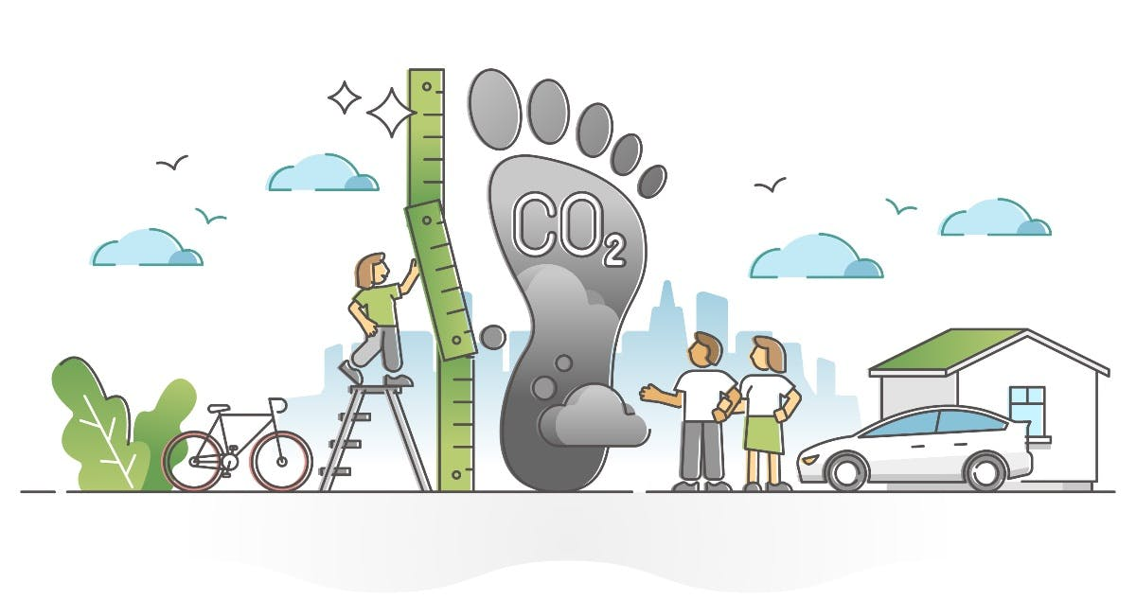
Using the Carbon Footprint as a Guide
Because Circular Economy is so product-focused, we need to use the concept of the carbon footprint to see how the adoption of circular economy practices helps in decarbonisation.
Carbon footprint = the total quantity of fossil fuels which were consumed (and thus led to CO₂ emissions) during a product’s life cycle: production, distribution and retail, use/consumption, and disposal (a product’s “embedded carbon”).

Slide 12
Support of Circular Economy Transition to Decarbonisation in the Production Phase
Today, because of time constraints, we will only look at the case of products made with technical materials.

Slide 13
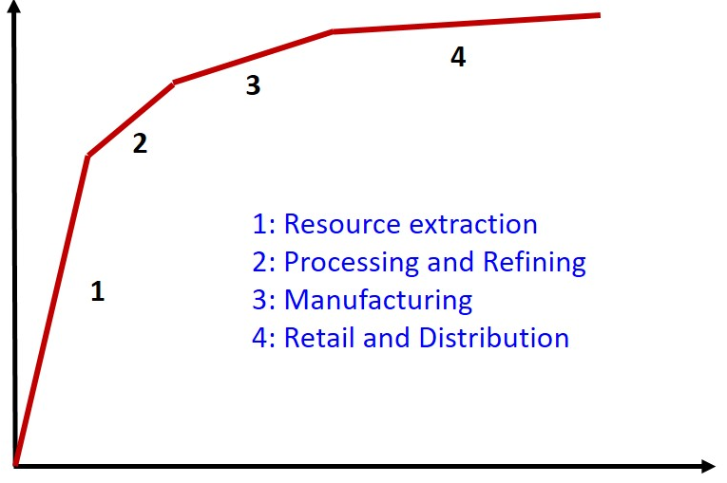
The Pattern of the Carbon Footprint in the Production Phase
This diagram shows the general pattern in the growth of carbon footprints (and environ-mental impacts more generally) of product parts and then products as they move along the supply chain in a linear economy.
Much of the carbon footprint gets created in the first two steps (resource extraction and processing / refining).
CARBON FOOTPRINT
(ENVIRONMENTAL IMPACT)
ADDED VALUE

Slide 14
A Specific Example
WASHING MACHINE
(Technical Material)
Distribution
Manu-facturing
Carbon Footprint
Material supply
Extracted from Ina Rüdenauer et al., “Eco-Efficiency Analysis of Washing machines: Life Cycle Assessment and determination of optimal life span”, Öko-Institut e.V. (2005)

Slide 15
Support of CE Practices in the Production Phase
Economy
Environment
Clearly, CE practices which can allow manufacturers to avoid the resource extraction and processing/refining steps of the linear economy will very much support decarbonisation efforts.
Resource Extraction
“top-up”
“leakage”
The three CE practices which can most do this are:
in the “slowing down” strategy:
remanufacturing (or refurbishing)
cascading
in the “closing loops” strategy
recycling.

Slide 16
Remanufacturing (& Refurbishing) – I
Remanufacturing:
A used product is completely disassembled. The parts are cleaned. Worn or broken parts are replaced, with a combination of reused, repaired and new parts. Software is updated. Everything is reassembled.
The reassembled product is tested to ensure it meets or exceeds Original Equipment Manufacturer's (OEM) performance specifications.
The remanufactured product carries a warranty that is equivalent to that of a new product. It is “as good as new”.
Refurbishing is a less high quality version of remanufacturing – and consequently the warranty is not so good.
Both are ways to reuse product parts rather than whole products.
Both can have a dramatic effect on the carbon footprint of products.

Slide 17
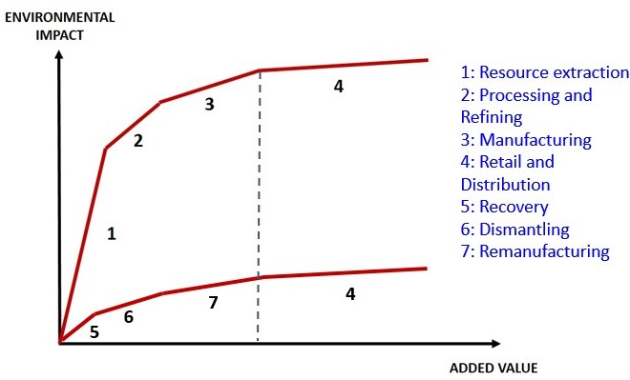
Remanufacturing (& Refurbishing) – II
Remanufacturing (and refurbishing) avoid (for the most part) the carbon-intensive steps of resource extraction as well as processing and refining, so the carbon footprint of a remanufactured product is much smaller than the equivalent new product. And it’s as good as a new product!
CARBON
FOOTPRINT
(ENVIRONMENTAL
IMPACT)

Slide 18
Remanufacturing (& Refurbishing) – III
The table shows the types of product currently being remanufactured (or refurbished):
Aerospace | Defense equipment | Medical equipment | Robots
Air-conditioning units | Electrical motors | Musical instruments | Rolling stock
Bakery equipment | Excavation equipment | Office furniture | Surgical medical tables
Compressors | Gaming machines | Office photocopiers | Toner cartridges
Computer equipment | Ind. food processing equip. | Power bearings | Vehicle parts
Telecom. Equipment | Machine tools | Pumps | Vending machines
Currently, products which are remanufactured (or refurbished):
Have a high value,
Are durable,
The technology doesn’t change quickly,
Fashions for the products don’t change quickly.
Governments need to take actions to extend remanufacturing (and refurbishing) to more classes of products!

Slide 19
Cascading
Cascading:
When a product can no longer perform its function at a satisfactory level, one possible strategy is to reuse - with little or no processing - the materials making it up to manu-facture a product with a lower value.
Cascading avoids the carbon-intensive step of resource extraction and part of the processing step (some processing is required to extract the material from the old product).
In general, the carbon footprint of a product made with cascaded materials will be smaller than the carbon footprint of a product made with virgin materials which have gone through the extraction step.
Source: Ellen MacArthur Foundation

Slide 20
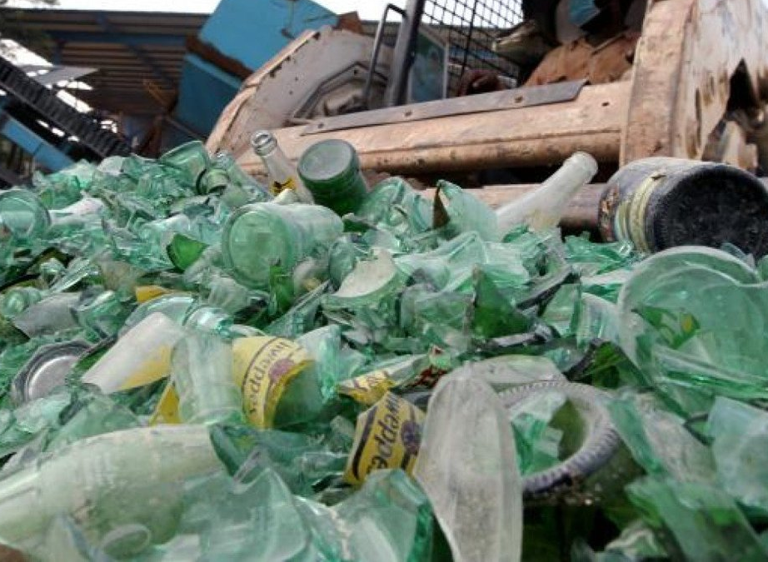
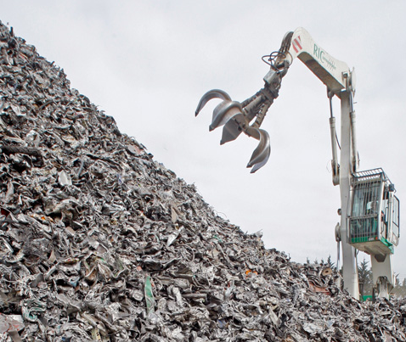
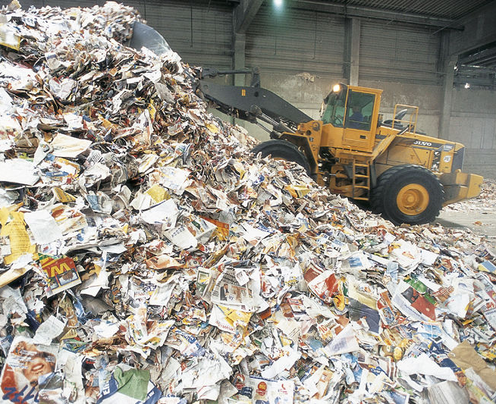
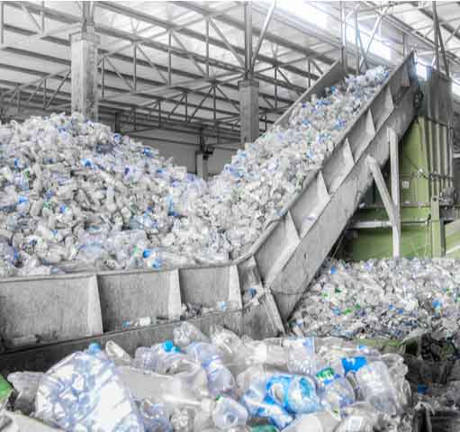
Recycling – I
Recycling:
When a product becomes unusable and thus a waste product, the technical materials “locked up” in them are extracted for reuse in new products.

Slide 21
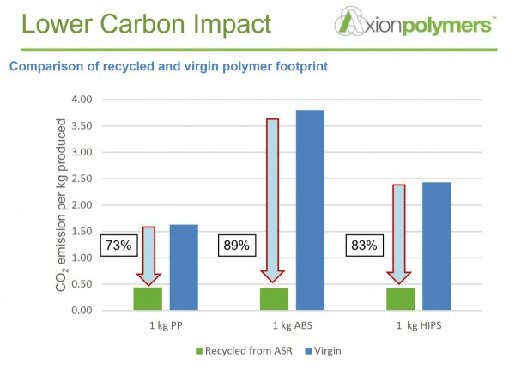
Recycling – II
In general, products made with recycled material can have lower carbon footprints, primarily be-cause the very carbon intensive step of resource extraction is avoided.
What is critical here is to minimize the carbon footprint of recycling processes. This means (a) working on the separation technologies and (b) ensuring that end-users can deliver the cleanest, best sorted waste materials.

Slide 22
Reduce the Purchase of Products – I
Up to now, we’ve assumed that products will be made and purchased by consumers.
But another CE practice we can adopt to decarbonise the production phase is to reduce the purchase of products (or services using products). Clearly, the less products (and the less services) which are purchased overall, the less products will be produced, and the lower will be the overall carbon footprint of the production phase.

Slide 23
Reduce the Purchase of Products – II
There are three versions of the “not purchasing” CE practice:
The most radical version (the “nuclear option”) is to put a brake on purchases. Don’t purchase products (or services) unless and until you really need them. Wait for as long as possible before purchasing anything.
This, e.g., is promoted as the top priority for clothes. Many of us have far too many clothes, and each item of clothing gets used far too little. It would be better to stop purchasing new clothes and use the clothes we have.
A special case is to purchase goods but reduce (ideally, eliminate) the amount of packaging that comes with the goods.
A less radical version is to purchase less products (or services), by extending the useful life of the products you have already purchased for as long as possible – will deal with this later under “Slowing down flows”.
A third version is to share products.

Slide 24
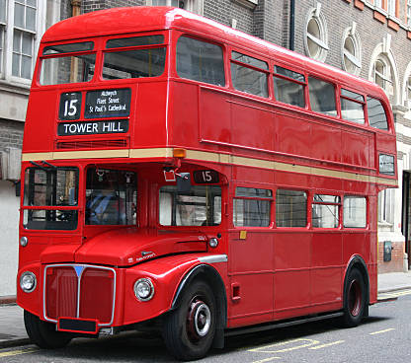
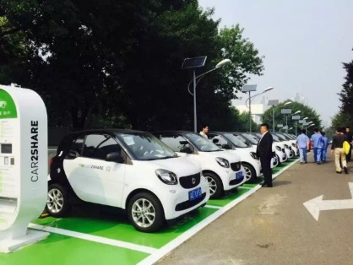
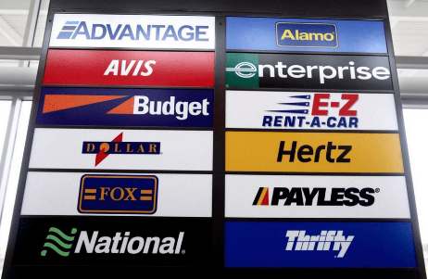
Reduce the Purchase of Products – III
Product sharing is a response to the fact that many of our products are under-used – there is a lot of “idle capacity” in our economies.
If one product is shared between many people rather than each person owning one copy of that product, many less products are needed to deliver the same amount of service => less materials needed => narrowed flows.
But also less (fossil) energy consumed => a smaller carbon footprint.
Many businesses are already built around the product-sharing business model. They have been joined recently by internet-based product-sharing businesses. These have the potential to greatly increase the pool of people sharing products.

Slide 25
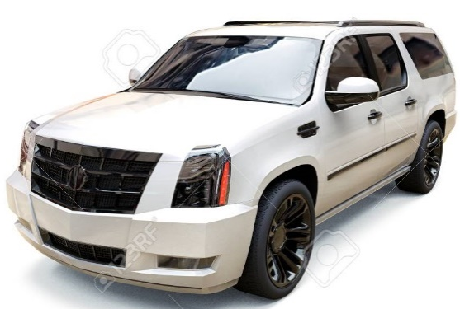
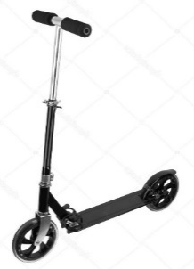
“Fit-for-Purpose” Purchasing
Even if you do purchase a product, you can still choose a product which doesn’t offer you more than you really need: that is “fit-for-purpose”.
Less materials, less energy, less “footprint” in the production phase

Slide 26
Efficiency
The mining, farming, and manufacturing sectors can of course decarbonise through the CE practice of good old-fashioned efficiency. Efficiency decarbonises in two ways:
The more efficiently these sectors consume fossil fuels, the less overall they will consume.
MORE IMPORTANTLY, greater efficiency in resource extraction and processing + greater efficiency in manufacturing => less (fossil) energy consumed by these sectors => the smaller will be the carbon footprint of the products they make.

Slide 27
Support of Circular Economy Transition to Decarbonisation in the Use Phase

Slide 28
Example of Carbon Footprints Revisited
WASHING MACHINE
Distribution
Manu-facturing
Carbon Footprint
Manu-facturing
Distribution
Use
Material supply
Material supply
Production Phase
Production + Use Phase
Support of CE practices for decarbonisation during the use phase will be especially impor-tant for products where energy and materials are consumed during use and where product lifetimes are long.

Slide 29
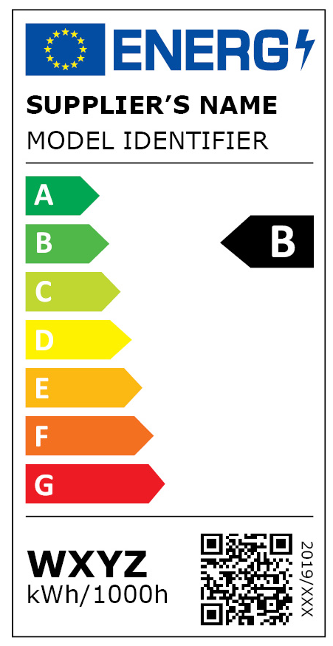
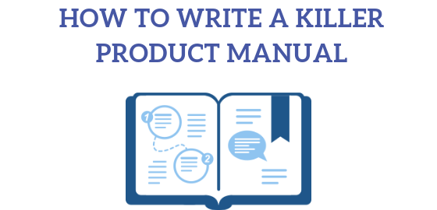
Efficient Use
Just as companies can be more efficient, so can consumers. But they need help!
Manufacturers need to design products which are inherently more efficient (governments need to use policies to push manufacturers to do this).
Manufacturers also need to give consumers information on how to use their products efficiently (governments can also give consumers this information).

Slide 30
Extending Useful Lives for Products
The objective of the “Slowing down flows” strategy is to keep products in use for as long as possible, so as to “extract” as much use from each product:
=> less new products purchased overall => less material flows=> less carbon footprint.
Reamnufacturing/refurbishing has already been covered. The other CE practices here are (a) maintenance and repair, and (b) reuse (2nd-hand products).
NOTE 1: Properly maintaining an energy-consuming product will also mean it consumes energy more efficiently => smaller carbon footprint.
NOTE 2: For energy-consuming products, there could be situations where extending use increases the overall carbon footprint: the newer version of the product is more energy efficient. So this is one CE practice where there could be a conflict of interest between circularizing economies and decarbonising them.

Slide 31
Circular Economy Business Models

Slide 32
Business models for Circularity
Enterprises can “knit together” all the various CE practices discussed into a coherent cicularising strategy for their products.
They can then (re)design their products to support the chosen strategy.

Slide 33
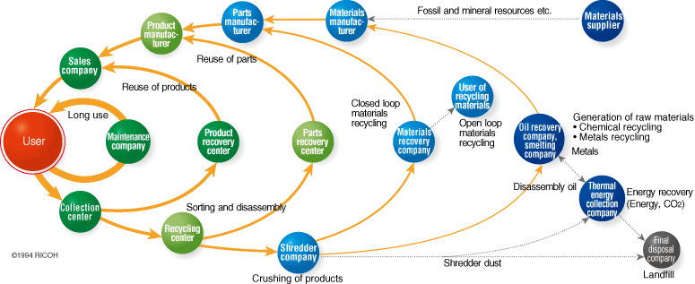
Example of a Circular Economy Business Model
Ricoh’s Comet CircleTM
Leasing business model
Reuse of parts
Remanufacture
Good maintenance and repair
Recycling
Treatment, Disposal

Slide 34
Questions?

Slide 35
Thank you!

Slide 36
https://www.researchgate.net/publication/226206499_Life_cycle_assessment_of_commercial_furniture_A_case_study_of_Formway_LIFE_chair

