Slide 1
Impact of COVID-19 on Manufacturing Enterprise Performance in Developing and Emerging Economies
Green Industry Summer School-2022
27 July, 2022, Vienna
Ozunimi Iti, Industrial Development Officer
Department of Environment
Alejandro Lavopa, Research and Industrial Policy Officer
Department of Policy Research and Statistics
United Nations Industrial Development Organization

Slide 2
Let’s test ourselves

Slide 3
UNIDO COVID-19 firm level survey
Objectives of the survey
Assess current and future impact of the pandemic on manufacturing firms
Document type of responses from firms and governments
Identify factors of vulnerability and resilience
Modality of implementation
Survey implemented online with support of local partners on the field (industry associations, chambers of commerce, universities, government agencies)
Coverage
About 4,000 responses collected in 26 countries covering Asia, Africa and Latin America during the 1st and 2nd quarters of 2021 (see next slide)

Slide 4
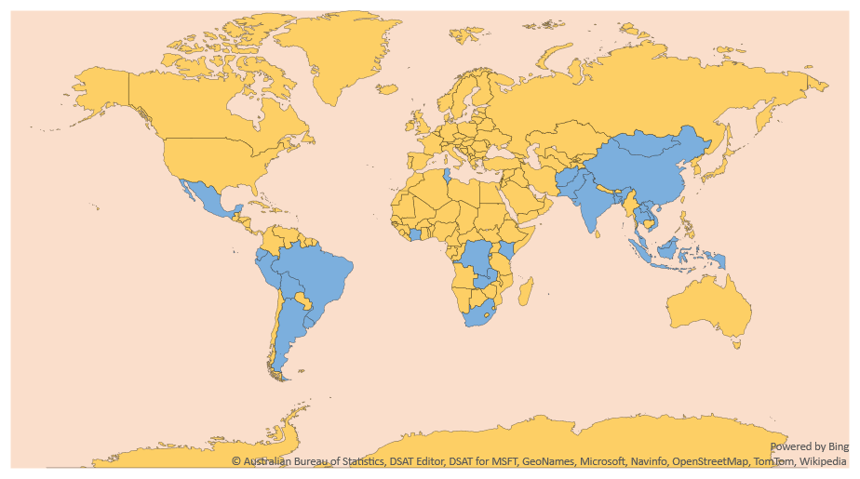
UNIDO COVID-19 firm level survey: regional coverage
11 Asian countries (2q 2021)
2,200 firms
7 Latin-American countries
(2q 2021) 1,000 firms
8 African countries (1q 2021)
900 firms
Notes:
Asia (11): Afghanistan, Bangladesh, China, India, Indonesia, Lao PDR, Malaysia, Mongolia, Pakistan, Thailand, Viet Nam
Africa (8): DRC, Ivory coast, Kenya, Mauritius, Rwanda, South Africa, Tunisia, Zambia
Latin América (6): Argentina, Bolivia, Brazil, Ecuador, Peru, Mexico, Uruguay

Slide 5
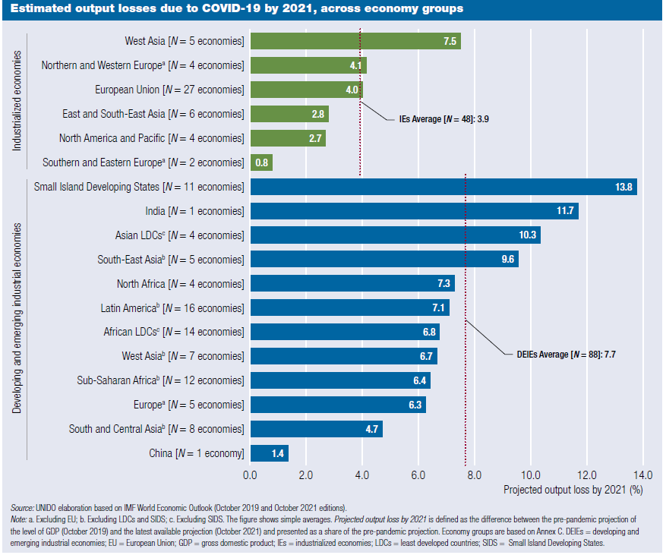
Who were the most affected?
Estimated output losses due to COVID-19 by 2021, across economy groups
The economic impact was uneven across regions
Industrialized economies (IEs) were less affected than developing and emerging industrial economies (DEIEs)
The estimated output loss by 2021, compared to the prepandemic estimates, is 3.9 and 7.7 percent on average in each group.
Source: UNIDO elaboration based on IMF World Economic Outlook (October 2019 and October 2021 editions).
Notes:
Note: a. Excluding EU; b. Excluding LDCs and SIDS; c. Excluding SIDS. The figure shows simple averages. Projected output loss by 2021 is defined as the difference between the pre-pandemic projection of
the level of GDP (October 2019) and the latest available projection (October 2021) and presented as a share of the pre-pandemic projection. Economy groups are based on Annex C. DEIEs = developing and
emerging industrial economies; EU = European Union; GDP = gross domestic product; IEs = industrialized economies; LDCs = least developed countries; SIDS = Small Island Developing States.
The impact on economic activity has been different across regions. Industrialized economies (IEs) were less affected than developing and emerging industrial economies (DEIEs).
The estimated output loss by 2021, compared to the prepandemic estimates, is 3.9 and 7.7 percent on average in each group. But the range of impacts is also much more pronounced in DEIEs, where the projected losses range from a maximum of 13.8 percent in Small Island Developing States (SIDS) to a minimum of only 1.4 percent in China.
Within IEs, oil-rich economies of West Asia together with Northern and Western Europe and the European Union (EU) have been the most impacted by the crisis, with output losses over pre-pandemic
Estimates of 7.5 and 4 percent by 2021. Among DEIEs, the most impacted were the SIDS, India, Asian least developed countries (LDCs), and South-East Asian DEIEs. South and Central Asian DEIEs (excluding India) and China, instead, rank among the groups with the lowest projected declines in output by 2021.

Slide 6
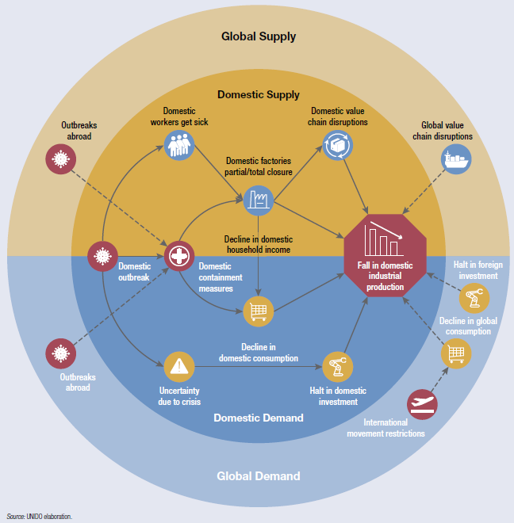
The framework: Connecting the COVID-19 outbreak to industrial production
Channels of impact within a country
The crisis simultaneously impacted the demand and the supply side
COVID-19 affected the global and domestic industrial production ecosystem
On the supply side, global value chain (GVC) disruptions severely impacted globalized domestic firms
Notes:
On the supply side (the upper part of the figure), the outbreak of the pandemic initially affected domestic industrial production through a healthrelated channel, as manufacturing workers got sick and factories closed or reduced their production. This was the case in the early stages of the crisis, when isolated outbreaks led to the closure of some factories. As the virus continued to spread, domestic authorities began introducing a number of containment measures that directly affected the operations of local factories and, consequently, overall industrial production. This effect was exacerbated when local supply chains were disrupted. It was also exacerbated when firms that had not previously been directly impacted by local restrictions could no longer produce because of shortages in key inputs and components.
In most cases, the supply-side effects triggered a decline in economic activity. These initial supply side effects were reinforced and magnified by the demand-side effects that followed (the lower part of Figure). The impact of COVID-19 on the domestic consumption of industrial goods tended to be very high because of the combined effect of the containment measures and the decline in household income due to layoffs resulting from factory closures or reduced operations. This self-reinforcing effect was spurred by a plunge in investments, as firms and investors postponed or cancelled investment projects as a result of the uncertainty generated by the crisis.
Taken together, the framework depicted in Figure above identifies seven channels through which the pandemic directly affected industrial production.

Slide 7
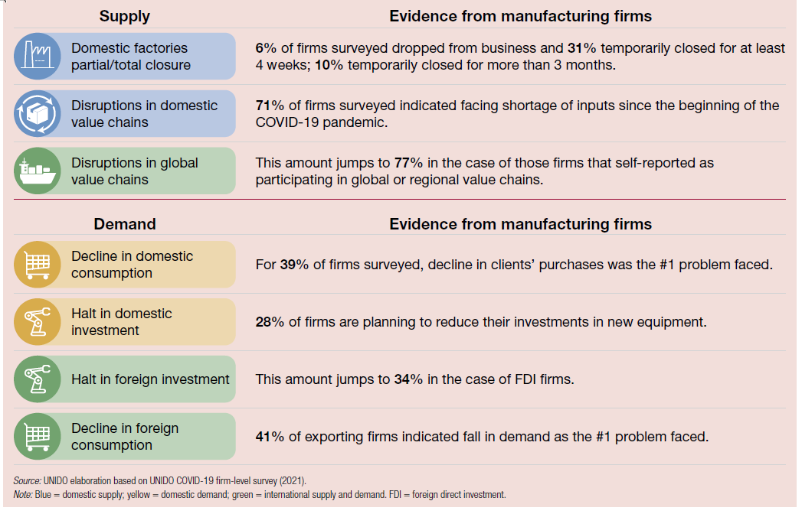
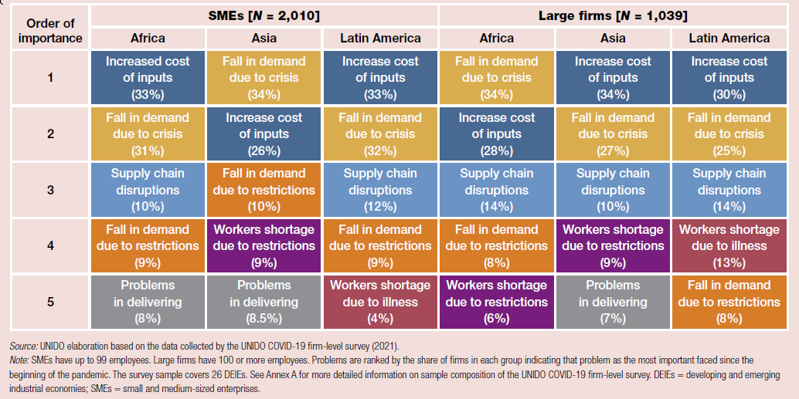
Channel of impact and challenged in Developing and emerging industrial economies
Channels of impact and evidence from selected DEIEs
Top five most important challenges faced by manufacturing firms in selected DEIEs across regions and firm types
Notes:
Figure 1 (left) summarizes the channels and provides snapshot evidence on how severe each of them have been for manufacturing firms operating in a subset of DEIEs, building on a recent survey on the impact of COVID-
19 conducted by UNIDO across 26 countries.
Figure 2 (right) illustrates the importance of each of these channels and their differential impacts across different types of firms. Each of these channels operates differently, depending on the country context and the responses
to the pandemic implemented by domestic actors. The importance of the channels also depends on the type of firm affected (see Figure 1.14). The major concern for most firms is typically either the fall in consumer demand due to the crisis or the increased cost of inputs.

Slide 8
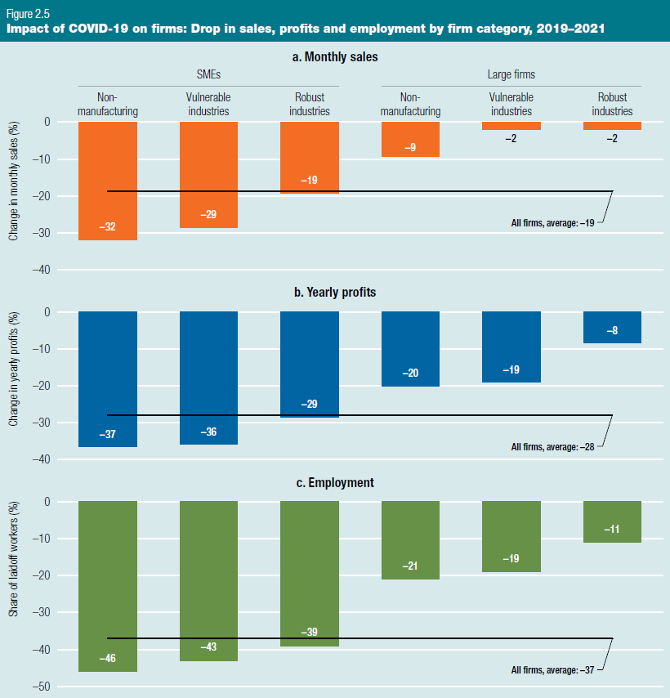
The impact of the pandemic was very diverse across firm groups
Data collected in 4,000 firm in 26 DEIEs in Africa, Asia and LAC
Monthly sales declined, on average, by about 20%. But this decline was much larger in SMEs than in large firms
Yearly profits declined, on average, by about 30%. Again, SMEs outside manufacturing and in vulnerable industries suffered much larger declines
The impact on employment was much more dramatic across SMEs and Large firms

Slide 9
Resilience: From countries to firms
Country-level, sector-level and firm-level factors shaping manufacturing firms’ resilience during the COVID-19 pandemic
Pre-existing factors affect socioeconomic resilience
Industrial capabilities have been a key ingredient of pandemic resilience
Digitally advanced firms were able to better resist the crisis
Notes:
Figure represents how these interrelations between the different factors and levels of analysis can enhance or weaken resilience at the firm level.
Country-level (macro) factors converge to amplify or reduce the effects of these channels. Examples include the degree of exposure of firms to international trade and the effectiveness of governments in tackling the crisis. Country-level industrial capabilities can also contribute to mitigating these effects.
firm-level conditions and characteristics also shaped the effect of the channels of impact across firms. Resilience lies in firms’ ability to adapt operations in response to the crisis

Slide 10
Digitalization and resilience
We investigate the relationship between digitalization and resilience
Main findings:
Digitally advanced firms have been more resilient against the COVID-19 shock
Digitally advanced firms show lower declines in their profits in 2020
Difference even more pronounced when looking at monthly sales (previous month against same month in 2020)
The difference remains even after splitting the sample by size (which was identified as an important determinant of adoption and also of impact)
COVID-19 impact: changes in monthly sales compared to same month in 2020, by level of digitalization of the firm and regions

Slide 11
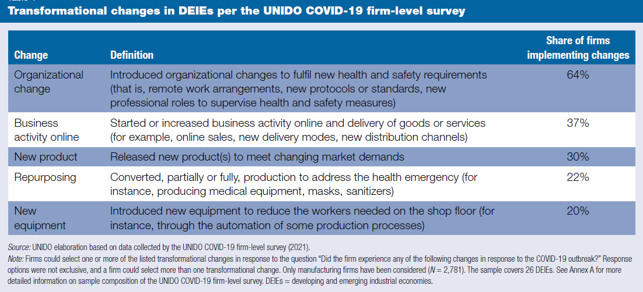
Types of responses
Five types of transformational changes were implemented by manufacturing firms
Organizational changes were very frequent among surveyed firms
Digitally advanced firms introduced changes more often
Notes:
When it comes to firms, five types of responses have been identified (see Table ) based on original data collected for this report. These responses are considered transformational changes as they imply strategic
changes in the organizations, operations, routines as well as business models of the firms. These changes pursued two aims: a more proactive one, to exploit opportunities created by the shock, and a more defensive
one, to cope with the constraints imposed by the crisis and thrive through the crisis to re-orient towards the new normal.

Slide 12
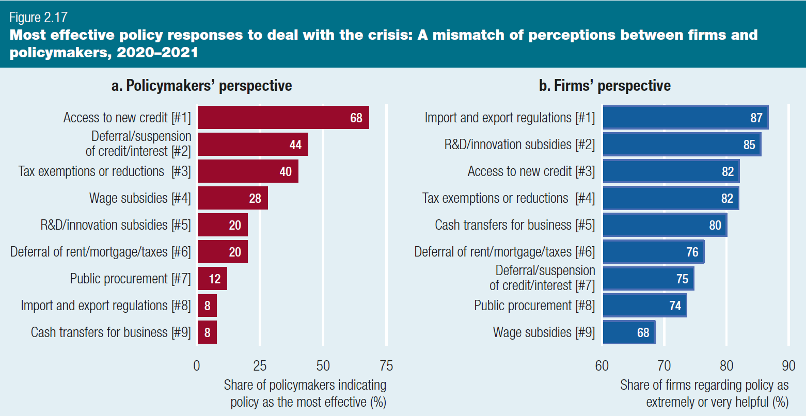
Different perceptions on the effectiveness of policies implemented during the pandemic
UNIDO survey on policymakers (left panel) and firms (right panel)
Policymakers expected relief measures to be the most effective
But firms indicated trade regulations and R&D subsidies as the most helpful

Slide 13
Empowering Green Recovery
https://www.youtube.com/watch?v=B_L5tJvBE8c

Slide 14
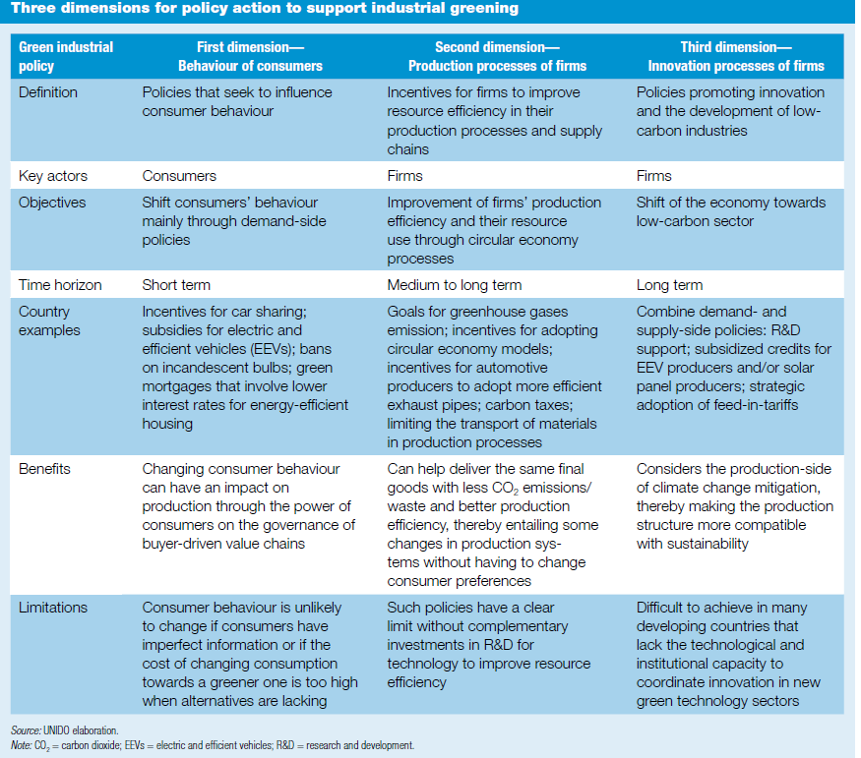
Three dimensions for policy action to support industrial greening
Policy focus should shift to the strengthening of new productive and innovative capabilities related to green industries
Such a green policy has three dimensions: behaviour of consumers, production processes of firms and innovation processes of firms.
Notes:
In the longer term, however, the policy focus should shift to the strengthening of new productive and innovative capabilities related to green industries that promote a transition from “low-quality” activities
to “high-quality” activities.
Table describes each policy dimension and uses examples to illustrate how post-pandemic green industrial policy can address those dimensions. It also highlights the importance of policies to promote the
circular economy in manufacturing processes and supply chains (see the column labelled “Second dimension—Production processes of firms” of Table ), so that a more efficient and sustainable use of resources can ensue and contribute to resilience

Slide 15
Thank you

