Slide 1
Russian Invasion of Ukraine
Resource and Policy Implications
May 2022

Slide 2
What is food security?

Slide 3
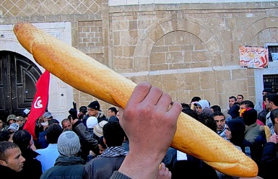
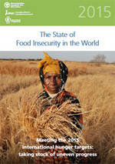
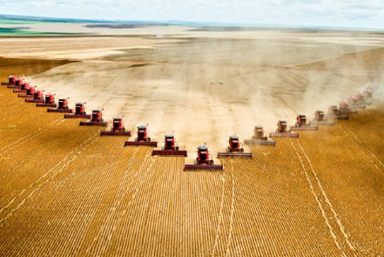
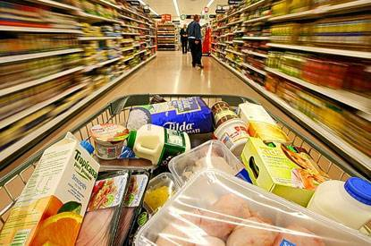
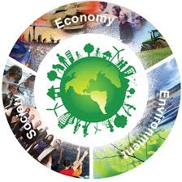
“Food security exists when all people, at all times, have physical and economic access to sufficient, safe and nutritious food that meets their dietary needs and food preferences for an active and healthy life”. (World Food Summit, 1996)
“9 meals from anarchy” & “hunger challenge” food security: is the short term supply of food assured to allow people to eat when they are hungry?
“market-led” food security: can the market supply the sorts of food people like to eat, cheaply? The cheap-food focus ignores the costs externalised to the environment and health systems.
“Sustainable” food security: can the market be structured to supply food that people like and want, and that underpins a healthy diet, and is supplied sustainably (i.e. costs are not levied on health and environment)?

Slide 4
What is a “food systems’ APPROACH”?
Taking a food systems approach is much needed to avoid problems getting worse…

Slide 5
The term ‘food system’ encompasses the entirety of the production, transport, manufacturing, retailing, consumption and waste of food. It also includes impacts on nutrition, human health and well-being, and the environment.
waste
Notes:
Where to intervene to make the system sustainable? Choice which sets demand or production (supply)?
Who shapes the food system?
Consumers say the food companies
The food companies say the consumer
Govt stays out of it as long as the market more or less works
Consumers ultimately have the power but not necessarily the knowledge
How much does the food chain have a responsibility to drive things towards sustainability?

Slide 6
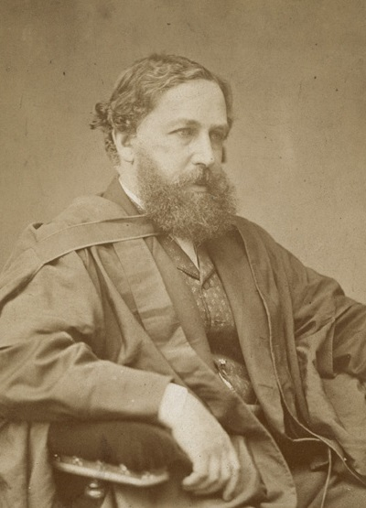
Meeting demand can make demand – Jevons’ paradox
Demand
Supply
Supply
Demand
Examples:
Palm Oil
grains and meat
“Efficiency thinking” confuses relative with absolute impacts: increasing efficiency whilst increasing supply increases the absolute impact
Hawkes et al 2012 Food Policy
Benton & Bailey 2019 Global Sustainability

Slide 7
Why does this matter?

Slide 8
Is cheaper food a public good? The experience over 60 years

Slide 9
The “cheaper food paradigm” (CFP) drives interlocking vicious circles
More
biomass for carbon capture and storage
Reduced
Nutrient
Content
Malnutrition
(in all its forms)
More
Waste
Climate Change
CFP: Agricultural
Intensification and trade
Agricultural
Expansion
More
Livestock
Yield
Decline
Dietary
Convergence
Crop
Concentration
Soil
Depletion
Biodiversity
Loss
Source: Benton et al 2021 Chatham House report
Benton & Bailey 2019 Global Sustainability

Slide 10
Systemic inefficiency
waste
Huge inefficiency
~30-~40% efficiency for calories and proteins (Alexander et al 2017)
Health and environmental costs 5-10x more than agricultural GVA
Huge efficiency

Slide 11
Huge inefficiency ….. and great fragility

Slide 12
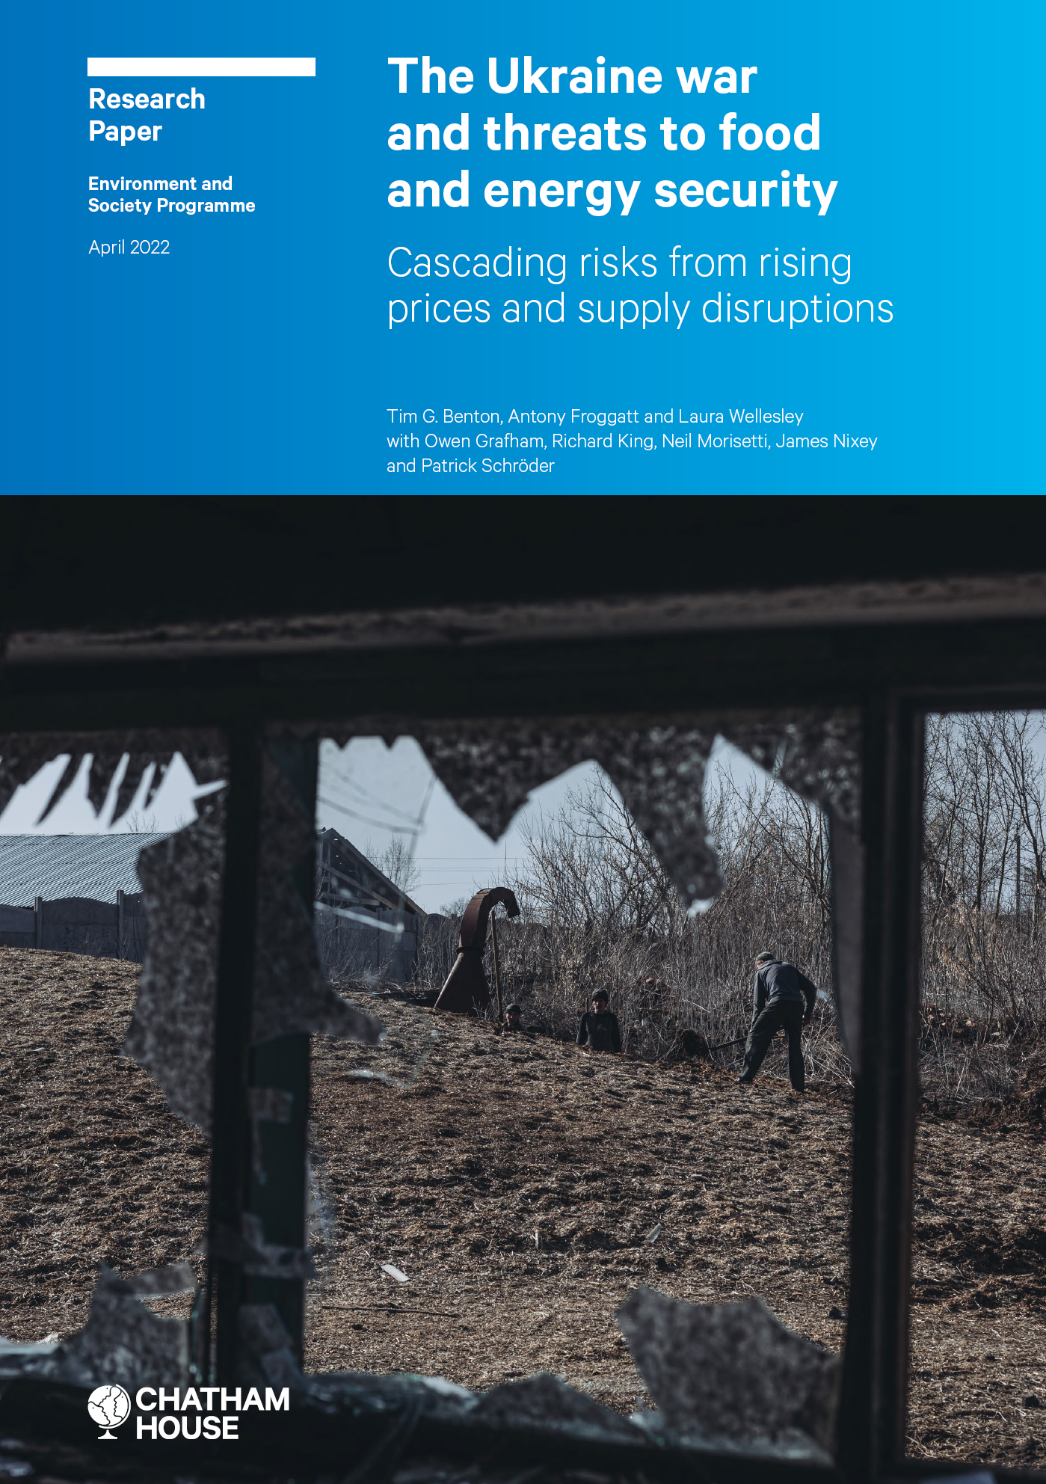
BACKGROUND
Context
Russia’s invasion of Ukraine has shocked global politics and markets. While there is uncertainty over how the war will develop, it is certain that its ramifications will be both long-lasting and far-reaching for societies around the world.
Both Russia and Ukraine are highly important to global resource markets, particularly for energy, food and fertilizers.
Prices for these commodities have spiked as a result of economic sanctions, trade restrictions and policy interventions introduced by national and regional governments in response to the invasion. This trend has been further exacerbated by disruption to supply chains and fears of potential supply shortfalls.
Following the COVID-19 pandemic, a global cost-of-living crisis had ensued, characterized by rising levels of energy and food poverty. Demand in energy, food and fertilizer markets was already running ahead of supplies and driving up prices. These conditions will be significantly worsened by the war in Ukraine.
High prices for energy and food pose immediate threats to human security, particularly among low-income and vulnerable populations in all economies and against a backdrop of post-pandemic inflation and limited fiscal capacity.

Slide 13
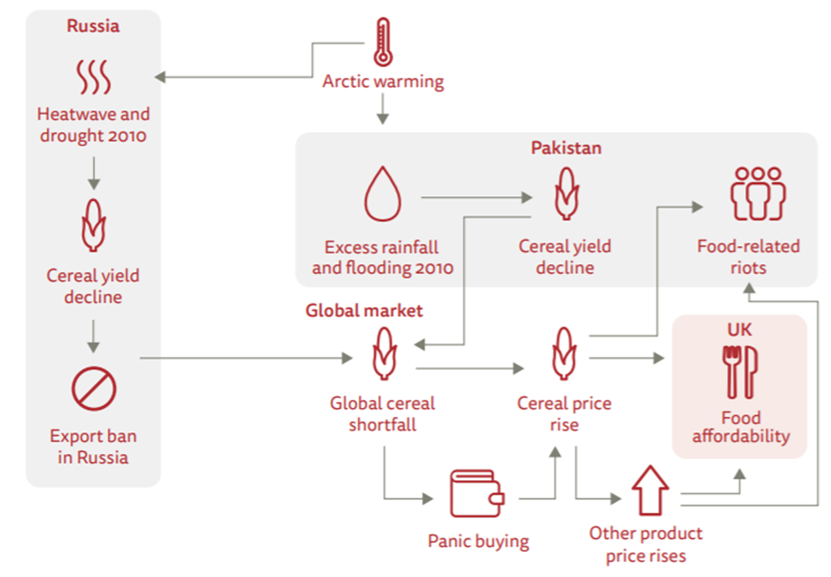
BACKGROUND
The war in Ukraine, and its impacts on resource markets, could trigger cascading risks globally
In recent decades, the pursuit of economic growth as one of the main goals of development has led to an increasingly interconnected world, characterized by just-in-time supply chains, rising inequality and efforts to maximize comparative advantage.
This global interconnectedness has many benefits, but it also creates systemic fragility to events that disrupt supply – whether caused by geopolitical events or environmental hazards (such as through the COVID-19 pandemic or climate change impacts).
As is increasingly apparent, this systemic fragility is undermining ways of life as crisis follows crisis.
Concentrated markets and complex supply chains have increased the risk of price instabilities and impacts on production in one region can have significant impacts in other countries and regions
Climate change is a threat multiplier and there is increase evidence of its impacts: such good shortages and higher prices leading to social unrest and/or migration.
To this existing state of systemic fragility, the conflict in Ukraine has added both direct threats – high energy and food prices and the threat of reduced supply – and cascading risks, with the potential for resource market impacts to ripple out and deepen economic insecurity.
The figure below is an example of cascading climate risk with a starting point of declining cereal yields. A similar chain of events was seen in 2010-11 due to Ukraine/Russia heatwave - and ultimately contributed to the Arab Spring and the deep geopolitical reconfigurations to which it gave rise.

Slide 14
BACKGROUND
Possible outcomes of the war
Possible outcomes of the war
Russian objectives – for Ukraine to pivot politically to the east and/or for large parts of the country to be brought under Russian control – currently seem unlikely to be met.
The war has, so far, strengthened NATO and led to an increase in Western governments’ military expenditure.
EU views towards Russia have significantly hardened – particularly Germany’s zeitenwender, or sea change – and are likely to remain so.
Ukraine’s economy and infrastructure have been decimated and are likely to suffer further. Recovery will take decades.
A regional conflict is possible
  Moldova is seen as a likely country for future invasion.
  Even the use by Russia of non-conventional weapons, nor a conventional attack on a nuclear power plant, may not necessarily lead to a regional conflict.
  And even if the conflict spreads to other countries, it may be the case that not all NATO countries become involved.
A cessation of conflict may occur for and might:
  Lead to both Russia and Ukraine declaring victory.
  See Russia increase the territory under its control with ongoing, localised conflicts.
  Delay, but not necessarily halt, the expansionist desire of the current administration in Russia.
The duration and evolution of the conflict will determine:
  If or when international economic, political and cultural sanctions are scaled down.
  The speed at which the EU seeks to become independent from Russian fossil fuels.
  The extent of the bipolarisation of global politics (EU+US vs Russia+China-led blocks): structural change in world markets is inevitable

Slide 15
Food
Russian Invasion of Ukraine
Resource and Policy Implications
Summary
Existing trends 2000-2021
Black Sea region’s importance to global food security
Impacts since 24 Feb invasion
Potential scenario outcomes
Policy options
Chatham House | The Royal Institute of International Affairs

Slide 16
SUMMARY
Russia’s invasion has caused food prices to reach their highest level on record;
the World Bank predicts a ‘human catastrophe’ food crisis
Existing trends pre-invasion | Food prices were already at 2010-11 levels by the end of 2021, and fertilizer prices reached historic highs. Global nutrition security has become more precarious since the onset of COVID-19.
Black Sea region’s importance to global food security | Ukraine and Russia are collectively responsible for ~12% of global calorie exports and ~5% of total global market calorie production. Many low-income, food-deficit countries depend heavily on wheat from Russia and Ukraine. Much of South and Central America, West Africa and Europe – including Ukraine itself – are heavily reliant on Russia and Belarus for their fertilizer imports, especially for potash.
Impacts since 24 February invasion | Global food prices have reached all-time highs since the invasion. 20-30% of Ukraine’s usual harvest may be lost; impacts on particular crops will differ depending on the regions into which the conflict spreads and how it continues. Governments have responded with trade restrictions and, in the EU’s case, with an easing of environmental protections.
Potential scenario outcomes | Disruptions in fertilizer markets risk constraining harvests around the world; poor weather conditions bring additional risks. The World Bank predicts a ‘human catastrophe’ food crisis, and even best-case scenarios will bring severe market disruption. The medium- to long-term ramifications are highly uncertain, but could ultimately prompt an Arab Spring-like situation as well as permanent structural change in global markets.
Policy options | Policy responses must not undermine long-term resilience, and must tackle demand. Production sustainability is fundamental for food system resilience and food security Protecting the vulnerable should be a top priority, but so too should locking in more sustainable demand patterns Strategic reserves in food-deficit regions and global market transparency are both critical to system resilience

Slide 17
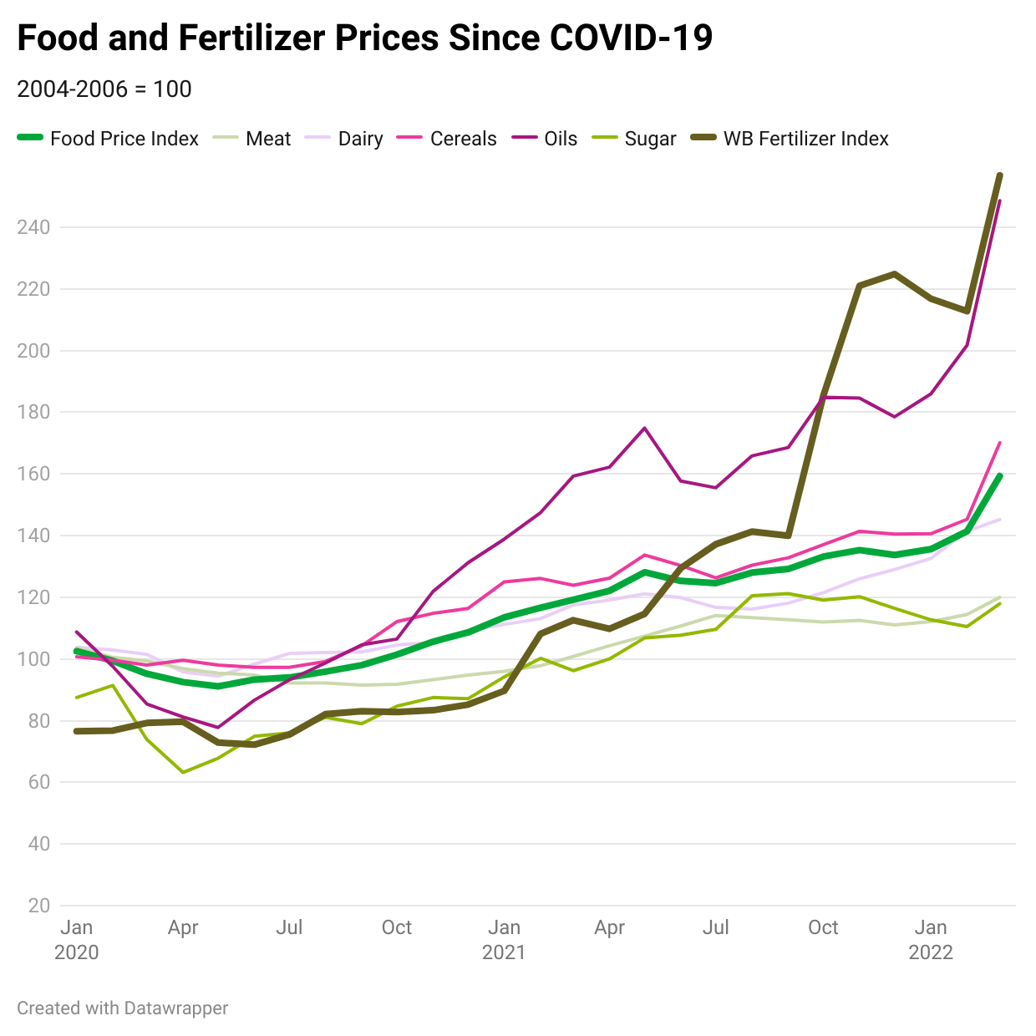
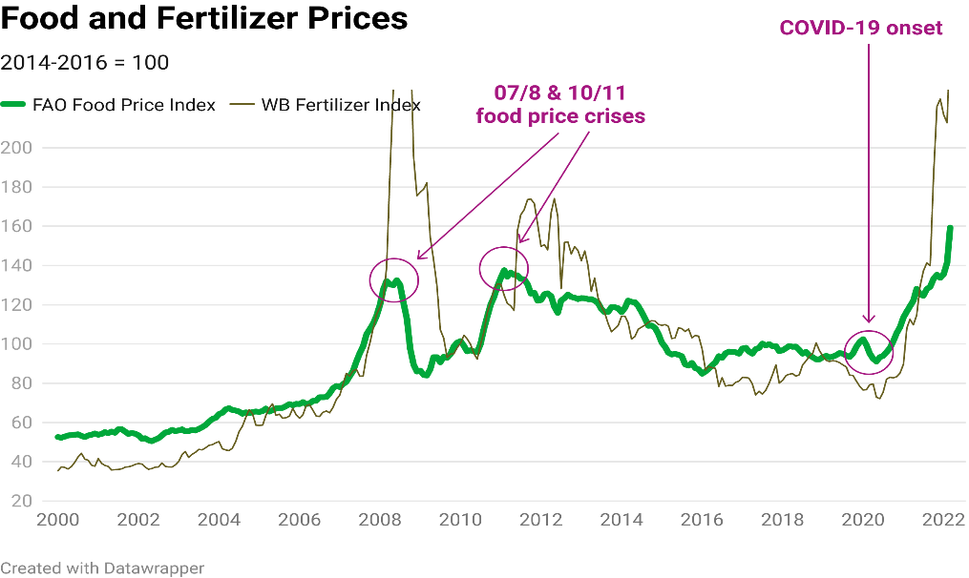
EXISTING TRENDS PRE-INVASION
Food prices were already at 2010-11 levels by the end of 2021, and fertilizer prices reached historic highs
Global food prices were already experiencing their sharpest and most sustained increases since the 2007-08 and 2010-11 food price crises, well before conflict concerns were being priced in
Food price rises were the result of demand increases and logistical challenges
By February 2022, global food prices exceeded the all-time highs of 2011. This trend reflects generalized food price increases across all food commodity types, but prices for vegetable oils have shown the most dramatic increases.
Whereas the 2007-08 and 2010-11 food price crises were driven by supply constraints and subsequent trade restrictions, the 2021 price rises reflected supply-chain challenges in responding to the bounce-back of demand as economic restrictions were lifted. Particular pressures included:
the stranding of empty shipping containers in Europe and the US at a time when demand for Asian exports was increasing rapidly;
increasing demand for vegetable oils in the biodiesel sector; rising energy prices (leading to rising input prices);
and recovering Chinese demand for grain as it looked to restore reserves following the 2018-19 African swine fever outbreak.
Fertilizer prices rose in near lock-step with energy prices throughout 2021 and reached their highest level for 13 years in October
High energy prices and sanctions imposed by Canada, the EU, the UK and the US on Belarus’s state-owned potassic fertilizer supplier, Belaruskali, drove price increases through the first half of 2021, but prices spiked from July when China suspended exports, hitting global supply of phosphate-based fertilizers, and again at the end of the year when Russia restricted exports of nitrogenous and phosphate-based fertilizers for six months.
Notes:
LW – refs and bullets

Slide 18
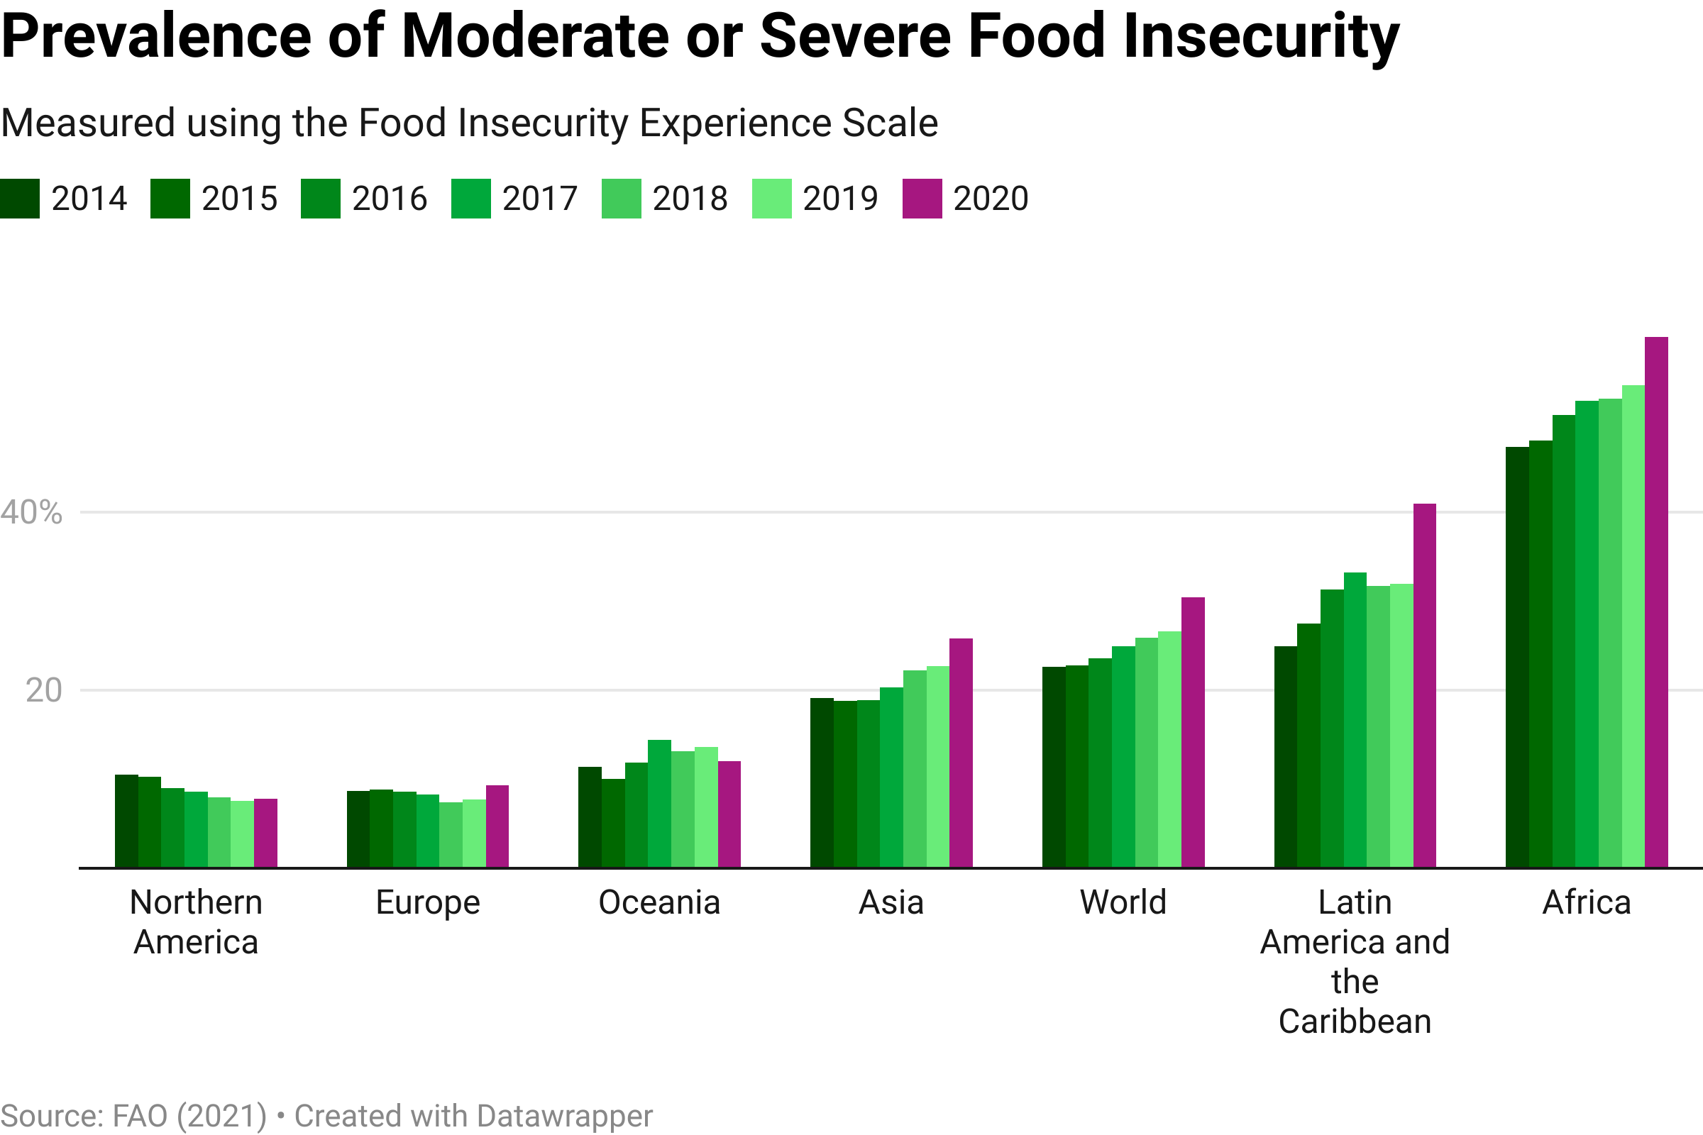
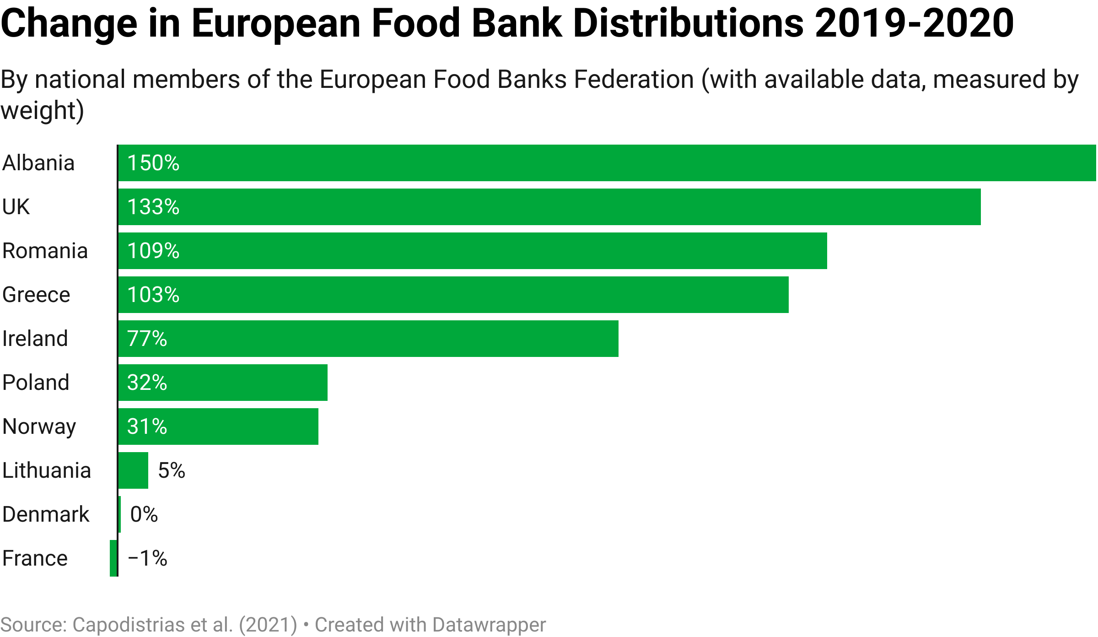
EXISTING TRENDS PRE-INVASION
Global nutrition security has become more precarious since the onset of COVID-19
The global prevalence of moderate or severe food insecurity has been slowly increasing since 2014, but the estimated increase in 2020 was equal to that of the previous five years combined
Food poverty and food bank dependence increased sharply in Europe as a result of COVID-19
¹
²
Nearly one in three people (2.4 billion) did not have access to adequate food in 2020 – an increase of almost 320 million people
Nearly 40% of those people (12% percent of the global population, 928 million) faced severe food insecurity
The 2020 increases were sharpest in Latin America and the Caribbean and Africa, but even in Northern America and Europe, regions with the lowest rates of food insecurity, the prevalence of food insecurity increased for the first time since the beginning of data collection in 2014
An estimated 6.6% of households with children in the EU were unable to afford a meal with meat, fish, or a vegetarian equivalent every second day in 2020.³
¹ FAO/IFAD/UNICEF/WFP/WHO (2022) ² Capodistrias et al. (2021) ³ Van Lancker and Parolin (2021)

Slide 19
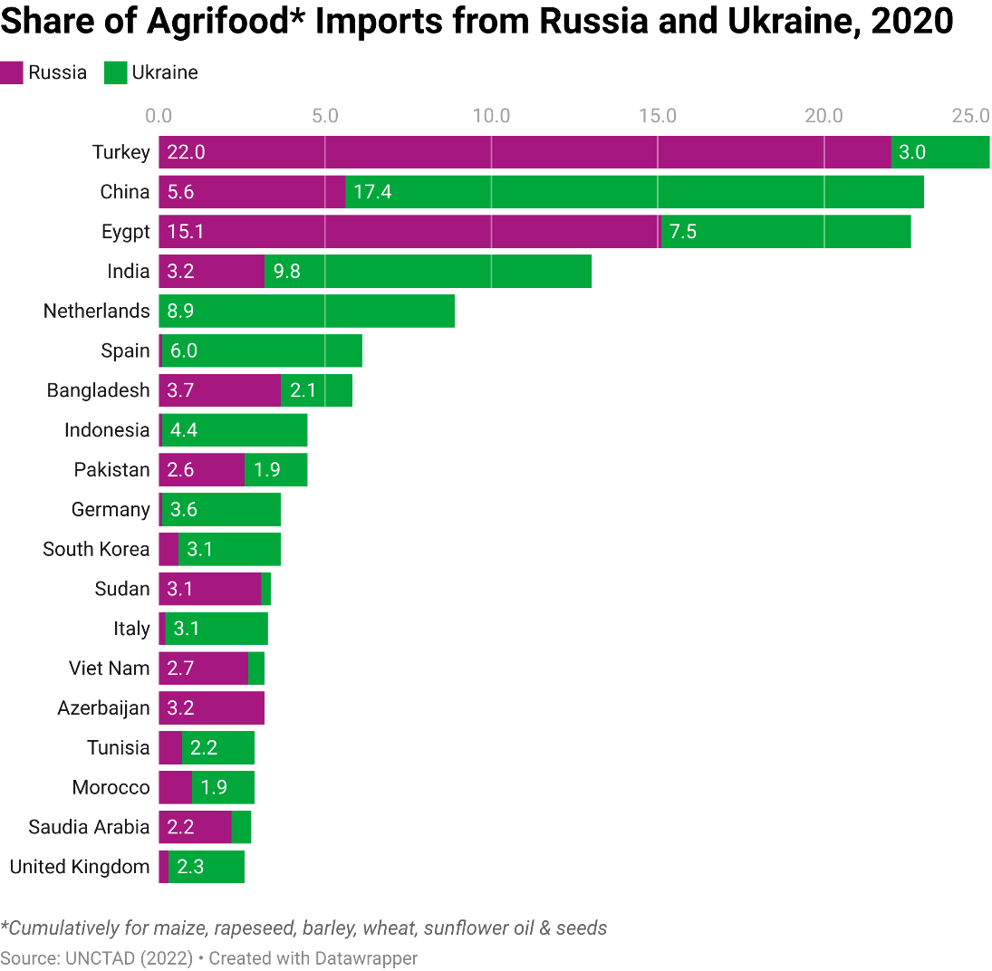
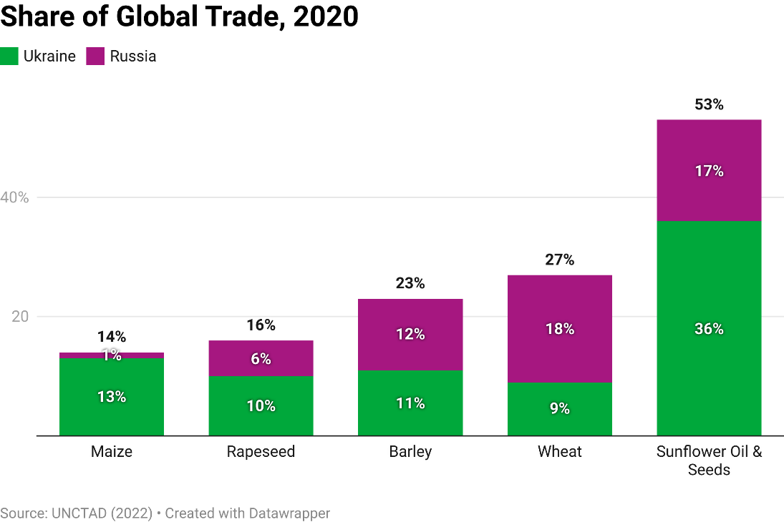
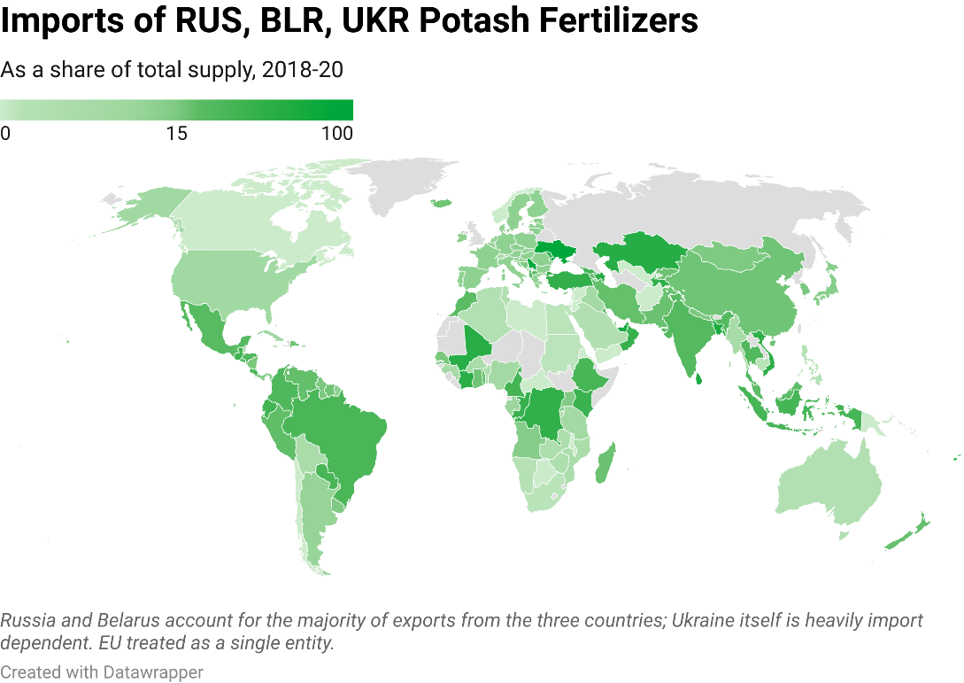
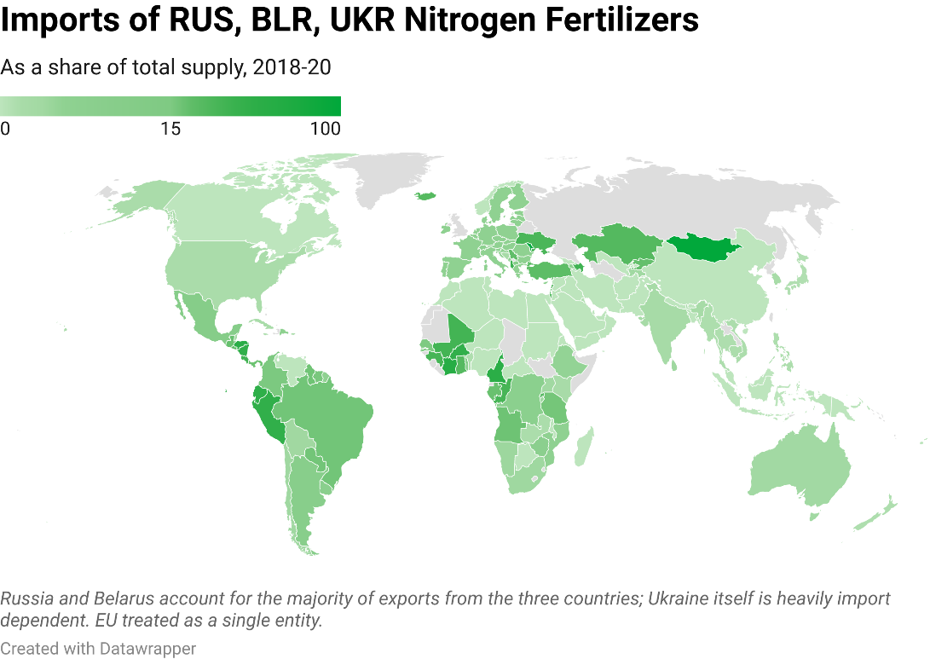
IMPORTANCE TO GLOBAL FOOD SECURITY
Russia and Ukraine are globally significant players in grain, oilseed and fertilizer markets
UKR & RUS are collectively responsible for ~12% of global calorie exports and ~5% of total global market calorie production¹
Many low-income, food-deficit countries depend heavily on wheat from Russia and Ukraine³
Much of South and Central America, West Africa and Europe – including Ukraine itself – are heavily reliant on Russia and Belarus for their fertilizer imports, especially for potash²
In addition to direct import exposure, UNCTAD calculates more than 5% of the import basket of the poorest countries are products that are likely to face a price hike resulting from the ongoing war in Ukraine. The share is below 1% for richer countries.
¹ Calculated from FAO Food Balance Sheets ² Chatham House (2022) ³UNCTAD (2022)

Slide 20
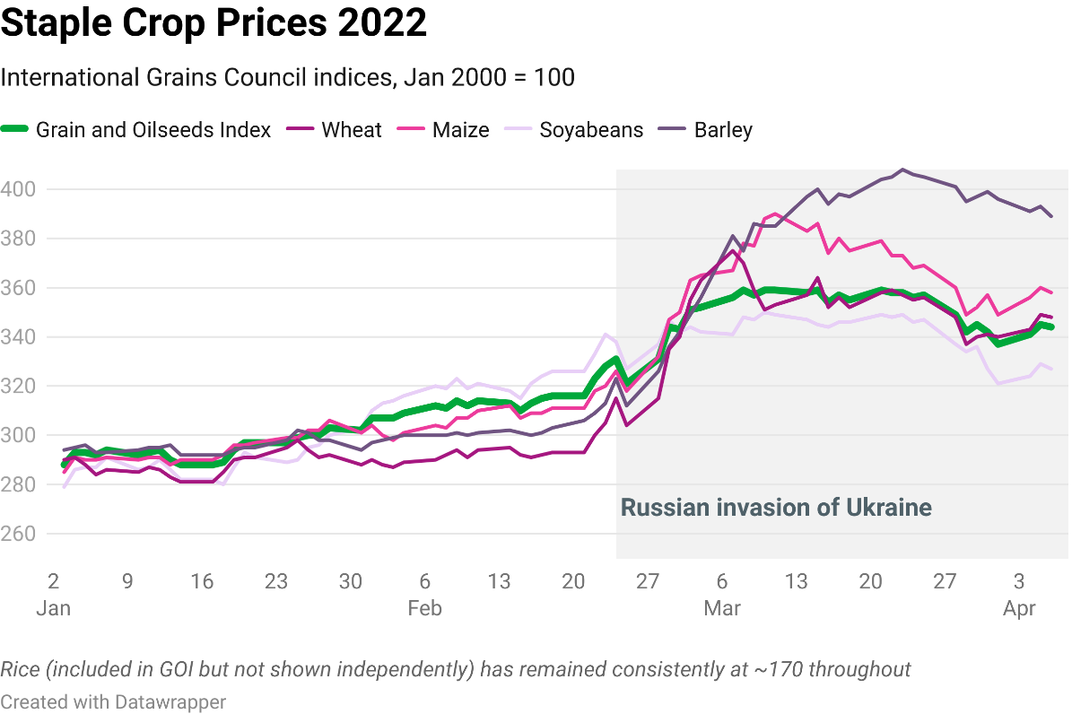
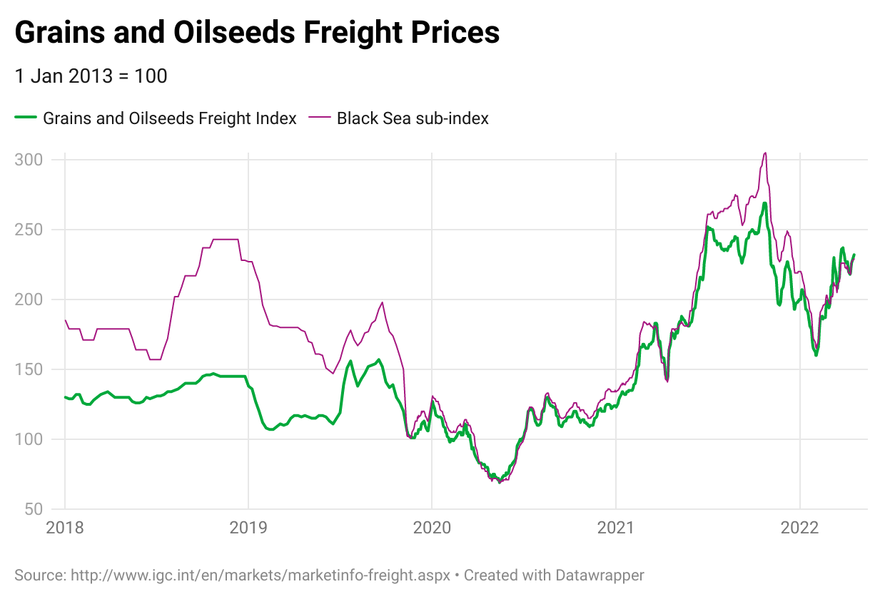
IMPACTS SINCE INVASION
Food and fertilizer prices have skyrocketed since Russia’s invasion
Global food prices have reached all-time highs
Shipping costs have risen sharply
Freight rates were already at historic highs before the conflict owing to COVID-19 disruptions; recent declines have been reversed since the onset of the conflict.
High insurance premiums, extra customs checks to avoid sanctions infringements and rising energy costs are exerting upward pressure on shipping costs.
Bunker prices are now twice the average of the five years pre-COVID.³
UNCTAD estimates that high freight could increase consumer prices by 1.5% over 2022.⁴
Prices for all staple crops barring rice, and especially for barley and maize have surged since invasion, though are starting to recede slightly.
In March, the FAO’s food price index was 34% higher than in April 2021.¹
World Food Programme operational costs are increasing by up to $71 million a month as a result of food and fuel inflation
¹ FAO Food Price Index ² UN-GCRG (2022) ³ UNCTAD (2021)

Slide 21
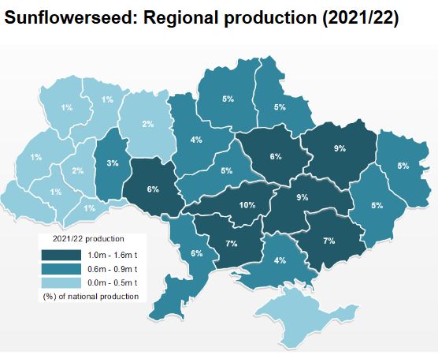
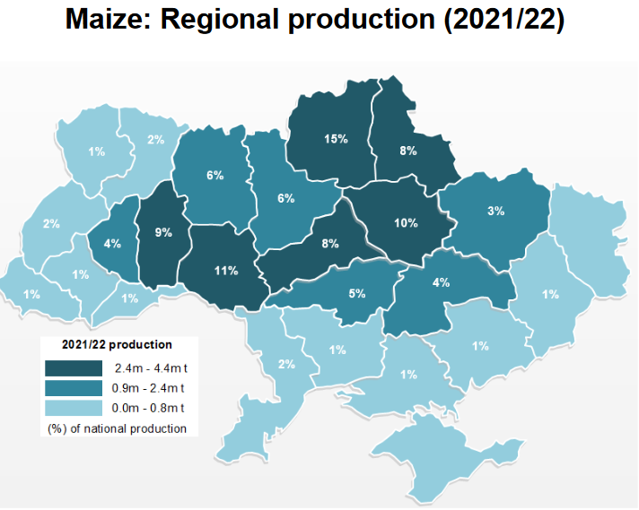
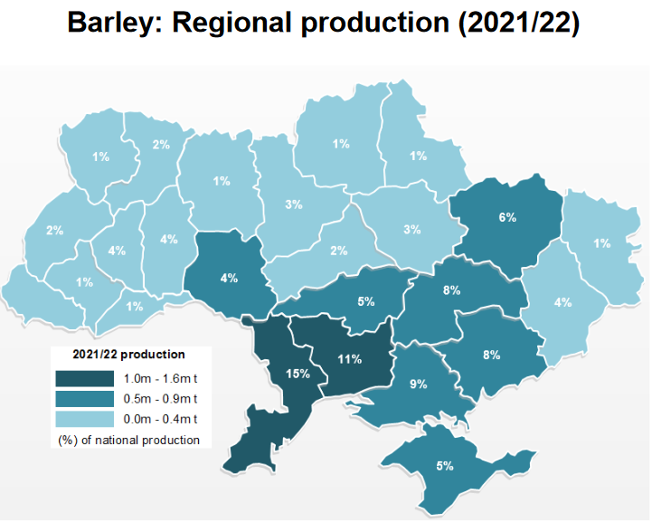
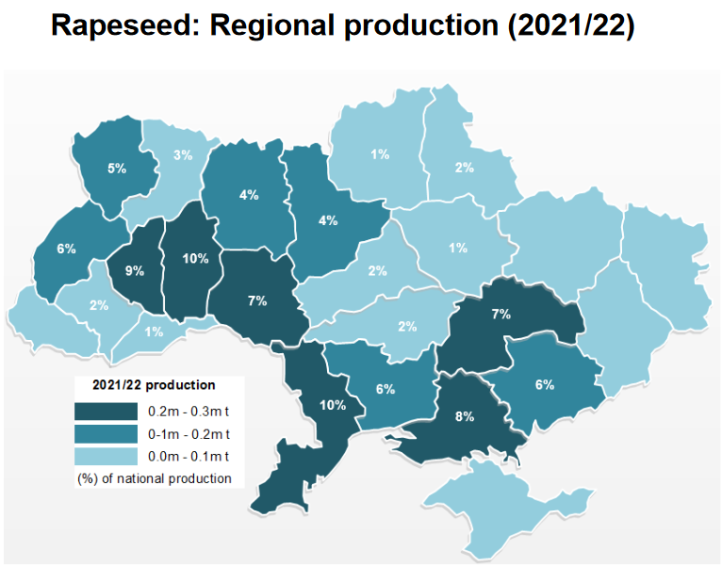
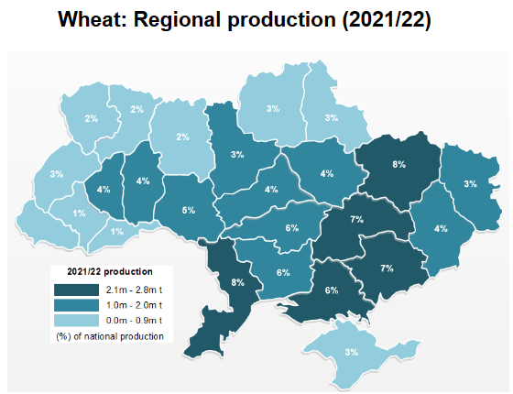
IMPACTS SINCE INVASION
Grain, oilseed and fertilizer exports from Russia and Ukraine have all but stopped
Russian fertilizer exports have all but stopped
Russian fertilizer exports are not subject to any sanctions or official export ban, but the suspension of services in Russia by a number of major shipping companies, coupled with importing countries’ restrictions on the docking of Russian vessels, led the Russian Ministry of Industry and Trade to issue a recommendation to the country’s fertilizer producers that they halt exports.¹
20-30% of Ukraine’s usual harvest may be lost, the geographic and temporal scope of the conflict may have differentiated impacts by crop
Ukraine’s most important sunflower- and wheat-growing regions are in the east and northeast of the country where fighting has been most intense. 7% of wheat production and 10% of sunflower seed production is in the Donbas region.² Maize production is more concentrated in northern and central regions, barley in the south, and rapeseed in the south west.
Many farmers will have been fighting or forced to flee; those still tending their land will struggle to access the necessary fertilizers, pesticides and herbicides, and fuel for farm machinery.
The main planting season for many crops has already been disrupted; if the conflict persists into late summer/autumn then harvesting activities will also be threatened. The FAO predicts 20-30% of the areas under winter cereals, maize and sunflower seed in Ukraine will either not be planted or remain unharvested during 2022–23 season.³
⁶
Ukraine’s ports are closed to commercial shipping. Its railways have been attacked by Russian forces and sabotaged by Ukrainian forces, and over 1,000 grain-carrying train wagons are reportedly queuing at the border with Poland. ³
⁵
1 Wall Street Journal (2022) 2 IGC (2022) 3 FAO (2022) 4 Reuters (2022) 5 IGC (2022) 6 USDA (2022)

Slide 22
IMPACTS SINCE INVASION
Governments have responded with trade restrictions and, in the EU, with an easing of environmental protections
A number of countries have introduced food export restrictions
Environmental protections have been eased in the EU to boost production, but remain unchanged in the US
Despite commitments and calls from the G7 agriculture ministers, the Agricultural Market Information System (AMIS) Rapid Response Forum and the Food and Agriculture Organization of the UN (FAO) director general to keep global food and fertilizer trade open, transparent and free from speculative behaviour, some countries have already moved to impose export restrictions on cereals and oilseeds:
In Europe: Hungary, Moldova, Russia, Serbia, Turkey, Ukraine
In Asia: Armenia, Indonesia, Kazakhstan, Kyrgyzstan
In Africa: Egypt
In South America: Argentina (increased export levy)
Indonesia’s decision in late April to ban palm oil exports further heightened concerns over high oilseed prices and cooking oil shortages.
EU: On 23 March, the EC introduced a number of measures to support producers:²
a temporary derogation from greening obligations, including permission to plant food and feed crops on fallow land while maintaining greening payments;
permission to offer state aid to producers, including fertilizer manufacturers and food processors;
temporary easing of minimum pesticide residue levels for food and feed;
and support for pigmeat producers (who were already facing a crisis pre-invasion).
US: The USDA has rebuffed calls from farm lobby groups and Republican lawmakers to allow for planting on land protected under the Conservation Reserve Program.³
Secretary Vilsack said: “Quickly converting this land to crop production is clearly unfeasible, even if we were to overlook the negative consequences of increased erosion and reduced water quality, wildlife habitat reduction, and decreased carbon sequestration and storage.”
Major agribusinesses are pulling back from Russia
Bayer has made its supply for 2023 contingent upon Russia ‘stopping its unprovoked attacks on Ukraine and returning to a path of international diplomacy and peace.’ Bunge and Cargill have suspended new investments and export businesses; ADM is scaling back activities in Russia.¹
¹ Bayer (2022), Nasdaq (2022), Reuters (2022b) ² European Commission (2022) ³ Politico (2022)

Slide 23
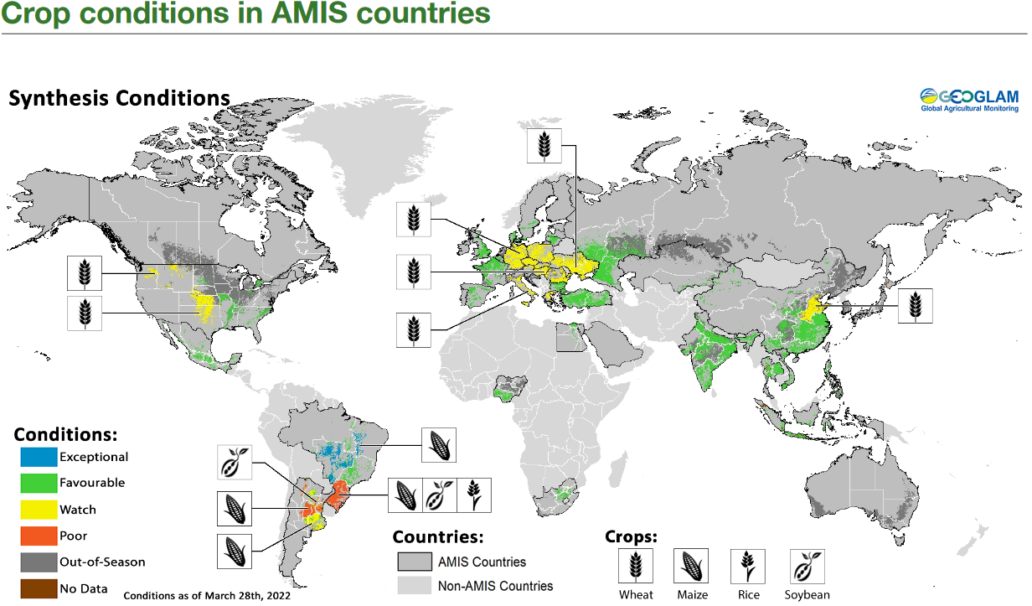
POTENTIAL SCENARIOS
Disruptions in fertilizer markets risk constraining harvests around the world;
poor weather conditions bring additional risks
High gas prices threaten fertilizer production, and high fertilizer prices may limit planting
Poor crop conditions in South America and low global stocks add further layers of risk
The FAO does not expect other exporters to compensate fully for the shortfall from Ukraine and Russia.¹
Producers who would usually respond to high global prices by ramping up wheat production are, in many cases, investing in alternative, less fertilizer-intensive crops in response to high fertilizer prices: the USDA forecasts record soybean harvests this year, while wheat harvests are at their fifth-lowest in 100 years.²
Yara, the world’s largest fertilizer-producing company, and Borealis, another major fertilizer producer, have both reduced ammonia and urea production capacity in Europe – in Yara’s case, to just 45% of usual (though the company has reportedly begun to ramp up operations since March).³
In the medium term, increasing the cultivation of nitrogen-fixing crops could offset nitrogenous fertilizer shortages: in the EU, these crops could supply over 4mt of N (double the amount imported from Russia/Belarus – IDDRI analysis). Long-run high fertilizer prices could prompt such a move.
Maize and soybean yields in South America, currently being harvested, are reduced this year owing to hot and dry conditions earlier in the season.⁴
Wheat production in the US and in southern and eastern Europe may be impacted by dry conditions.⁵
La Niña conditions risk bringing a second year of dry conditions in southern South America, southern US, northern Mexico and in parts of East Africa and Central and Southern Asia.⁶
Stocks in major exporting countries have been declining and, before the invasion, were estimated to require three good harvests in order to be replenished.⁸
⁷
¹ FAO (2022) ² CSIS (2022) ³ Bloomberg Quint (2022), S&P Global (2022) ^{4,5,6,7} AMIS (2022) ⁸Arnaud Petit, Director of IGC, during WTO Trade Dialogue on Food (2022)

Slide 24
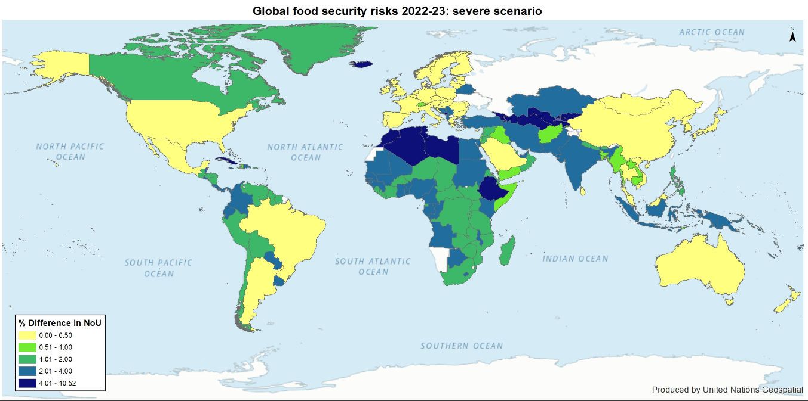
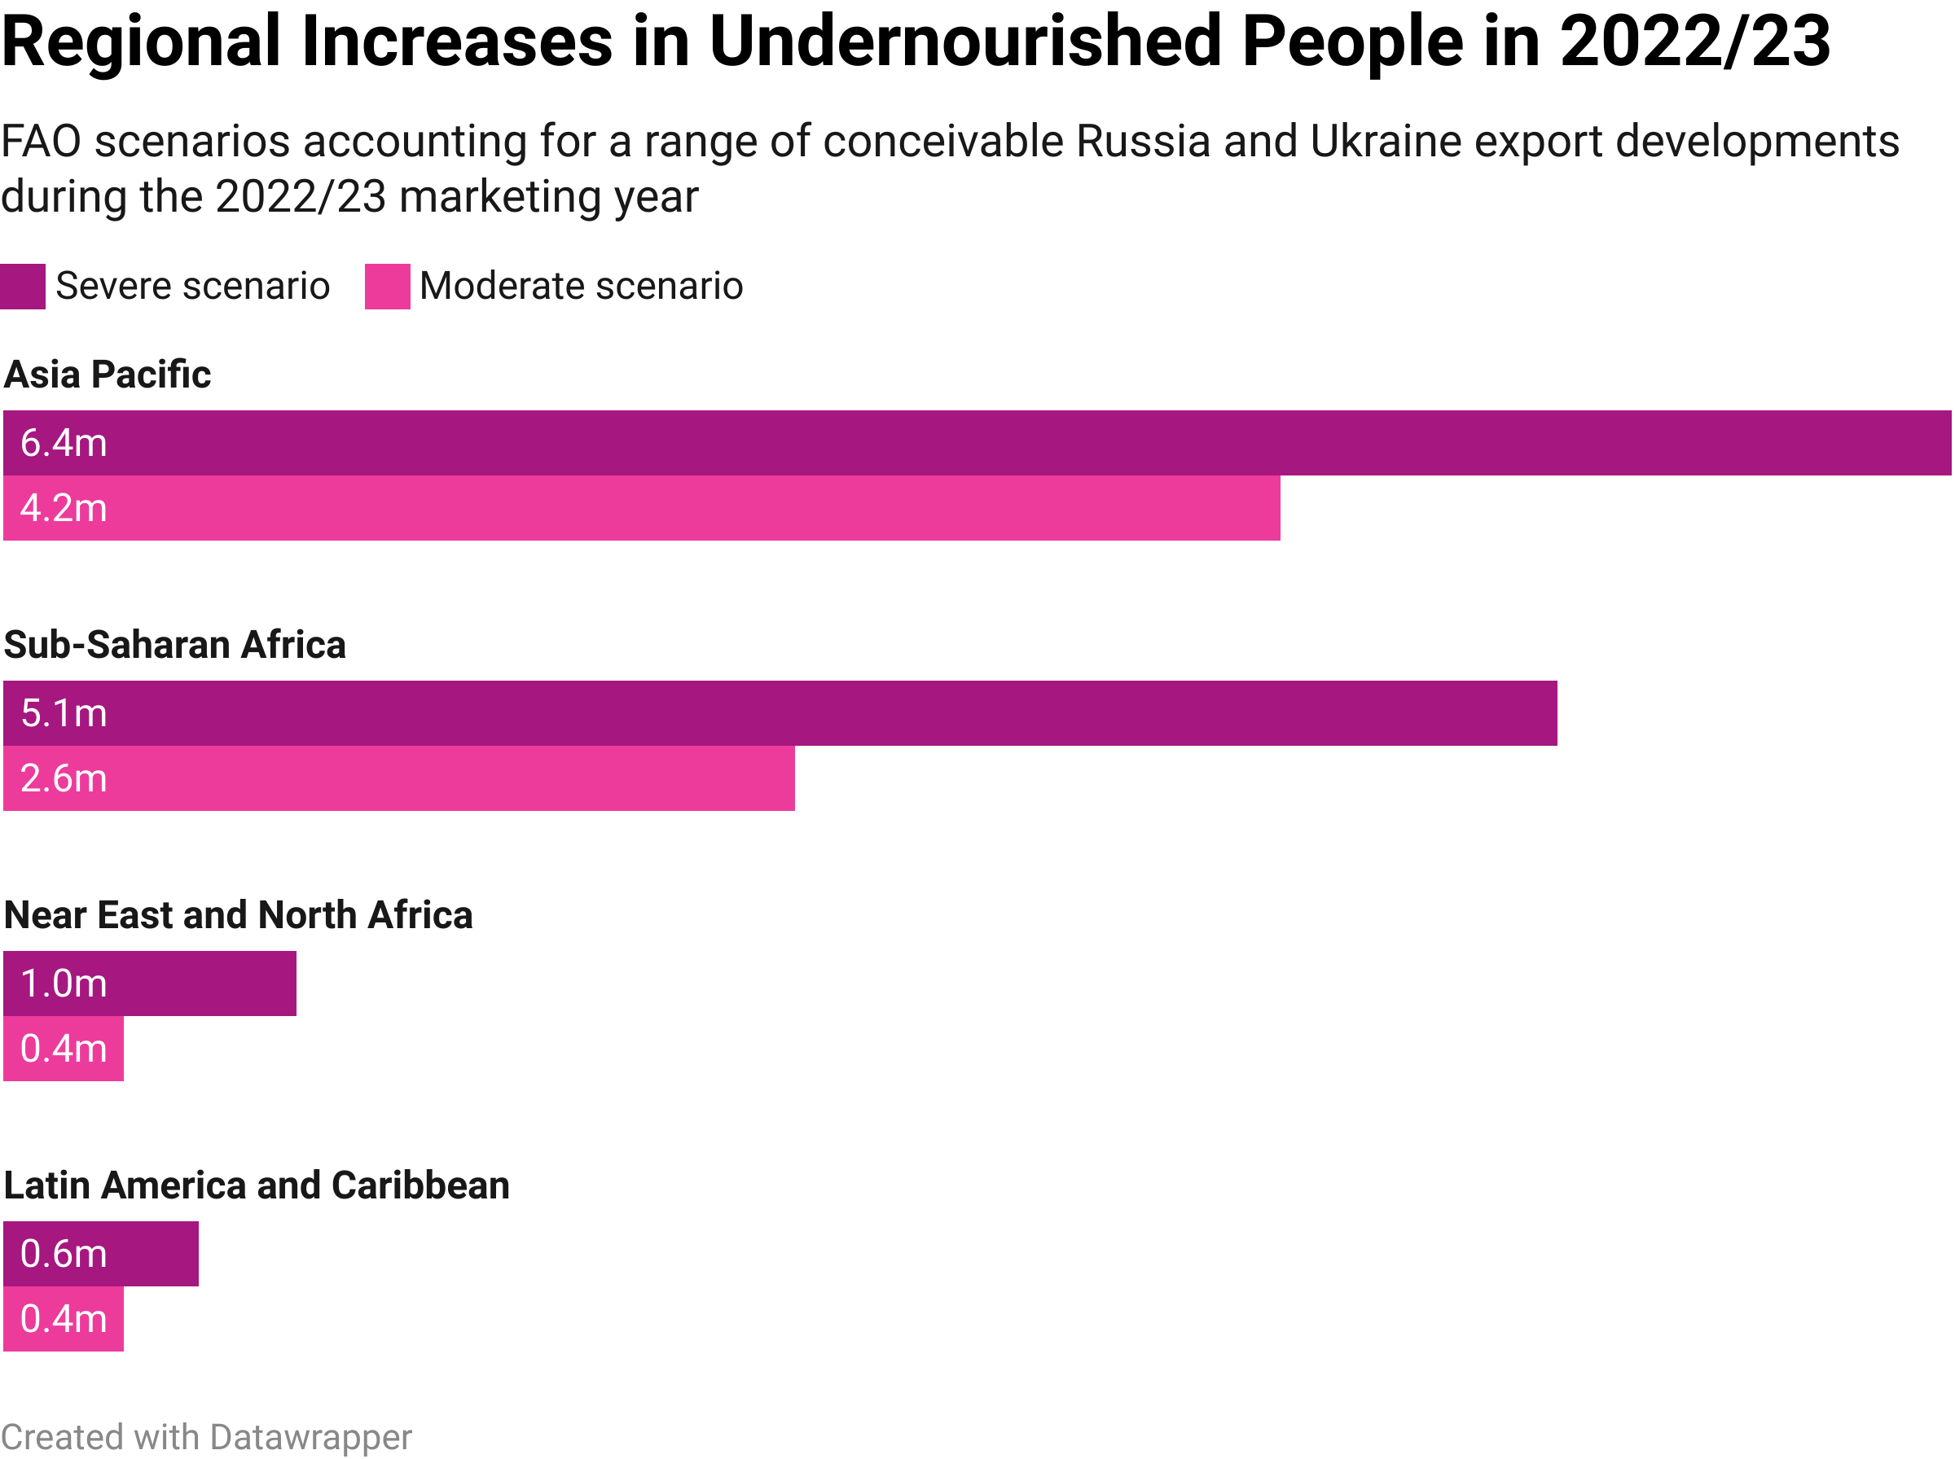
POTENTIAL SCENARIOS
Best- and worst-case scenarios will both bring long-term disruption to food markets
The World Bank predicts a ‘human catastrophe’ food crisis
²
The World Bank believes food prices could rise by 37%. It says as many as 60% of the poorest countries are now either in debt distress or at high risk of being in debt distress.³
The UN Global Crisis Response Group on Food, Energy and Finance has identified 69 economies – with a combined population of 1.2 billion people – who face a ‘perfect storm’ of exposure to high food and energy prices and a sovereign debt crisis.⁴
The FAO predicts the number of undernourished people globally increasing by 7.6-13.1 million, with particularly marked increases in the Asia-Pacific and Sub-Saharan Africa.²
¹ FAO (2022) ² FAOb (2022) ³ BBC (2022) ⁴ UN-GCRG (2022)
Notes:
FAO on left and WB on right

Slide 25
POTENTIAL SCENARIOS
The medium- to long-term ramifications are highly uncertain, but could ultimately prompt an Arab Spring-like situation
The nature and duration of the war are highly uncertain, but one plausible scenario might entail active conflict becoming more spatially confined to eastern Ukraine, but Russia’s pariah status and market instability persisting. Some possible medium-term consequences for different nations:
Ukraine
Production in eastern Ukraine continues to be hit but rest of country’s production may be able to recover to a degree?
Resumption of some exports may become possible through Odessa’s port following infrastructure repairs. But…
  There may still be human and infrastructure capacity constraints?
  There may still be continued issues accessing Russian and Belarusian fertilizers?
  Domestic food security needs may be prioritised over export markets?
Russia
Access to financial services needed to complete international transactions could remain constrained
This could lead to loss of Russian export markets and depressed incomes for Russian farmers...
...which could negatively influence future production decisions by farmers and result in state-mandated export restrictions
Low-income, food-deficit countries (LIFDCs)
Prolonged reduction in food exports by Ukraine and/or Russia would likely result in continued upward pressure on international prices, which could be further exacerbated by other supply/demand dynamics
LIFDCs, especially those without increased export earnings to cover increased food import bills, would be particularly badly hit
Fiscal costs of maintaining consumer subsidies (and food assistance) to protect consumers from price fluctuations would increase
LIFDCs could become priced-out in competition to secure supplies from relatively more affordable (including shipping costs) producer countries
Could ultimately result in broader civil unrest, political instability and uprising similar to those witnessed during the Arab Spring
In the long-term, a new bipolar world-order is possible (EU+US vs Russia+China) or a multilateral world with less Russian engagement: either leads to permanent changes in global market structure

Slide 26
POLICY OPTIONS: Summary
Policy responses must not undermine long-term resilience, and must tackle demand
Policy responses must serve both near- and long-term objectives
Supply changes | Demand changes | System changes
Incentivize agroecological farming approaches to reduce reliance on energy-intensive synthetic fertilizers. | Incentivize more sustainable diets, including reduced meat consumption, to decrease dependence on global grains. | Establish common strategic reserves and sharing arrangements in food-deficit regions to mitigate future shortfalls.
Diversify agriculture to reduce global reliance on major grains. | Reduce food waste to boost supply of nutritious foods. | Clarify and strengthen WTO rules on market-distorting trade restrictions to reduce pressure on global prices.
Diversify trade relationships to reduce dependence on major producing regions. | Build social safety nets to protect the vulnerable from price spikes. | Strengthen overall transparency of food markets to reduce uncertainty and discourage protectionism.
Expand the area of agricultural production to increase supply. |  | Strengthen speculation controls to avoid further amplification of price rises.
Lift environmental trade restrictions to increase imports. |  | Introduce flexible biofuel mandates to allow for the redirection of grain to food supply chains.
Ill conceived short-term policy decisions risk undermining key components of resilient systems: diversity; redundancy; flexibility.
They also threaten global efforts to radically and rapidly reduce greenhouse gas emissions in line with international climate mitigation commitments.
Government policies need to spur changes to food production and supply, changes to global governance systems, and changes to demand and consumption.
‘No-regrets’ options – highlighted here in green – would ease immediate economic and social pressures while reducing vulnerability and exposure to supply and price shocks in the longer term, including actions to tackle climate change and environmental degradation

Slide 27
EU POLICY OPTIONS: Supply Changes
Production sustainability is fundamental for food system resilience and food security
Incentivizing agroecological farming approaches can reduce reliance on energy-intensive synthetic fertilizers and improve biodiversity | Improved and reduced use of inputs are pillars of the transition to sustainable agriculture in line with the EU Green Deal. Pursuit of the transitions set out in the EU Farm to Fork and Biodiversity strategies (in particular through the development of an ambitious legislative framework for Sustainable Food Systems) is essential to reduce risks in the medium and long-term (incl. reducing fertilizer use by >20%, reducing nutrient losses by >50%, achieving 25% of farmland under organic production by 2030) Fundamental reorientation of EU agriculture towards sustainability is required under the framework of the reformed 2023-2027 Common Agricultural Policy. The Commission has urged Member States’ to ensure their CAP strategic plans for 2023-27 ‘support farmers in adopting practices optimising the efficiency of fertilisers, thus reducing their use’.
Diversifying agricultural production and value chains is necessary to reduce global reliance on major grains | European Council has called for boosting EU plant protein production to increase nitrogen supply to cropping systems (thus reducing EU’s nitrogen import dependence) and reduce the EU’s dependence on protein crop imports. Reducing the EU livestock herd (as part of a shift towards more plant-based diets), and targeting the least resilient livestock systems – following the Dutch example – would reduce the need for grain-based animal feedstocks and reduce EU’s dependence on protein crop and nitrogen imports, while releasing a significant amount of grain to compensate for the reduced harvest in Ukraine / Russia. The Commission supports Member States in using possibilities to reduce the blending proportion of biofuels which could lead to a reduction of EU agricultural land used for production of biofuel feedstocks, thus easing pressure on the markets for food and feed commodities.
Diversifying trade relationships is required to reduce dependence on major producing regions | The new European Food Security Crisis preparedness and response Mechanism (EFSCM) is preparing a mapping of risks and vulnerabilities of the EU food supply chain to be followed by recommendations and appropriate mitigation measures. This will need to include consideration of long-term sustainable and resilient trade relationships.
Expanding the area of agricultural production to increase supply threatens long-term resilience | The Commission has introduced temporary derogation to allow planting of food and feed crops on fallow land that is part of Ecological Focus Areas in 2022, and adopted a Temporary Crisis Framework to allow for increased state aid to impacted producers and energy-intensive fertilizer manufacturers and processors. Such derogations will need to be revoked at the earliest possible opportunity and reviewed by the EFSCM to prevent them becoming entrenched.
Lifting environmental trade restrictions to increase imports undermines system sustainability | Some EU Member States facing livestock feed shortages as a result of the war have utilised flexibility in EU legislation that allows for temporary imports of feeds that don’t conform to normal standards governing the maximum level of pesticide residues. In the longer term, reduced dependence on feedstocks to support smaller livestock herds will be an important component of increasing the resilience of European food systems.

Slide 28
EU POLICY OPTIONS: Demand Changes
Protecting the vulnerable should be a top priority, but so too should locking-in more sustainable demand patterns
High and volatile food prices are the new normal and necessitate sustainable and comprehensive social safety nets | Emergency response measures to safeguard food access for vulnerable households are necessary, but more sustainable social safety nets – such as school meal programmes, holiday meal provision and cash transfers – are needed to mitigate food and nutrition insecurity in the longer term, given that food prices are likely to remain high and the cost-of-living crisis looks set to worsen. Effective new networks, structures and strategies introduced to shore up food access during the COVID-19 pandemic should be given long-term support, recognizing that neither COVID-19 nor the current situation are one-off or short-lived crises. Additional support will be needed in Poland and other countries receiving a large influx of Ukrainian refugees.
Waste reduction is needed along value chains to weather high prices and reduced input availability | Under the Farm to Fork (F2F) Strategy, the European Commission is set to revise its Waste Framework Directive (a public consultation is running from April to June). Revisions must include an ambitious, legally binding food waste reduction target to (a) reduce pressure on land, feed, fertilizer, grain and other resources, and (b) reduce sectoral emissions in line with the EU’s climate mitigation targets. France’s food waste law – which requires that supermarkets distribute unsold food to charities and food banks rather than discarding it – offers an exemplar for other Member States to tackle food shortages in the near term and to support local food distribution networks in the long term.
Acting to spur reduced meat consumption would reduce the EU’s dependence on imported feed and fertilizer while bringing significant co-benefits | Over 60% of EU+UK-produced cereals are used for feed, and the volume of feed production is on an upwards trend (IDDRI analysis). The pigmeat and poultry industries are the most feed-intensive. Measures to curb demand for animal products across the board – not only demand for red and processed meat, as outlined in the F2F Strategy – will be needed if demand for domestically produced and imported feed is to be reduced. This would also help households to cope with price increases / inflation, which are particularly high for animal-source food, while being nutritionally beneficial. On the supply side, financial support should be rebalanced to incentivize arable farming and plant-based protein production and further R&D should be channelled into cultured meat and plant-based meat alternatives, but demand-side measures – such as sustainable dietary guidelines, changes to public procurement guidance, changes to VAT rates on meat and meat alternatives, and ‘less meat’ guidance for school meal provision – will be critical in influencing upstream actors and stimulating longer term, structural changes, as noted in the latest IPCC report on climate mitigation. The Sustainable Food System legislative framework under preparation would be an ideal legislative vehicle for the enactment of those changes.
Household coping strategies could spark positive changes to behaviour | Reducing food waste will be an important coping strategy for households in response to rising food prices, while high vegetable oil prices and global shortages are likely to prompt reduced usage by households, with potential benefits to the healthiness of food cooked in the home. Well-timed awareness campaigns highlighting (i) ways to reduce food waste, and (ii) the benefits of reduced vegetable oil usage, ways to cook with less oil, and recipes that do not require cooking (and so that save on energy use as well) could encourage such behaviour changes to stick, and so contribute to healthier habits in the long term.

Slide 29
EU POLICY OPTIONS: System Changes
Strategic reserves in food-deficit regions and global market transparency are both critical to system resilience
ODA funding in food-deficit countries should support strategic reserves and increase financial flows to support agricultural development in the South | While expensive to maintain, strategic grain reserves are critical to protecting access to food in import-dependent countries in the event of a major supply shock, and to buying governments some time to source affordable goods from alternative suppliers. ODA in low-income, food-deficit countries should support the establishment of strategic grain reserves at national or regional level, capacity and institution building to promote their strong and transparent governance, and resilient transport infrastructure to facilitate their distribution. There is potential to increase the resilience of national/local food systems in many food-import dependent countries providing sufficient development support. ODA in low-income, food-deficit countries should thus also support agricultural development pathways targeting more resilient food systems.
The EU should push for strengthened WTO rules on trade restrictions among major exporters | The EU says it will continue to strongly advocate, including in international fora, to avoid export restrictions and export bans, emphasising that WTO coordination is essential. At the 12th Ministerial Conference in June, the EU should lend its weight to secure the formal adoption of a proposed measure exempting purchases of food by WFP from food export restrictions.
The EU should support the continuation and expansion of the Agricultural Market Information System, including an agreement on emergency coordination on stocks and biofuel mandates | The Agricultural Market Information System (AMIS), a G20 initiative established in the wake of the 2010-11 food price crisis, plays an important role in promoting staple crop-market transparency and policy coordination, and likely mitigated distortive trade restrictions during the COVID-19 pandemic. But funding for AMIS is scant and the recent bout of export restrictions, despite commitments by AMIS-participating countries to hold back from such moves, signals a potential weakening of collective commitment to transparent and open trade policy. Additional political and financial support to AMIS from the EU could enable greater monitoring of risk hotspots in global food trade networks to enhance early warning of potential supply shocks. Enhanced political and financial support to AMIS could also be directed at the establishment of an emergency coordination mechanism among AMIS-participating countries for times of acute market disruption which would encourage the synchronised and transparent management of strategic grain reserve releases to alleviate market pressures and reduce market volatility, including through collective easing of biofuel mandates (something that EC has encouraged Member States to do in response to the current crisis).
The EU should ensure governance of financial speculation in agriculture and input markets remains fit for purpose | The revised Markets in Financial Instruments Directive (MiFID II) introduced in 2018 included provisions on commodity-derivative position limits, with the aim of avoiding excessive speculation. Post-COVID-19 'Quick Fix' amendments aimed at supporting economic recovery from the pandemic narrowed the scope of these limits. As part of the ongoing reviews of MiFID II, the EU should ensure that the legislation is having the intended impacts, and should consider any additional or ancillary measures necessary, to avoid excessive speculation in agriculture and factor markets, especially as these markets are now witnessing the largest price increases since its introduction.

Slide 30
Geopolitics and Economics
Russian Invasion of Ukraine
Resource and Policy Implications
Geopolitical ramifications
Global economies and institutions
Chatham House | The Royal Institute of International Affairs

Slide 31
International Sanctions
GLOBAL ECONOMIES AND INSTITUTIONS
Russia’s attack on Ukraine and the unprecedented package of Western economic and financial sanctions it triggered will have lasting implications for the way our global economic system operates
The West’s package of economic and financial sanctions on the Russian economy and against its government are designed to weaken the Russian government’s ability to pursue the war in Ukraine
The sanctions package - 3 key components:
Restricting Russian access to international financial markets, including freezing the Russian Central Bank’s assets and suspending key Russian banks from the SWIFT payment system
Strong and co-ordinated measures against Russian kleptocrats who support the government. The goal has been to freeze assets, or confiscate them when they are known to have been illegally obtained
Restricting Russia’s access to international markets for goods and services, focussing increasingly on Russia’s ability to sell coal, oil and gas in western markets, and on advanced technology equipment (critical to its transportation and energy sectors)
Sanctions have been adopted by a broad range of countries beyond the G7 (e.g. Switzerland moved from its traditional neutrality and adopted sanctions aligned with the EU)
Sanctions have been amplified by voluntary steps taken by many western multinationals – either suspending their activities or withdrawing completely from the Russian economy (sometimes at considerable financial cost)
It is very unlikely that sanctions will be eased whilst Russia continues to occupy Ukrainian territory
  Given the apparent durability of the Russian government’s stance, they could be in place indefinitely
  There are many major emerging market economies not taking pro-active measures, e.g. China and India, which may be providing tacit economic support to Russia
  There is the potential for the West to impose secondary sanctions, particularly if there are trade or financial interactions sustaining Russia’s military equipment supply chain
Implications for the Russian economy
  Russian GDP is expected to contract some 10-15% this year despite Russian efforts to stabilise domestic financial markets through rouble interest rates at 20% and trying to force payment for oil and gas exports in roubles
  There are very serious implications for Russia’s economic prospects in the longer term with continuing sanctions and switches away from fossil fuel exports (e.g. Germany phasing out gas imports by 2024)

Slide 32
Implications Of The War For The Global Economy And Global Economic Governance
GLOBAL ECONOMIES AND INSTITUTIONS
Russian actions and the Western responses will have fundamental implications for the international economic architecture and the role it can play in supporting the drive to net zero
Policymakers must begin to get to grips with the implications as quickly as possible - to mitigate the downsides and to benefit from any new opportunities created
Economic governance. Russia’s attack put multilateralism under enormous strain (e.g. the walkouts by Western countries at the IMF/WB spring meetings late April). Western countries cannot work together with a major power undermining the international governance system. But other major economies are not prepared to expel or suspend Russia. There needs to be development of “G7 plus like-minded country” groupings. The G20 will be far less effective, and the world may have to move to new balanced groupings like the G2 (China and US), or G4 (US, EU, China and India). Parts of the international economic architecture where the west dominates through its voting weights should be able to continue to function within exiting mandates, but the move towards greater legitimacy (e.g. through a further revision of IMF voting weights) may be stalled.
Global currency system. The West’s action has made 50% or more of Russia’s foreign exchange reserves unusable. Russia also has no current access to IMF facilities to support countries facing foreign exchange difficulties. This remains manageable only as long as Russia maintains income revenues from its hydrocarbon and mineral exports. In the long term, other authoritarian regimes imagining “upsetting the West” will be trying to devise a response to the issue that the prime convertible currencies are provided by Western liberal democracies. Use of cryptocurrencies and international payments systems for non-convertible currencies may help avoid some of the impact of restrictions on convertible. Rapid change in the international currency system is inevitable.
Development finance. Where to fix the envelope for international development finance and how to prioritise within this is a critical issue. The struggle to reach the $100bn pa target for public climate finance, and the difficulties encountered in funding the relatively modest (when compared with the risks) needs for pandemic preparedness and response highlights pre-existing challenges for development finance. Western donors are facing a greatly increased prioritisation dilemma: the need to fund assistance for refugees and reconstruction in Ukraine (an ODA-eligible country) whilst simultaneously dealing with the substantial rise in public debt (from 10-25% points of GDP) caused by the pandemic. There is a growing risk that recent developments will trigger a systemic debt crisis affecting low- and some middle-income countries. This may force enhanced collaboration between China and the West, but could also raise the financial burden on advanced countries.
Governance of financial flows and corruption risk. It is critically important to devise and implement enhanced measures that will control or mitigate corruption risks linked to climate finance. Net zero globally requires vast funds in the next 8-10 years, often for countries with relative weak governance. Afghanistan and the pandemic show the enormous risk of corruption that arises in these situations (whether in developing, emerging or even advanced countries). Funds are wasted or lost if corruption risks are not controlled because the private sector is scared off, &/or political support in the West for international public climate finance disappears.

Slide 33
GEOPOLITICAL RAMIFICATIONS
Ramifications For International Security And Globalization
Hard security has risen up the political agenda | EU Institutions | End of globalization, rise of regionalization and resource nationalism
Enlarging NATO membership: Finland and Sweden likely to apply for membership in June and be accepted Increased military expenditure by western governments: even before war UK proposed £6.2 billion higher expenditure in 2024/25 compared to 2020/21. Germany announced an additional, one off €100 billion expenditure. Denmark and others pledge to meet NATO min target of 2% of GDP. Potentially at the expense of ODA and climate finance. Global nuclear threat has increased and heightened risk of nuclear proliferation The situation in Ukraine has significantly increased the political will to arm and has strengthened NATO | In the face of the one of the likely motivations of Russian invasion Ukraine remain firmly politically facing the West. Furthermore, Ukraine is now on a fast track to start of membership talks – even if rapid membership is not likely The EU has put in place a number, 5 to date, of economic sanctions against Russia. The most recent (8th April) included a ban on coal imports, although oil and gas remain unaffected Around 4.5 million people have left the Ukraine and gone to EU countries The EU remains largely, but not totally, united in its approach. As the war goes on remaining united will be key challenge. | Bipolarization of global relations (and trade?) possible, into US+EU-led and Russia+China-led blocs at worst, with other countries forced to pick sides. At best Russia much diminished as member of global community. Global response to Russia, may change the option space for resolving the future relationship between China and Taiwan and the possibility of future military intervention. Structural change in global markets very likely, especially as sanctions may last many years. Resource nationalism therefore likely to trump co-operation on key commodities Russian invasion of Ukraine seen as failure for UN, due to its limited engagement and inability to pass adequate resolutions Western failure to deliver adequate financial support for developing countries, on debt, covid-relief and vaccines, again to be tested with cost of living crisis and higher commodity costs More constrained business environment and major industries avoiding sanctions may derail the ESG and corporate responsibility and purpose agenda. Commentary rife on ‘death of multilateralism’ – although not for the first time. Undoubtedly this is a pivotal moment and there is the possibility permanent global divisions to a bipolar world akin to the Cold War.

Slide 34
GEOPOLITICAL RAMIFICATIONS
Ramifications For Global Climate Politics
Reduced technical co-operation | UNFCCC and international process | Climate impacts and resilience | Mixed support for accelerating the necessary transition
Delivery of net zero carbon societies and meeting the objectives of the Paris Agreement require an acceleration of the pace of technology change Political agreement and multilateral instruments drive international collaboration, and global targets build markets and encourage upside risks and innovation – such as in solar, wind and batteries. All require international supply chains and global deployment. Whilst strong economic arguments to maintain open trade and investment ties remain, there is increase need to take a risk management approach to security concerns. It therefore looks inevitable that there will be more fragmentation in global markets for goods and services, and more constraints on sharing research and deploying technologies critical to the net zero transition (and achievement of SDGs). | Political attention on climate change will be diminished as a result of the war The G20 leaders summit is in the month prior to COP and sets the tone for the level of ambition – this will be disrupted irrespective of Russia’s participation. The G7, especially following election of President Biden, is key driver of momentum. Despite German presidency, climate is unlikely to be the focus Russia is Egypt’s largest trading partner, particularly for food. Egypt is the COP 27 President and will have to balance geopolitical and financial concerns over the war with climate leadership The Umbrella Group (non-EU developed countries – Australia, Iceland, US, etc.) have expelled Belarus and Russia (March 2022) Reduced trust will affect all negotiations and political boycotts will further reduce engagement opportunities. Any momentum build up around COP 26 is likely to be lost. | Conflict-driven higher food and energy prices will to be exacerbated by the occurrence of climate change induced extreme weather events Supply chains stresses induced by the war, and the need to diversify sources and routes, will rebalance supply patterns. Additional pressures on supply security compounded by climate change, will affect developing countries particularly badly. A priority for the UK’s continual Presidency of the COP process in 2022 is to deliver ‘for climate vulnerable countries by ensuring commitments on adaptation and loss and damage are honoured’. The Egyptian presidency of COP 27 will ensure that Loss & Damage and adaption finance is high on the climate agenda and it will be at the heart of future international co-operation. | Concerns about security of supply and higher energy and food prices have evoked different responses. In the EU, this has lead to calls for a diversification of fossil fuel supplies, for the acceleration of the energy transition (towards renewables and increased efficiency), and for transformation of the food and farming system towards less resource-intensive demand and supply. Higher gas prices and constricted access will also increase the use of coal. Enlarging initiatives like the Powering Past Coal Making Alliance, will be more difficult. Equally, food price concerns may increase pressures to increase self-sufficiency through more intensive domestic production and reneging on environmental farming commitments. Although there is a risk of backsliding on transition progress in the near-term, there is also a huge opportunity to ensure inevitable recalibrations in resource markets drive an accelerated transition in the medium term
Notes:
G7
Russia expelled from the G8 in 2014 due to the occupation of Crimea
Under Presidency of Germany in 2022, priority was to be given to climate change, agenda includes:
Accelerating the global phase-out of coal
Forced decarbonisation of sectors
Systemic change towards environmental sustainability in all areas of life
Combating species extinction
Initiatives to protect the oceans
The agriculture agenda includes:
Strengthening sustainable, deforestation-free agricultural supply chains
Opportunities of carbon farming
Ongoing reduction of the use of pesticides
G20
Under Presidency of Indonesia in 2022
Serious doubts of functioning this year and beyond
Officials from Canada, EU, UK and US walked out of finance ministers meeting in April due to Russian presence
There is no process for expelling country from grouping
If Putin attends Leader’s Summit, half of members likely to stay away

Slide 35
SUMMARY
Before the war, the global pandemic had resulted in higher commodity prices and supply chain disruptions, on top of the last 15 years of crisi-on-crisis.
The outcome of the war is far from certain, but clearly it is not the quick war that Russia might have imagined. Whatever the outcome of the conflict, long term impacts will remain: sanctions may never be lifted, and there are likely to be structural change in markets, trade and global geopolitical alliances
Both Russia and Ukraine are highly important to EU resource markets, particularly for energy, food and fertilizers. Prices for these commodities have spiked as a result of economic sanctions, trade restrictions and policy interventions introduced by national and regional governments in response to the invasion.
Russia is responsible for about 10 per cent of global energy production and is a major exporter of all fossil fuels, particularly to the EU. Europe is putting in place measures to rapidly reduced imports; natural gas is particularly problematic due to fixed pipelines. Security of supply concerns have led to higher prices globally.
Food and fertilizer prices have similarly spiked owing to both high dependence on energy inputs and as a result of the Black Sea’s importance to global fertilizer, cereal and oilseed supplies. Low-income food-deficit countries with direct import dependencies are particularly vulnerable but price rises are affecting low-income households everywhere.
The combined consequences of food, energy, wider supply chain issues against a wider cost of living crisis post-Pandemic has the potential to increase poverty, drive labour disputes and risk wage-price spirals and recessions. Increasing domestic political tensions may mean reduced appetite for sustainability transitions and the political risks they are perceived to bring.
The impact of the war on Russia’s global role in metal and mineral markets may have significant but longer-term effects that increase resource nationalism and market volatility and thus may constrain the energy transition
Security rising up the global political agenda, and the situation in Ukraine has significantly increased the political will to arm. Broader geopolitical impacts may include decreased support for multilateralism, reduced climate and development financing, and greater resource nationalism – with consequences for trade and economic development.
The EU’s response has been unified to date and there is a commitment to start negotiations for Ukraine’s accession. But political divergences may widen over time.
The geopolitics of climate change are not immune from wider international issues. COP27 will particularly be affected by: less international finance, less trust in international processes, and reduced technology co-operation. Nevertheless, a desire to improve energy security could drive greater energy efficiencies and renewable energy.
Russia’s attack on Ukraine and the unprecedented package of Western economic and financial sanctions it triggered will have lasting implications for the way the global economic system operates
Resource policy needs to focus on reducing demand that can have an rapid impact on prices, aid security of supply and reduce the environmental impact. Greater public awareness, in particular in the EU, can facilitate needed behaviour change enabling the necessary and rapid transition will also require system changes, including greater storage and management of distribution. Any new or alternative supply needs to align with sustainable transition and climate mitigation objectives

Slide 36
Authors
The contents of this deck have been prepared by staff at Chatham House and IDDRI (Institut du développement durable et des relations internationals)
Drafting by and input from:
Pierre Marie Aubert, Tim Benton, Sian Bradley, Creon Butler, Antony Froggatt, Richard King, Bernice Lee, Dan Quiggin, Lavina Ranjan, Laura Wellesley
Thanks to many other colleagues who have participated with shaping ideas and analyses presented

