Slide 1
Impact of COVID-19 on Green MSME: Green recovery measures in developing economy
Green Industry Summer School-2022
27 July, 2022
27 July, 2022
Dr. Prasad Modak, Executive President
Environmental Management Centre Pvt Ltd

Slide 2
Index
Background
Methodology
Green MSMEs
Key Findings
Most impacted Green MSMEs
Challenges
Support extended towards Green MSMEs
Emerging opportunities
Policy recommendations

Slide 3
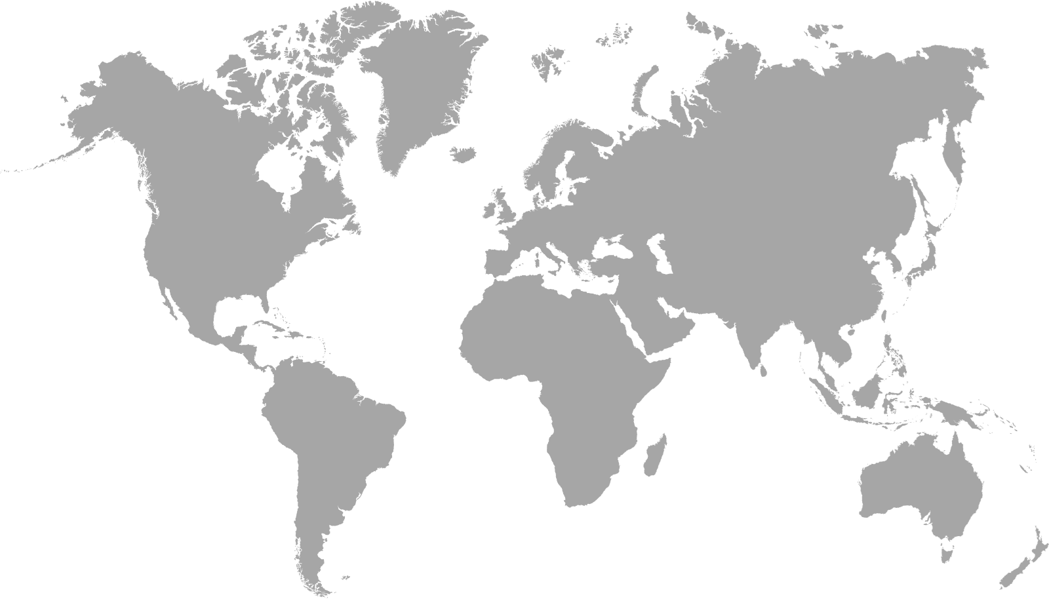
Objectives of the study
Evaluate the major challenges faced by the Green MSMEs in India, Ghana, Uruguay
Build on the previous studies conducted to assess impact of COVID19 on MSMEs
Investigate the impact of COVID-19 pandemic Green MSME operations
Identify responses of countries to boost green recovery
Recommend policy measures for government, financial institutions, NGOs, and enterprises to boost the Green Entrepreneurship
Ghana
India
Uruguay
Figure: Regional coverage of the study

Slide 4
Methodology and timeline
October 2021- Literature review
March, April May – Focussed Group Discussions conducted virtually in 3 countries
September 2021- Inception call
Jan-Feb 2022
Email survey sent to 1400+ MSMEs
June-August
Final Report and Toolkit

Slide 5
Methodology- Online questionnaire
Survey form was designed and sent to 1400+ Green MSMEs in 3 countries to capture their responses
MSME Questionnaire survey
Link to the survey form: https://forms.office.com/r/GGDv8qTESD

Slide 6
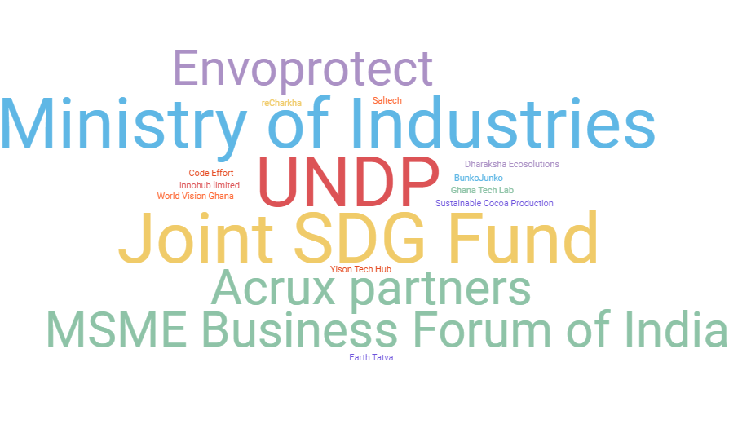
Methodology- Focused Group Discussion
Green MSMEs
Financial Institution
Business Association
NGO/CSO
Government Organisation
Figure: Organisations that participated in FGD
9 FGDs conducted in three countries
Responses captured from 24 stakeholder organisation

Slide 7
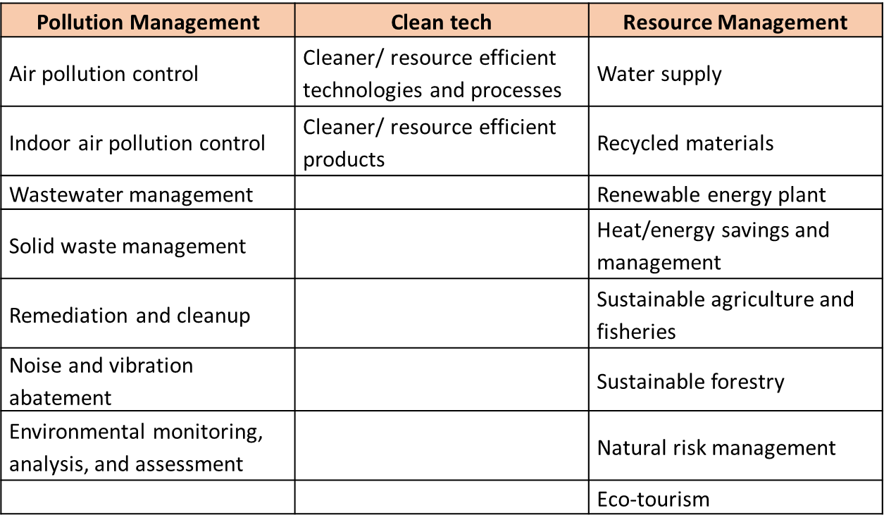
Categories of Green MSMEs identified
Green MSMEs from the following category (identified as Green enterprises as per OECD) were reached out for conducting this study:
What is a Green MSME?
A Green MSME is an enterprise that provides environmentally friendly products or services, practices an environmentally friendly process or uses cleaner technologies which reduce any negative effects of the business on the environment.

Slide 8
Key Findings
India, Ghana and Uruguay

Slide 9
Most impacted Green MSME categories
The following categories of MSME in India were widely affected:
The following categories of MSME in Ghana were widely affected:
The following categories of MSME in Uruguay were widely affected:
Renewable energy
Cleaner and Resource Efficient technologies
Cleaner and Resource Efficient technologies
Recycled materials
Recycled materials
Solid waste management
Solid waste management
Sustainable agriculture and fisheries
Sustainable Agriculture and Fisheries
Ecotourism
Ecotourism
Ecotourism
Notes:
Certain categories witnessed positive impacts while others witnessed negative

Slide 10
Impact on select categories
Negative Impact
Ecotourism declined due to travel restrictions
Import and export of green products and services was impacted negatively
Waste management practices disrupted due to restriction in movement of waste. Health and sanitation conditions were compromised
Women-led businesses were severely hit in comparison to men-led businesses
Positive Impact
Increase in demand for sustainable products, organic food, chemical-free products due to shift in consumer perspective
Solid waste management transformed to integrate technology and digitalization
More tourists started looking out for sustainable and local travel experiences post lockdown
Countries are shifting towards renewable sources of energy

Slide 11
Challenges faced by green MSMEs
Operational challenges | Financial challenges
Disruption in supply chain Unavailability of skilled labor Limited resource availability as operations were suspended by government Difficulty in sourcing raw materials (quantity and quality) Inability to meet contractual deadlines due to disruption to logistics Travel restrictions to visit customers/ suppliers | Increased logistics cost Increased cost of raw materials Reduction in orders Increased competition in the market Difficulty in paying salaries to the employees Uncertainty in making business investment decisions and hence, increased debt amongst owners Increased debt amongst owners Lack of liquidity / cash flow
The following three challenges were identified as the most important based on the survey results:
Reduction in orders from customers (local and international)
Increased cost of raw material
Uncertainty and inability to make business decisions

Slide 12
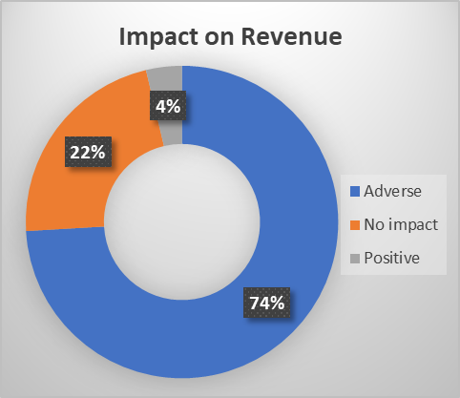
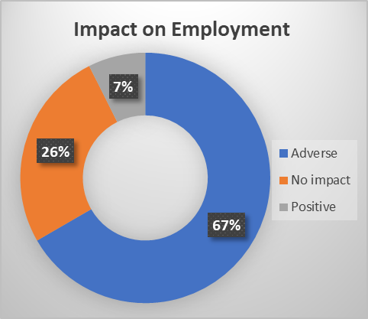
Overall Impact on Green MSMEs - India
74% green MSME surveyed have witnessed a decline in their business revenue due to COVID-19
4% of green MSMEs saw a positive impact on revenue
67% MSME faced an adverse impact on employment
More than 50% of the green MSMEs reported that their annual turnover had decreased by 50 to 90% as an immediate impact of the COVID-19 pandemic
19% of the surveyed green MSMEs laid off employees temporarily or permanently as a strategy to stay afloat

Slide 13
Impact on Green MSMEs - India
Change in working arrangements
Temporary or permanent closure
Disrupted cash flow
Increased logistics cost
Decrease in the number of persons employed
Reduced demand for products and services
Increased demand for products and services – local and international customers

Slide 14
Impact on Green MSMEs - Ghana
Reduced demand for products and services – local and international customers
Delays in production and/or delays in providing service
Disruption in cash flow
Inability to meet loan repayment or loan servicing obligations
Change in working arrangements (partial leave, telework, etc.)
Decrease in the number of people employed

Slide 15
Impact on Green MSMEs - Uruguay
Service delays of cancellation of order
Unable to meet loan repayment or loan servicing obligations
Reduced demand for products and services – local customers
Temporary or permanent closing of businesses
Change in working arrangements (partial, leave, telework etc)

Slide 16
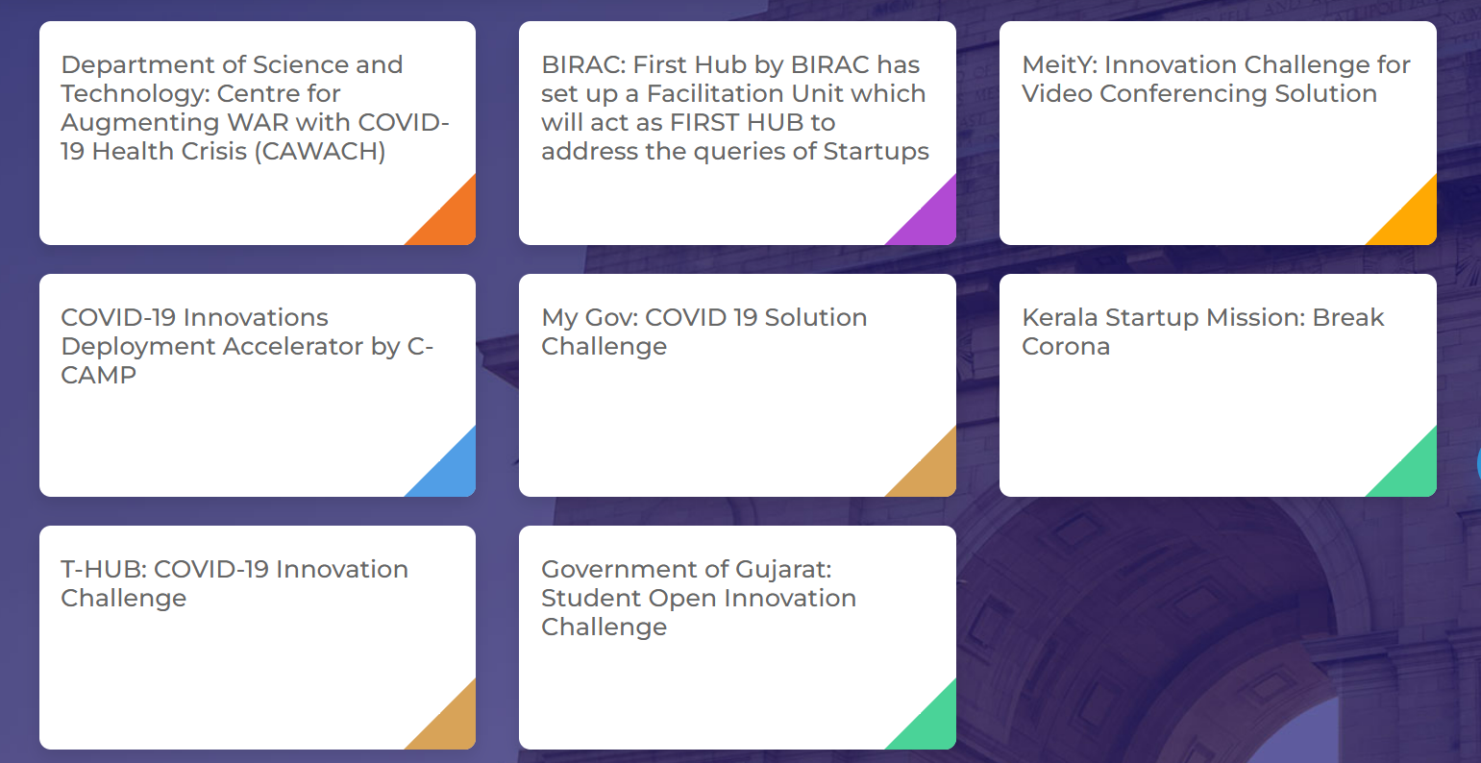
Support extended towards Green MSMEs - India
Relaxing tax returns and due dates, reducing penalty on delayed payment of taxes
The Reserve Bank of India reduced interest rates from 5.15 to 4% and announced a three-month moratorium on repayment of term loans for MSMEs
The Start-up India Initiative has released new opportunities and contests for Green MSMEs fighting COVID19 challenges- Grant Opportunities, Equity, Returnable Grant Opportunities and Knowledge Platforms
Bureau of Energy Efficiency of India has released support in various forms to promote energy efficiency initiatives
Figure: Startup India platform offering new opportunities to green enterprises through their platform

Slide 17
Support extended towards Green MSMEs - Ghana
Women Entrepreneurship for Africa (WE4A) project to promote women entrepreneurship
Coronavirus Alleviation Program Business Support Scheme (CAPBuSS) offered credits lines to MSMEs
Coronavirus Alleviation Program (CAP) focuses on protecting against job losses, protecting livelihoods, supporting small businesses, and ensuring the programme is efficiently and sustainably implemented
Unemployment Insurance Fund (UIF)
COVID-19 Alleviation and Revitalization of Enterprises Support (Ghana CARES)
National Financial Inclusion and Development Strategy
Digital Finance Service Policy

Slide 18
Support extended towards Green MSMEs - Uruguay
Financial support provided to Green MSMEs through SIGa Emergencia credit and SIGa SME Fund
Increase in Impact Finance and growth in multilateral firms supporting green projects
Financial institutions expanded the non-grant instruments and the financial capacity for renewable energy
Subsidy for taxpayers registered in the monotributo system of the Ministry of Social Development (MIDES)
Technical support provided to promote entrepreneurship and innovation – digital transformation, capacity building
Business competitiveness centers program and COVID-19 Territorial Business and Entrepreneurship Assistance Network set up ensure sustainability of MSMEs
Notes:
Finance:
SIGa Emergencia line was created in April 2020 as a flexible financing option to support loans to affected MSMEs
The SIGa SME Fund increased from US$ 50 million to US$ 500 million, with the aim of leveraging a total of US$ 2.5 billion

Slide 19
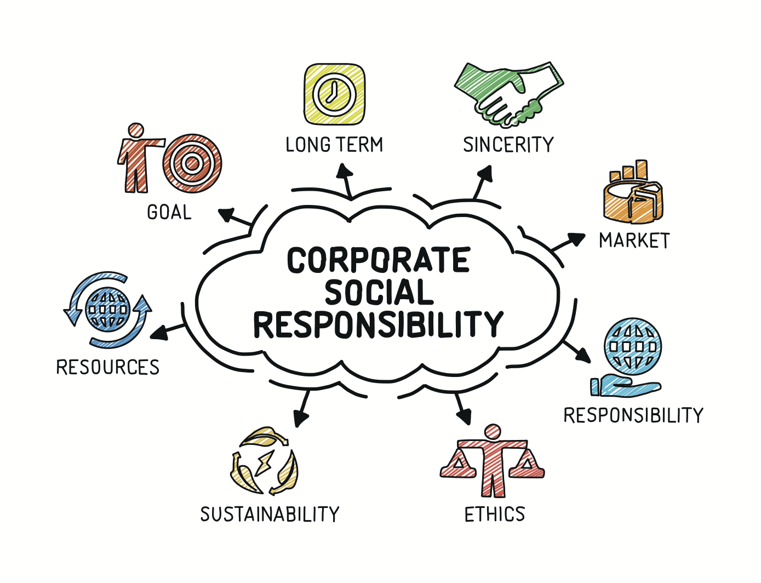
Emerging opportunities - India
Corporate Social Responsibility funds support green enterprises and projects
Legislations and policies that enable the growth of Green products and services
Sustainability moved from brown to green industry; has received great response from consumers
Growing awareness of responsible consumption
Increase in demand for organic food, toxin-free products and sustainable packaging increased
Partnership between Green MSMEs and corporations/ large brands due to policies like Extended Producer Responsibility
Digital adoption has been observed at a large scale – robotics, machine learning, blockchain etc
Notes:
Corporate Social Responsibility funds of the large scale enterprises have expanded significantly and support green enterprises and projects
Legislations and policies that enable the growth of Green products and services
Sustainability moved from brown to green industry; has received great response from consumers
Growing awareness of responsible consumption
Increase in demand for organic food, toxin-free products and sustainable packaging increased
Partnership between Green MSMEs and corporations/ large brands due to policies like Extended Producer Responsibility
Digital adoption has been observed at a large scale – robotics, machine learning, blockchain etc

Slide 20
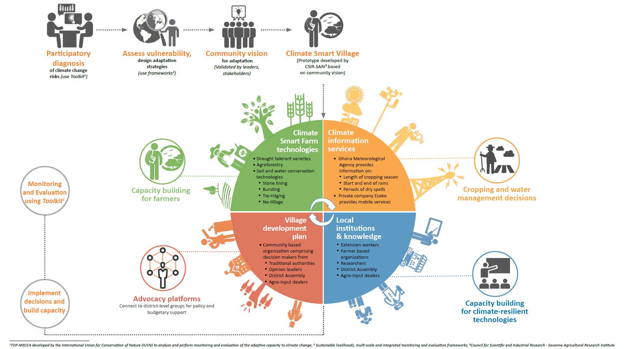
Emerging opportunities - Ghana
Increased application of digital payments, drone, IoT, and AI seen in various sectors
Climate Smart Agriculture - integrating technology and eco-conservation technology
Government to invest more on increasing dependency on Clean Energy
MSMEs moving from offline stores to building a robust online presence
Source: http://www.icrisat.org/Building-climate-smart-farming-communities/Agricultural-digital-technologies-approach.html
Notes:
More than a third of firms (37.5 %) started or increased their use of mobile money, and about a tenth of firms (9.0 %) started or increased their use of internet to do business

Slide 21
Emerging opportunities - Uruguay
Ecotourism or Responsible travel to see growth in the coming years
Need for increased resilience in tourism beyond summertime
Design community based tourism experiences for coastline conservation
Increase in number of surf reserves
Build awareness on responsible tourism
Explore application of technology in agriculture
Shift towards renewable energy (especially green hydrogen)
Rise in digitization, blockchain, robotics

Slide 22
Policy recommendations
Access to market and information
Digital Integration
Capacity building
Financial instruments

Slide 23
Policy recommendations
Strengthen online market place for green products supported by strong product recognition, certification and ecolabelling schemes
Build single window systems to disseminate information for Green MSMEs like schemes, subsidies, grants, loan approval and disbursement etc
Access to market and information
Notes:
Need for strengthening Government eMarketplace for Green products and services for better market linkage. Online market places need to be supported by strong product recognition, certification and ecolabelling schemes for creating awareness amongst consumers and prevent greenwashing.
MSMEs located in remote location suffer from lack of information regarding documentation, licensing, subsidies, grants and registrations. Along with extending digital infrastructure to the remote locations in the country, government websites and portals need to be updated for information on various schemes, subsidies, documentation and licensing details that will serve useful while availing these schemes

Slide 24
Policy recommendations
Improve digital infrastructure to facilitate a cheaper, secure, and sustainable source of remittances, e-trading of digital assets, and access to cheap capital
Along with extending digital infrastructure to the remote locations in the country, government websites and portals need to be updated for information on various schemes, subsidies, documentation and licensing details that will serve useful while availing these schemes
Digital Integration
Notes:
Need to improve regional digital infrastructure to facilitate a cheaper, secure, and sustainable source of remittances, e-trading of digital assets, and access to cheap capital
Improvement in digital infrastructure needs to be accompanied with improved digital literacy amongst consumers. Capacity building and training programs to be offered on subjects like Digital marketing, E-payments, E-Commerce, information sharing, etc.
MSMEs located in remote location suffer from lack of information regarding documentation, licensing, subsidies, grants and registrations. Along with extending digital infrastructure to the remote locations in the country, government websites and portals need to be updated for information on various schemes, subsidies, documentation and licensing details that will serve useful while availing these schemes

Slide 25
Policy recommendations
Issuance of Green Bonds
Recognition of recycled products and services to be made under specific tax slabs (Ex: under GST in India)
Need for providing subsidies, grants, and tax rebates on adoption of renewable and clean equipment to support vast uptake and innovation
Encourage cross-border collaboration and attracting international funding to upscale green economy
Financial instruments
Notes:
Ministry of Finance and other financial institutions to explore the possibility of issuance of Green Bonds. While financing institutions can extend long-term green loans, Central Banks could act as an anchor investor. Green bonds could serve as a low-cost source of funding for long term green credits and investments to solve the maturity mismatch challenges in green financing developing economies
Need to push for transfer to green technology, cross-border collaboration and attracting international funding to upscale green economy
Recycling businesses have a high capital and operational expenditure unless economies of scale are attained. Green products and services need to be recognised under specific tax slabs that can be lower than their non-green counterparts until a certain production capacity is attained. This will further foster innovation in development of greener products and services.
Need for providing subsidies, grants, and tax rebates on adoption of renewable and clean equipment to support vast uptake and innovation

Slide 26
Policy recommendations
Capacity building on subjects emotional Intelligence in business management, formation of cooperatives, branding, business strategy, leadership and disaster management
Women entrepreneurs to be given access to finance, cheap and long-term credit, access to new technology, appropriate capacity building
Formalisation of waste management sector through technology integration, capacity building
Enhance digital literacy amongst consumers through capacity building
Capacity building
Notes:
Green MSMEs require capacity building and training in areas like emotional Intelligence in business management, formation of cooperatives, branding, business strategy, leadership and disaster management
Women owned Green MSMEs need support through finance, cheap and long-term credit, access to new technology, appropriate capacity building to expand their businesses
Need for formalisation of waste management sector through technology integration, capacity building, access to finance and policy regulations.
4. Improvement in digital infrastructure needs to be accompanied with improved digital literacy amongst consumers. Capacity building and training programs to be offered on subjects like Digital marketing, E-payments, E-Commerce, information sharing, etc.

Slide 27
Comments from FGD - India
According to the financial institutions, young population working in the enterprises have played a key role in bringing about change and adoption of digital platforms- India
One of the major challenges on both operational as well as financial side was the inability of green MSMEs to compete with deeply entrenched non-green enterprises in terms of sourcing materials, operations, and market price- India

Slide 28
Comments from FGD - Ghana
It was reported by the NGOs interviewed that the green MSMEs were not able to avail most of the schemes launched by government majorly due to lack of knowledge in this regard. Although a number of the schemes have been made available for MSMEs, their penetration and target outreach has been poor and hence have not been widely availed - Ghana
Women-led micro-firms were noticeably more likely to report increasing the use of digital platforms, but less likely to invest in software, equipment, or digital solutions - Ghana
80% of women-owned businesses are stuck at the “micro” level. They are unable to expand because they lack properly coordinated support, cheap and long-term credit and sufficient access to new technologies. They face poor infrastructure, low capacity and sometimes obstructive government policies. Moreover, banks want collateral, which many women do not have, either because of social factors or the seasonal nature of their businesses – Ghana

Slide 29
Comments from FGD - Uruguay
According to the financial institutions interviewed in Uruguay, it was inferred that green firms are not as financially stable and profitable as the larger corporations. Young green firms were very unlikely to bear the consequences of the pandemic and survive the crisis- Uruguay

Slide 30
Next steps
Toolkit designed for MSMEs
Topics and exercises covered:
Internal and external risk assessment
Strategies for recovery
Resources (market linkage, finance, digital integration and capacity building)
Becoming investor ready!

Slide 31
Thank you

